Slide 1
Introducing and Honouring Our Ancestors
Macpherson Family Reunion
25-27 February 2011

Slide 2
McPhersons in the Far North
Arr 1910+ , Francis ‘Frank’ McPherson p. aft 1910-1922, m. 1921 Morehu Rebecca ‘Butu’ Arano
  Mary m. Waata Tepania, 14 chn, > 66 mokopuna
  Allan m. Nellie Brass, 8 chn, > 112 mokopuna
  Dollie m. Charlie Hohaia, 6 chn, > 60 mokopuna
  Alec m. Bub Berghan, 8 chn, 36 mokopuna
  Kath m. Ian Macnee, 5 chn, 9 mokopuna
  Noble m. chn?

Slide 3
Macphersons in the Far North
Arr 1923, Alfred Macpherson m. 1916-1925 to Margaret L. Kendall
  Hamish, returned to England, 4 chn?
  Buff m. Gertrude Hamilton 6 girls, m. Irene Edwards, 3 girls
  Guy m. Janet Boswell 4 boys, m. Wendy Pryce, 2 boys
  Peter and John, twins, d. 1942 in WW2

Slide 4
Macphersons in the Far North
Alfred Macpherson m. 1925-1945 to May Russell
  Doris m. Stan Andrews, 2 chn, mokos
  Ken m. Pat Geddes, 6 chn, mokos
  Gordon Ross m. Nancye Mills, 2 girls
Arr 1935, (Eric) Gordon Macpherson m. 1939-1979 Ines Bennett
  Rosemary m. Don Law, 3 boys, 4 grandchildren
  Robin m. Bob Dunn, 2 girls, 3 grandchildren

Slide 5
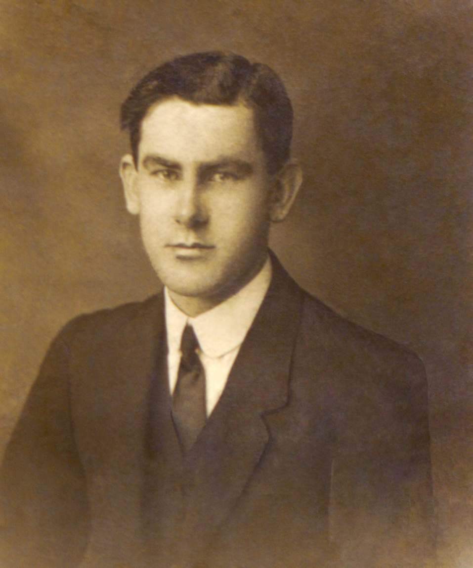
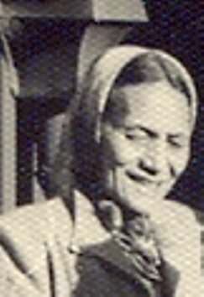
Francis ‘Frank’ McPherson and
Morehu Rebecca ‘Butu’ Arano p. aft 1910-1921, m. 1921-1922

Slide 6
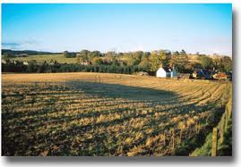
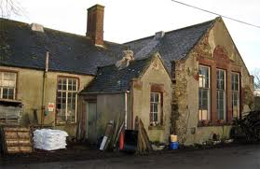
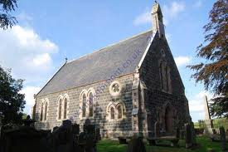
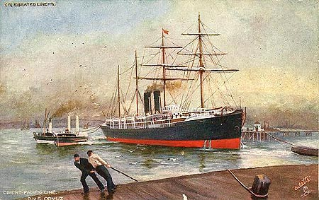
Francis ‘Frank’ McPherson of Wardwell, Inverkeithny, Banffshire, father John, mother Annie Allan, grandfather Alexander, gtgrandfather Francis,
Frank born about 1878, died about 20 Feb 1922, aged 44

Slide 7
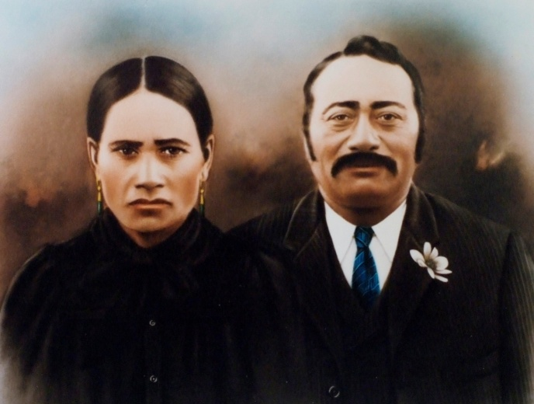
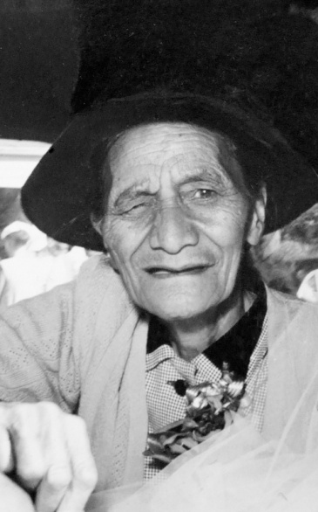
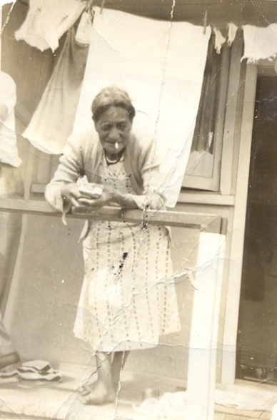
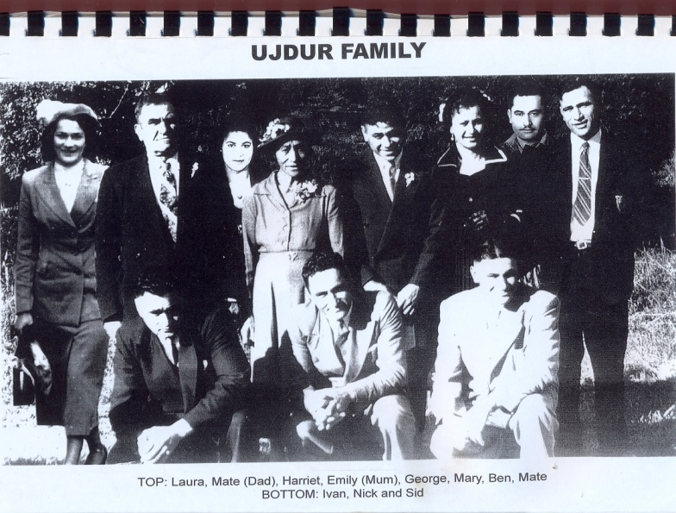
Morehu Rebecca Pene ‘Butu’ Arano parents Hariata / Hemoata Hehana and Pene Arano/ Allan
Chn: Butu, Dolly, Koti, Puki, John, Ngaranoa and Emily Mangai Arano
Butu born about 1877, died 21 February 1959 aged 73

Slide 8
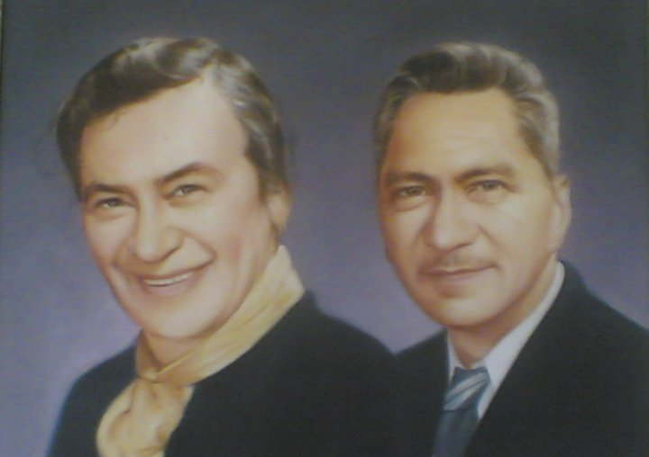
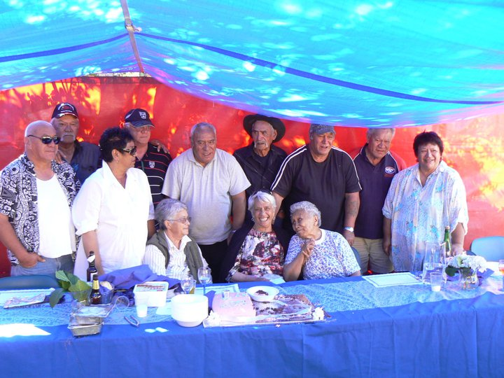
Mary and Waata Tepania
Their children: standing Michael, Ben, Dolly, Wally Busby, Wati, Eddie, George, Aubrey and Phoebe. Seated are May Matiu, Bub (Kathleen) Busby, and Mary (wife of the late Kennedy Tepania). Joseph was absent, ill.

Slide 9
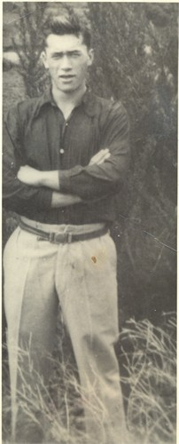
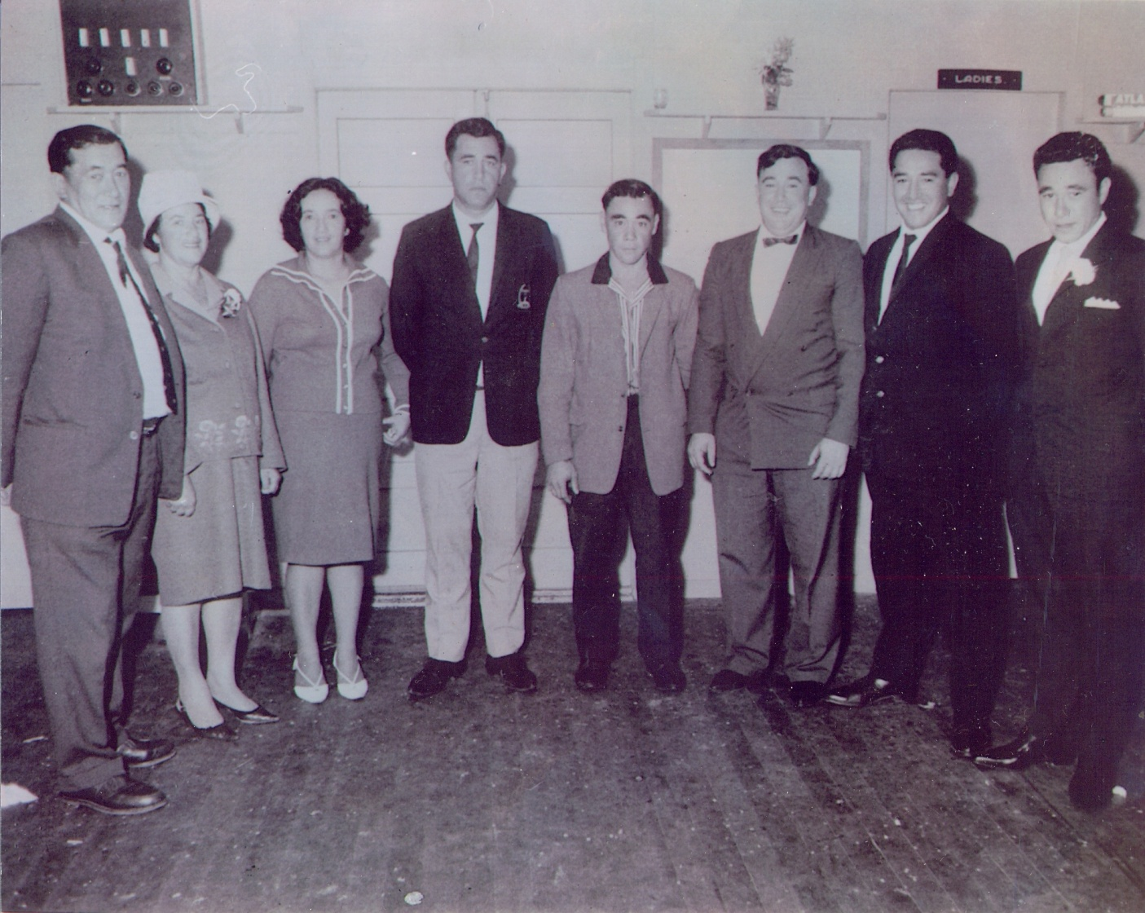
  Allan and Nellie McPherson with Kathleen, Scotty, Allan, Barney,
  Ron and John, > 112 mokopuna

Slide 10
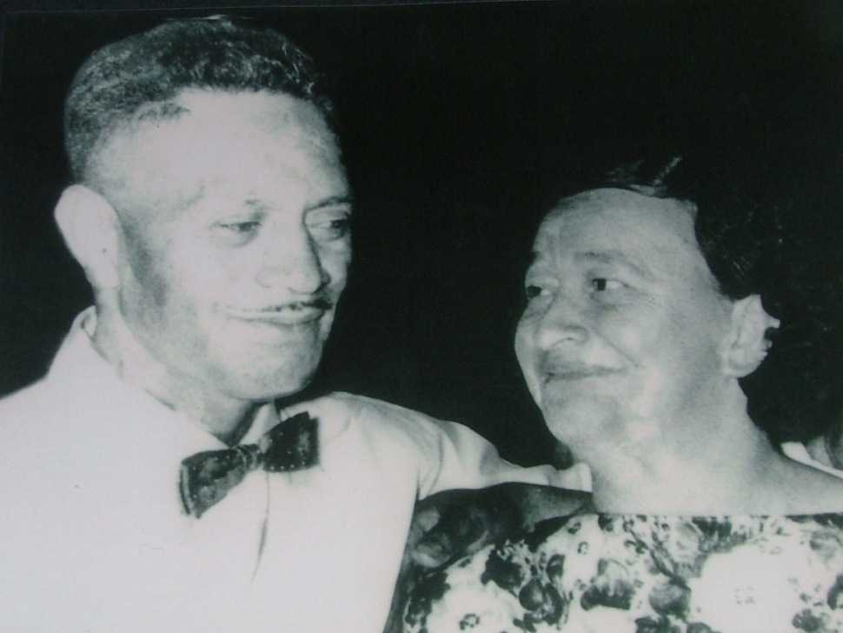
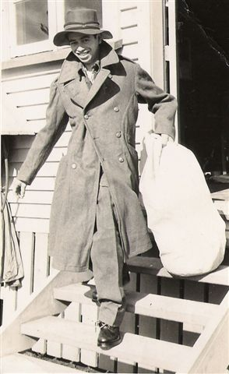
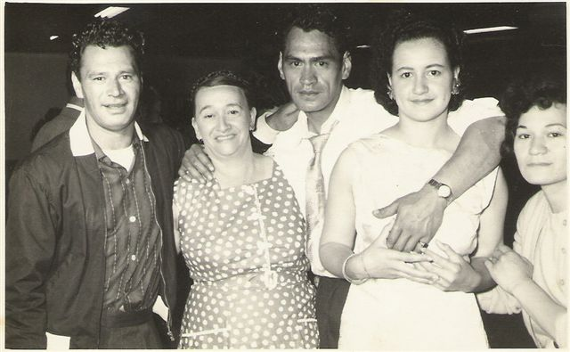
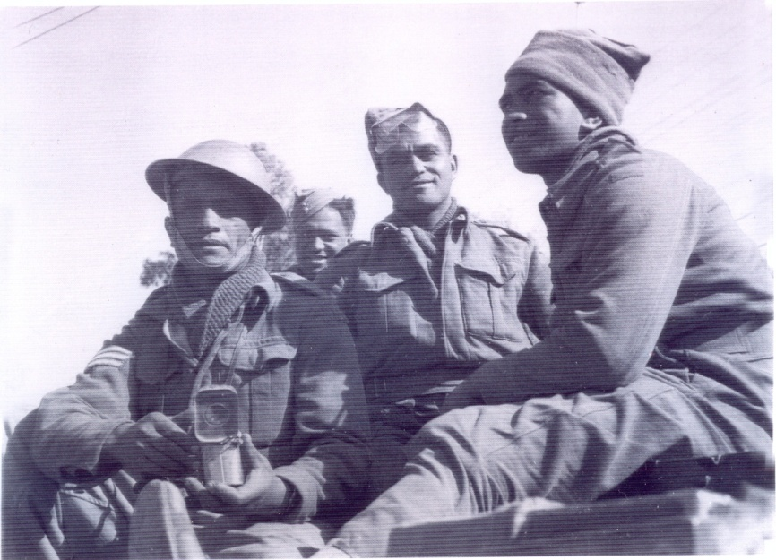
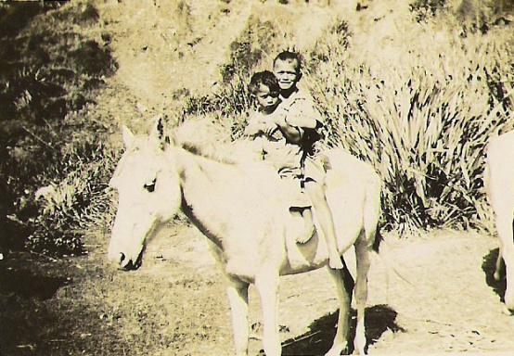
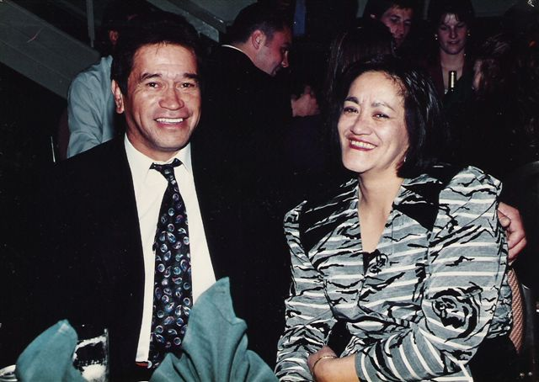
Dollie and Charlie Hohaia m. - 1988

Slide 11
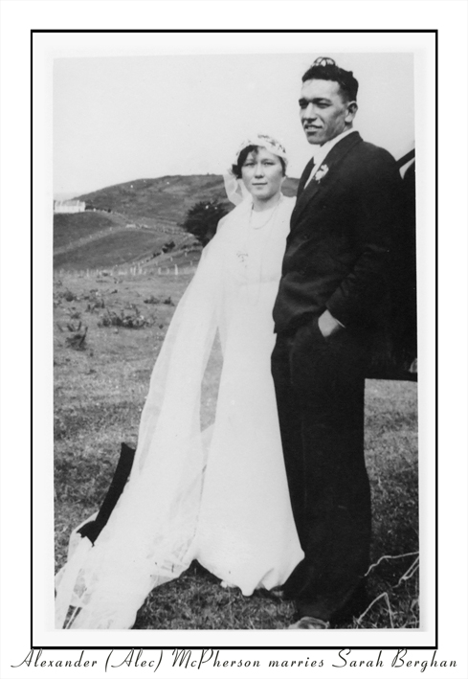
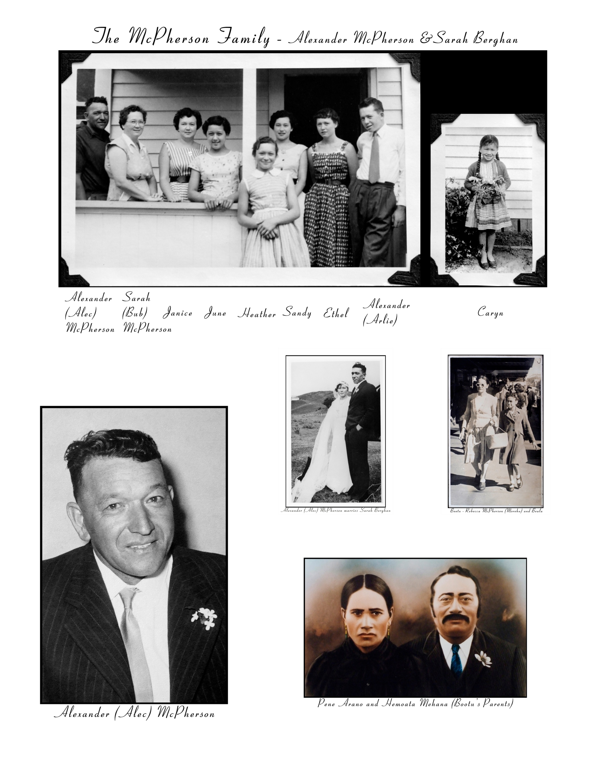
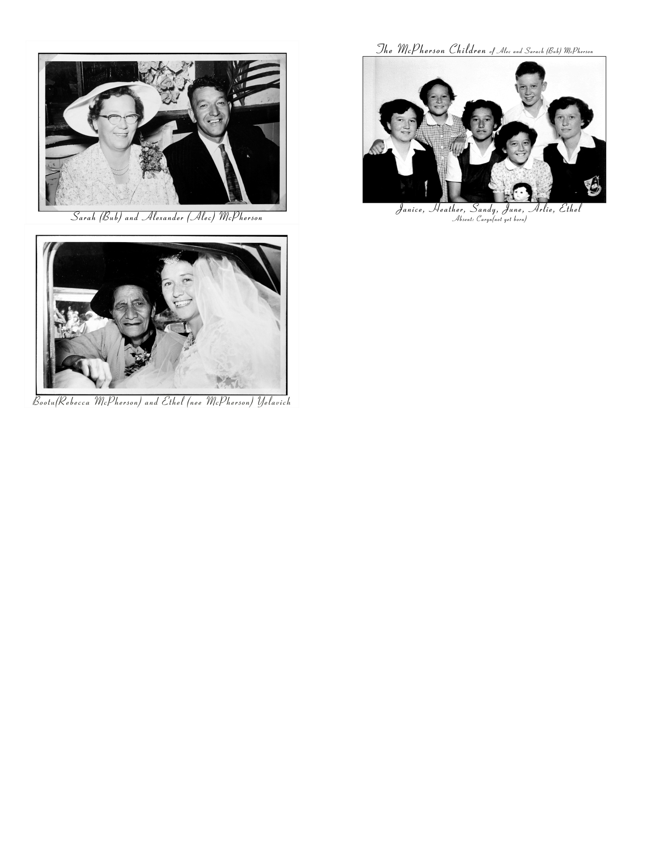

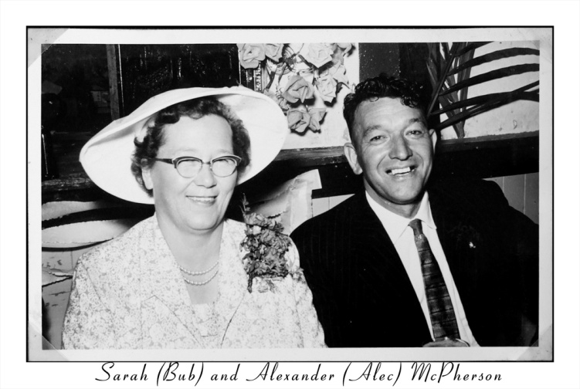
  Alec and Bub McPherson m. 1936-1973,
  8 chn, 36 mokopuna

Slide 12
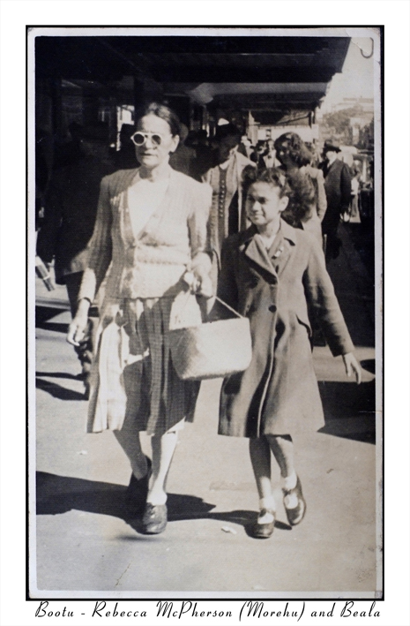
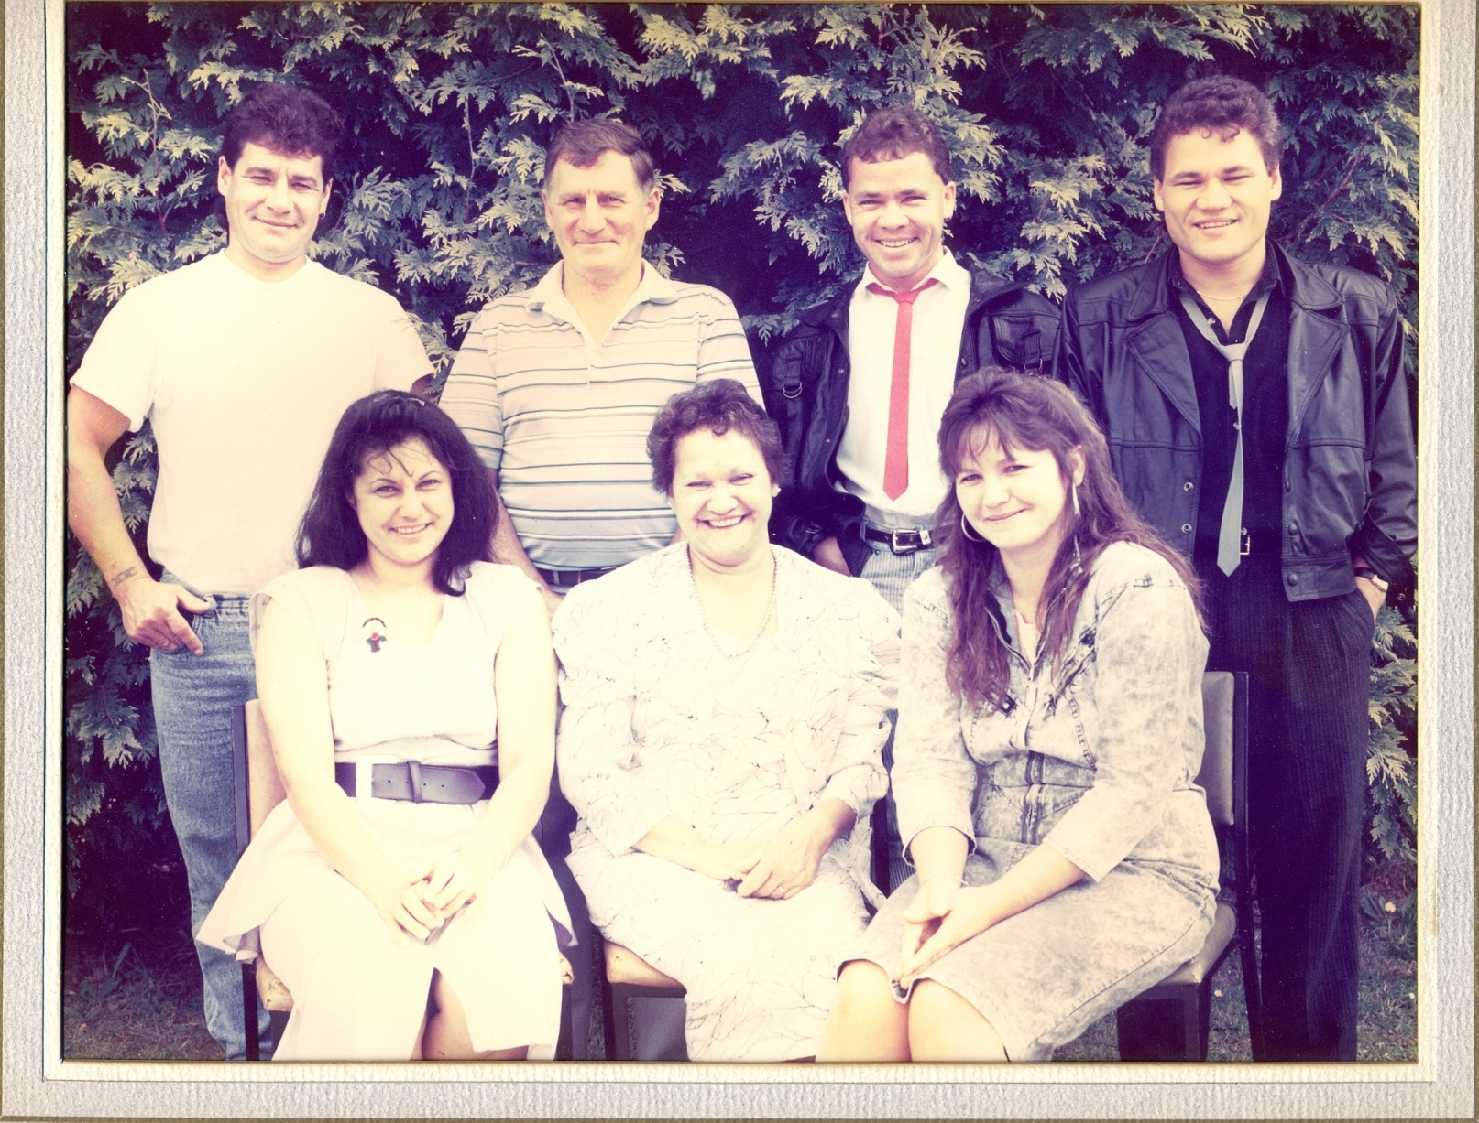
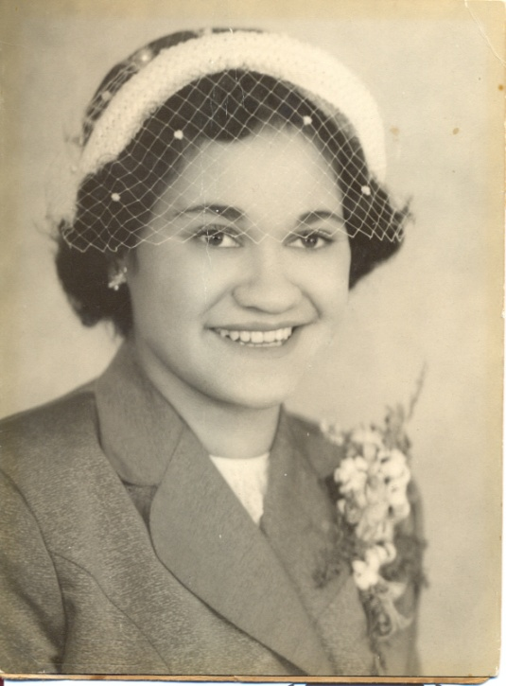
  Kath and Ian Macnee
  5 chn, 9 mokopuna
  Noble Hohaia

Slide 13
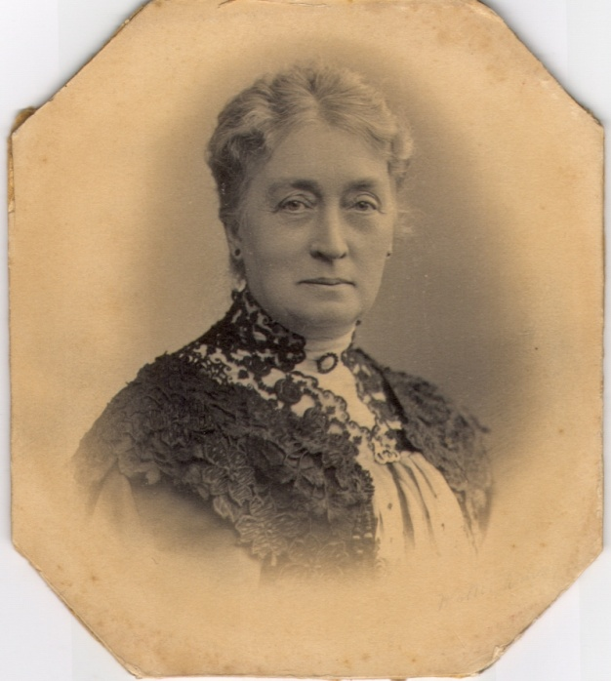
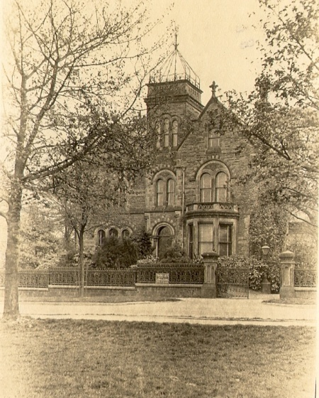
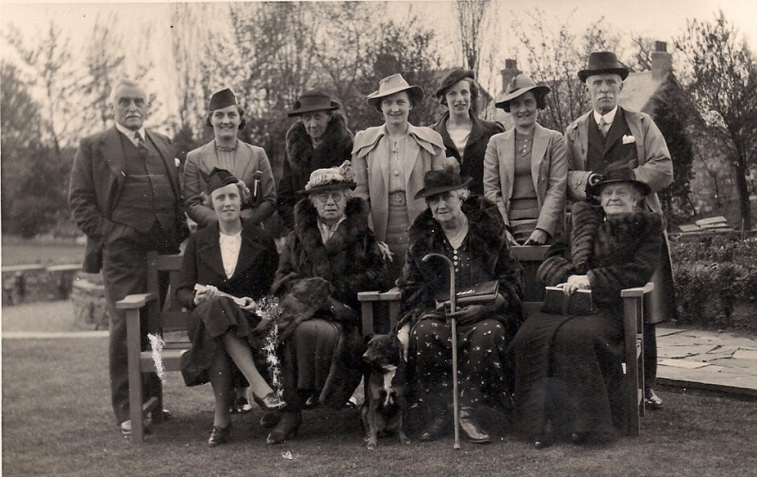
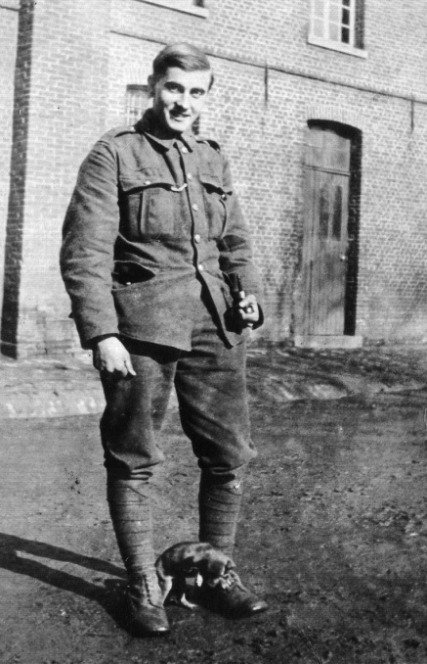
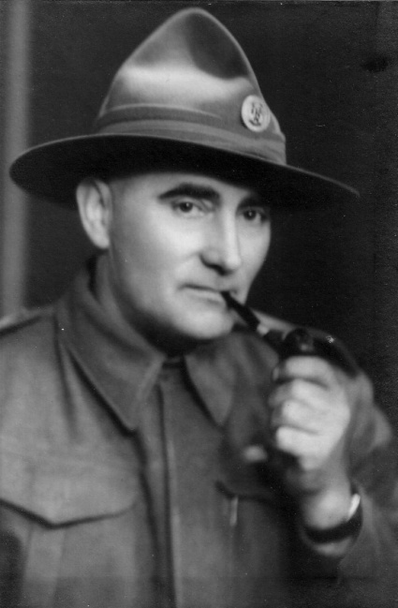
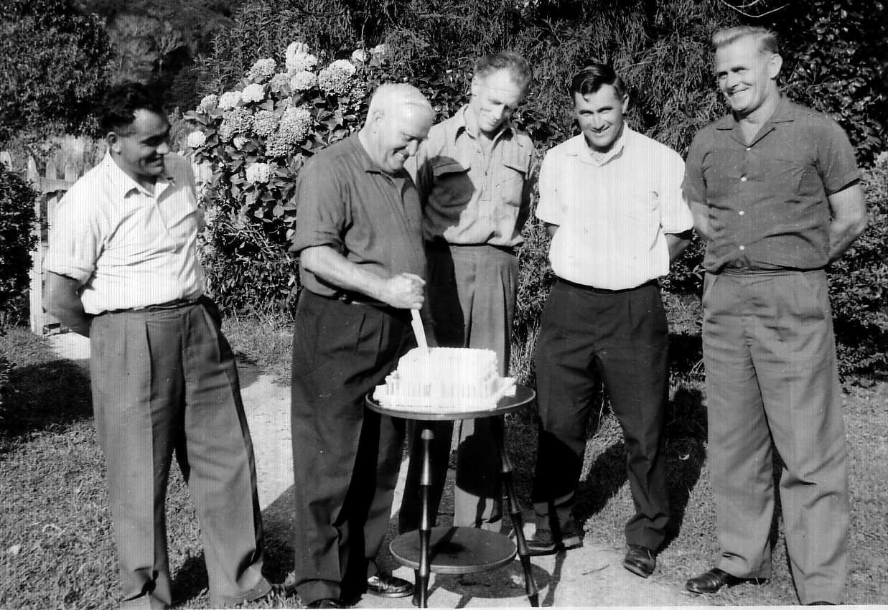
Alfred Sinclair Macpherson, 1895-1968

Slide 14
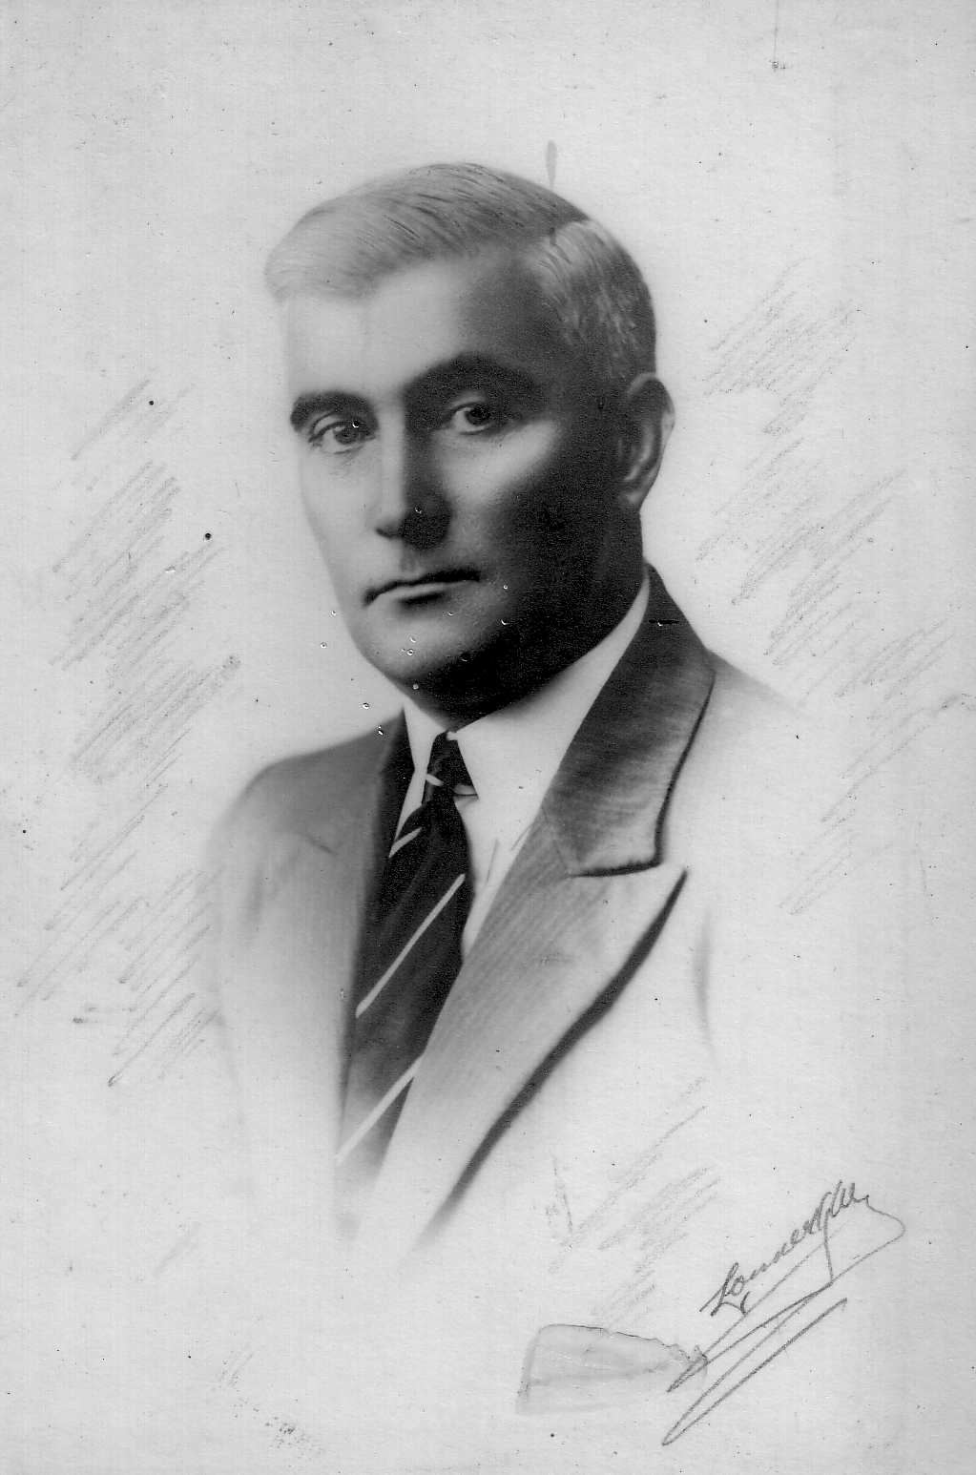
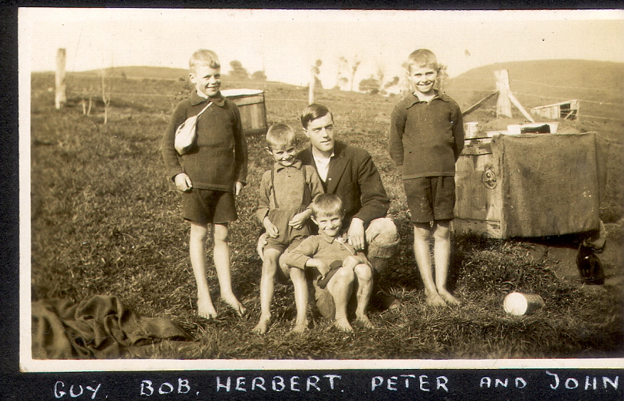
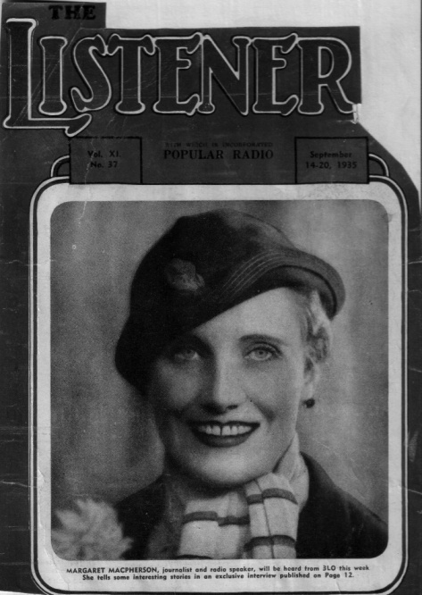
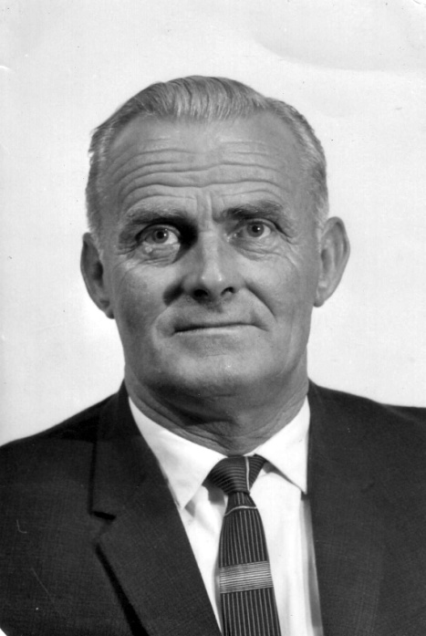
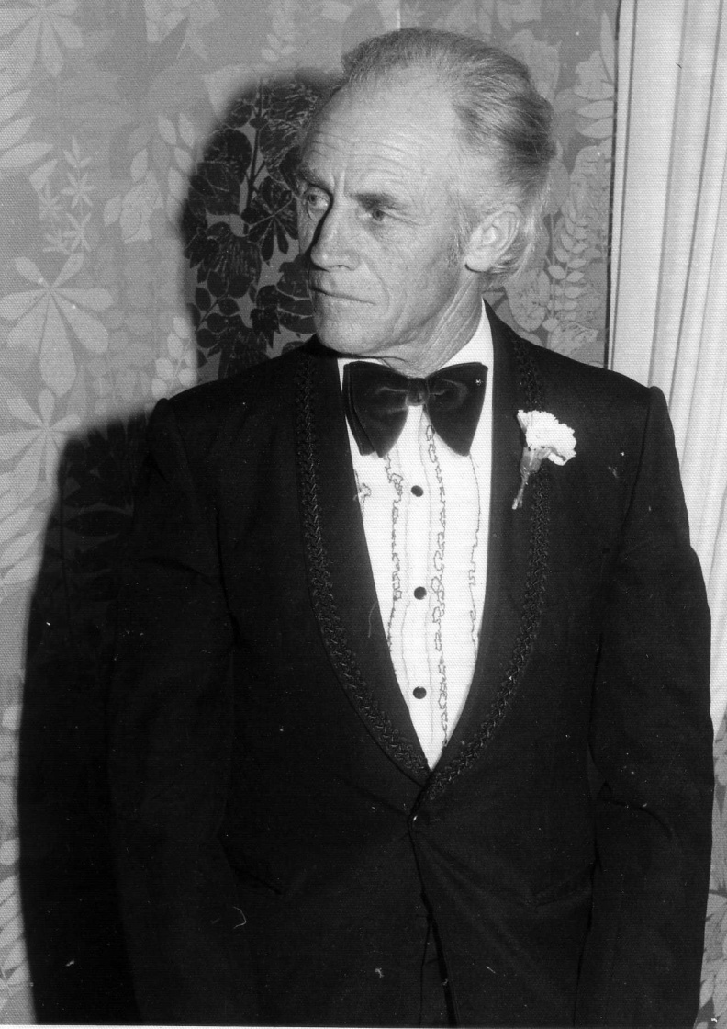
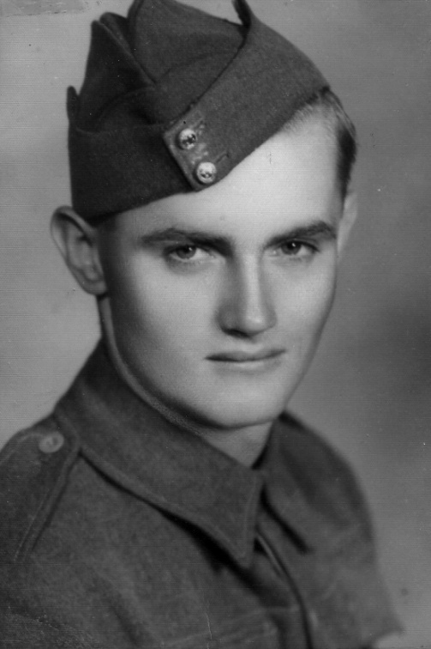
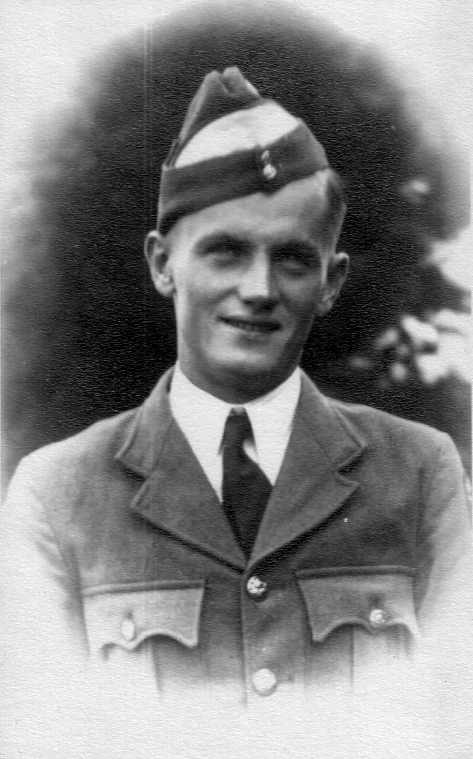
Alfred and Margaret Macpherson m. 1916-1925
Hamish, Buff, Guy, Twins Peter and John

Slide 15
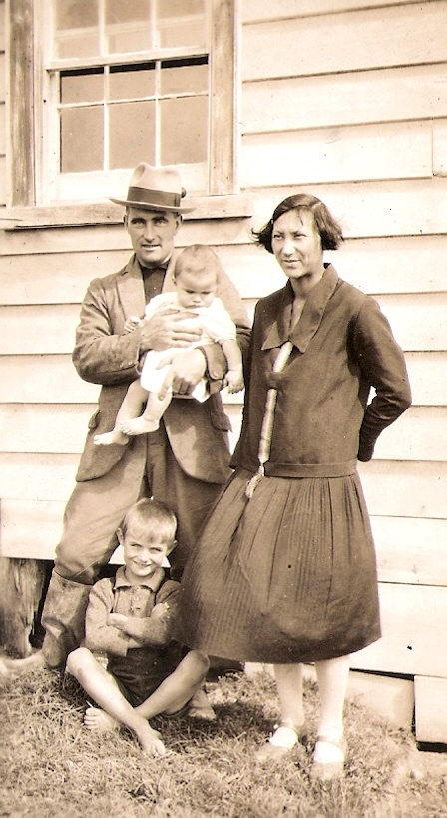
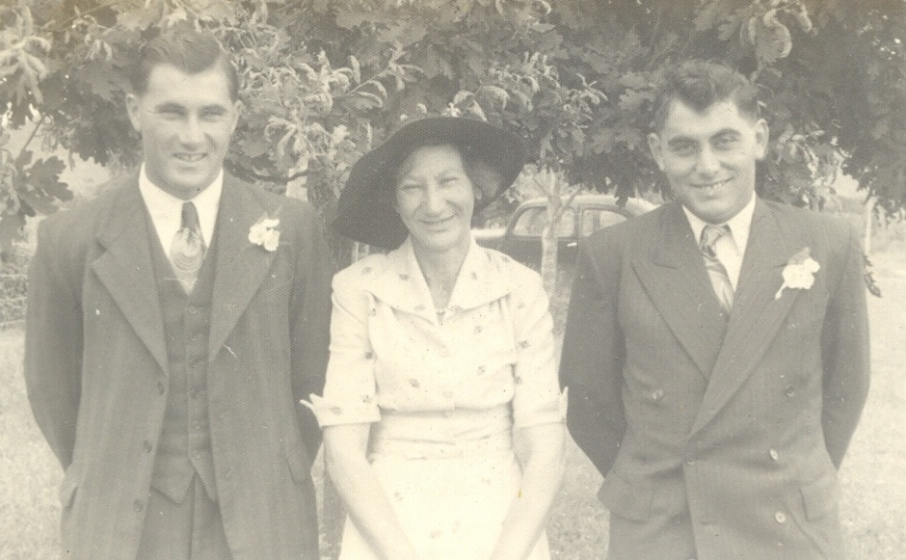
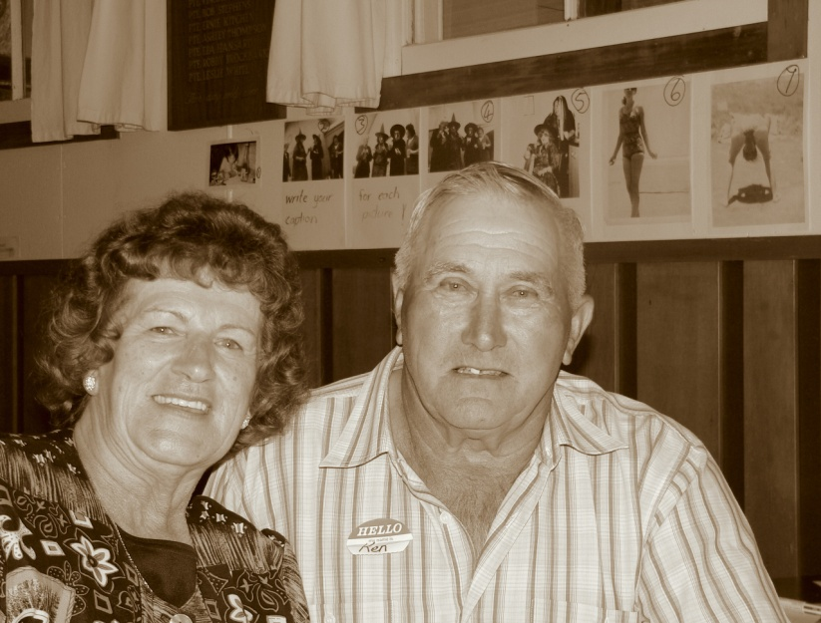
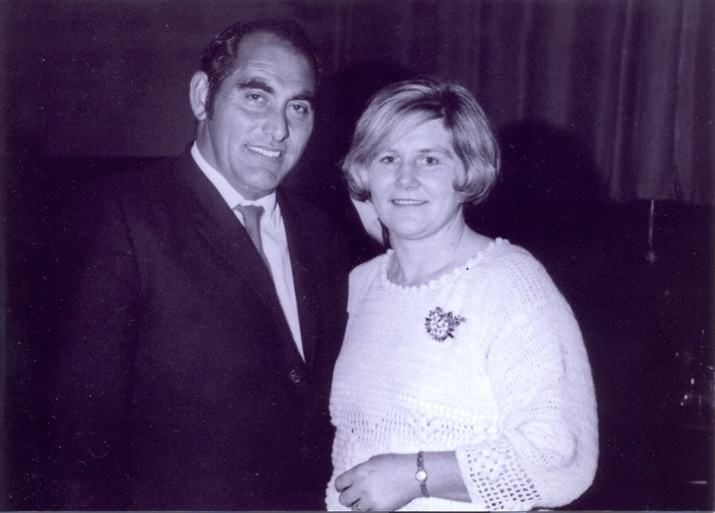
Alfred and May Macpherson m. 1925-1945
Doris, Ken, Gordon

Slide 16


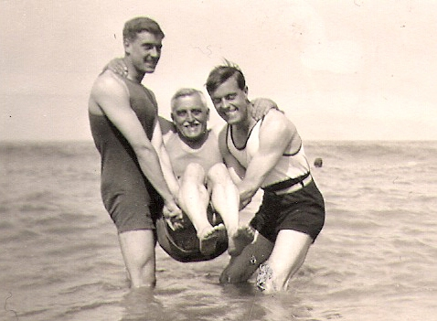
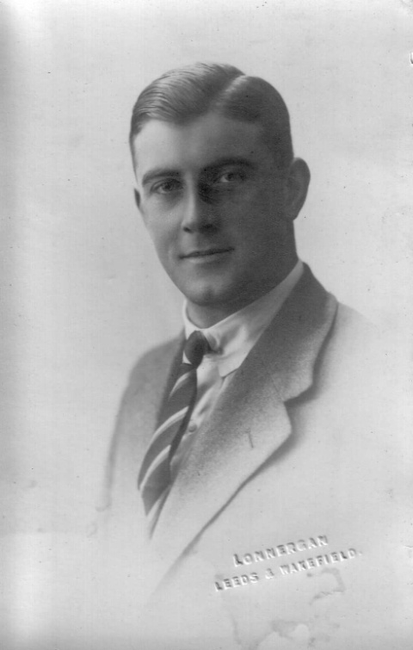
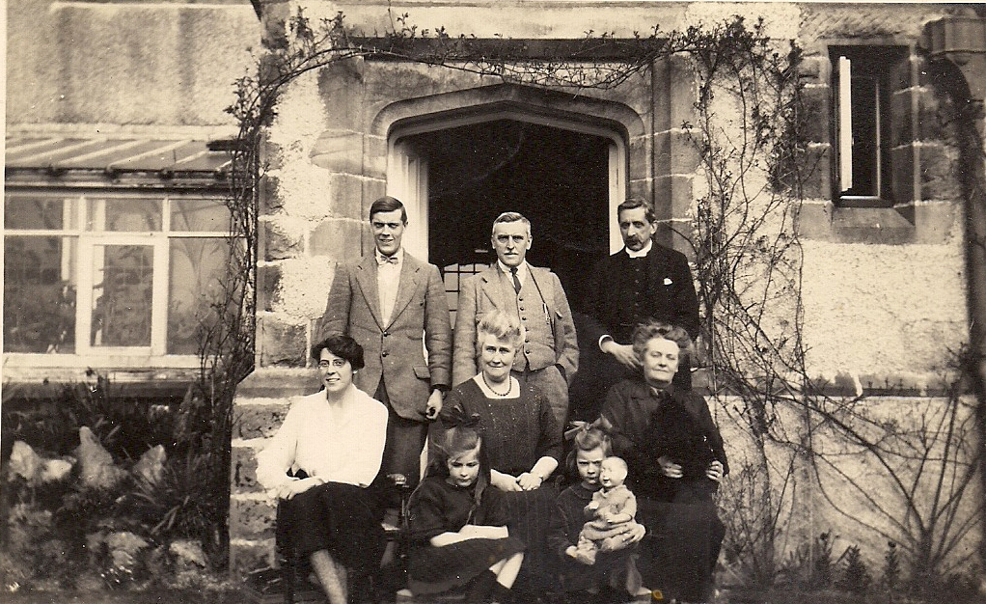
Eric Gordon Macpherson, 1907-1979

Slide 17
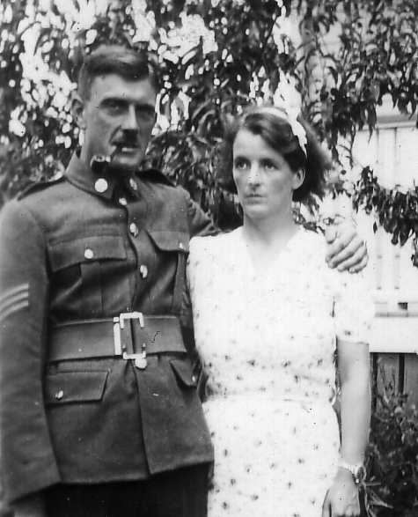
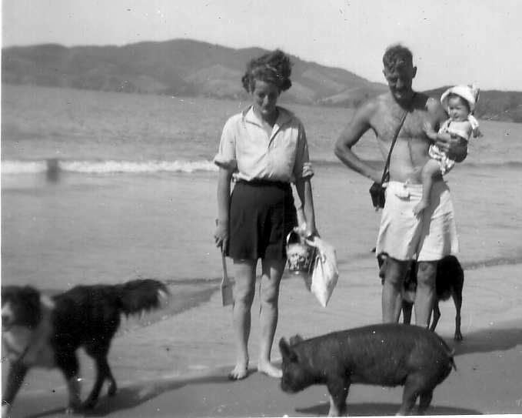
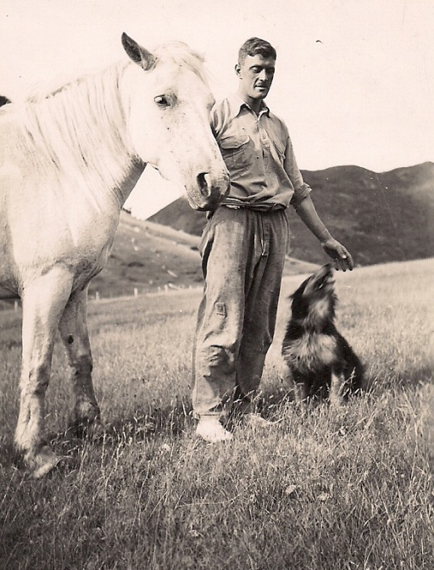



Gordon and Ines Macpherson, m. 1939-1979

Slide 18

Are the McPhersons of the Far North from Inverkeithny (A) related to the Macphersons of the Far North from Portsoy (B)? rt

Slide 19


Message from the Clan Chief – Sir William Macpherson (Cluny) – and President of the CMA – Shelagh Macpherson Noble

Slide 20
Heroes of the Macpherson Reunion
Catering Meet and Greet and Spit Roast Dinner – Desley Austin
Grass fed wild pig – Stephen Matthews
Historians - Aroha Amai, Kath Brass, Heather Carey, Jan Dixon, Jo Edwards, Donna Farrell, Raunu Hohaia, Betty and Marilyn McPherson, Eddy and Keri McPherson, Sonia Neho and Anita Tepania
Kaumatua – Pa Moses
Karanga – Mary Rollo and Betty McPherson
Potatoes, Kumaras and Squash – David Russell
Seafood – Alex Carey and the brotherhood
Sheep – Gwillam Macpherson
Smoked kingfish – Peter Macpherson
Spit Roasters – Gwillam and Marcia, John and Mac Macpherson
Sunday Luncheon – Neta Van Der Sluis and the Macpherson sisters

