Slide 1
Macpherson Family Reunion Photos
25-27 February 2011
Waipapakauri Domain and Houhora Deep Sea Fishing Club, Far North, New Zealand

Slide 2
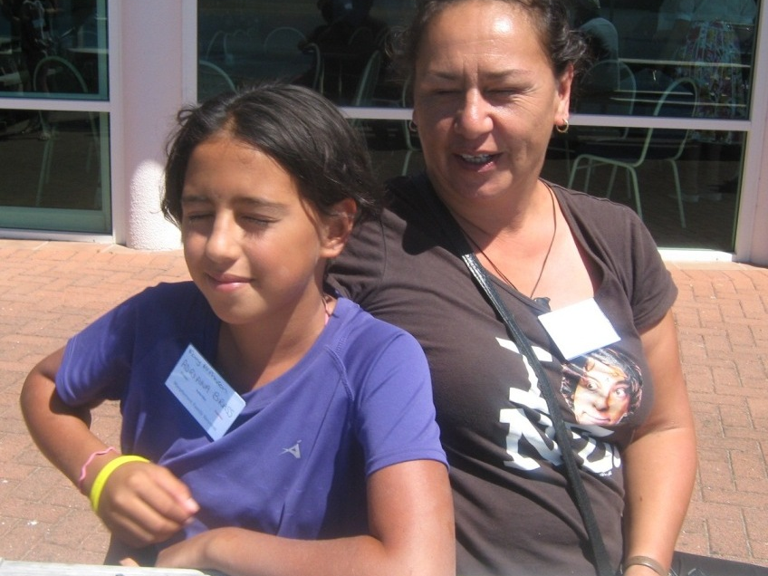
Adrianna and Kath Brass (Kaitaia) by Nicki Macpherson

Slide 3
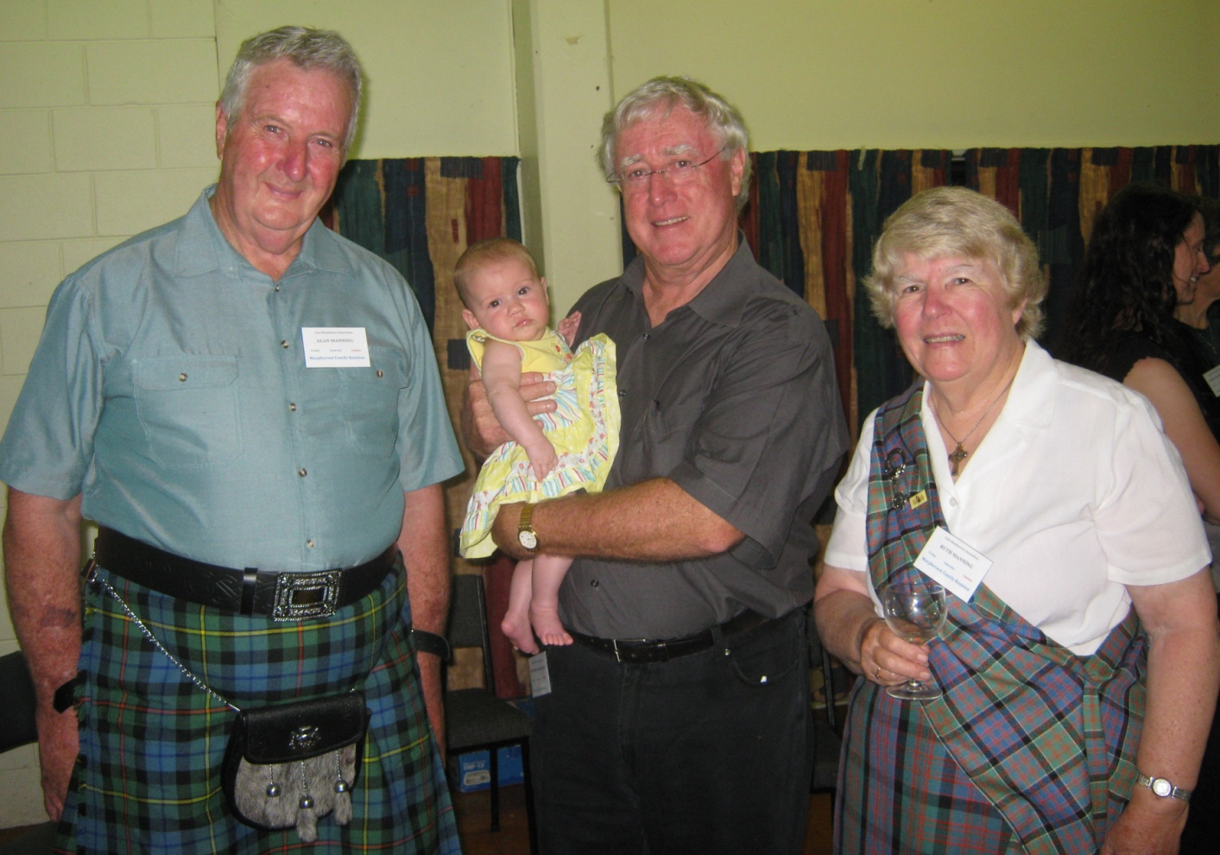
Alan Manning (Ngaruawahia), Olive Brooks (Tasmania) Reynold Macpherson (Rotorua) and Ruth Manning (Ngaruawahia) by Sonia Neho

Slide 4
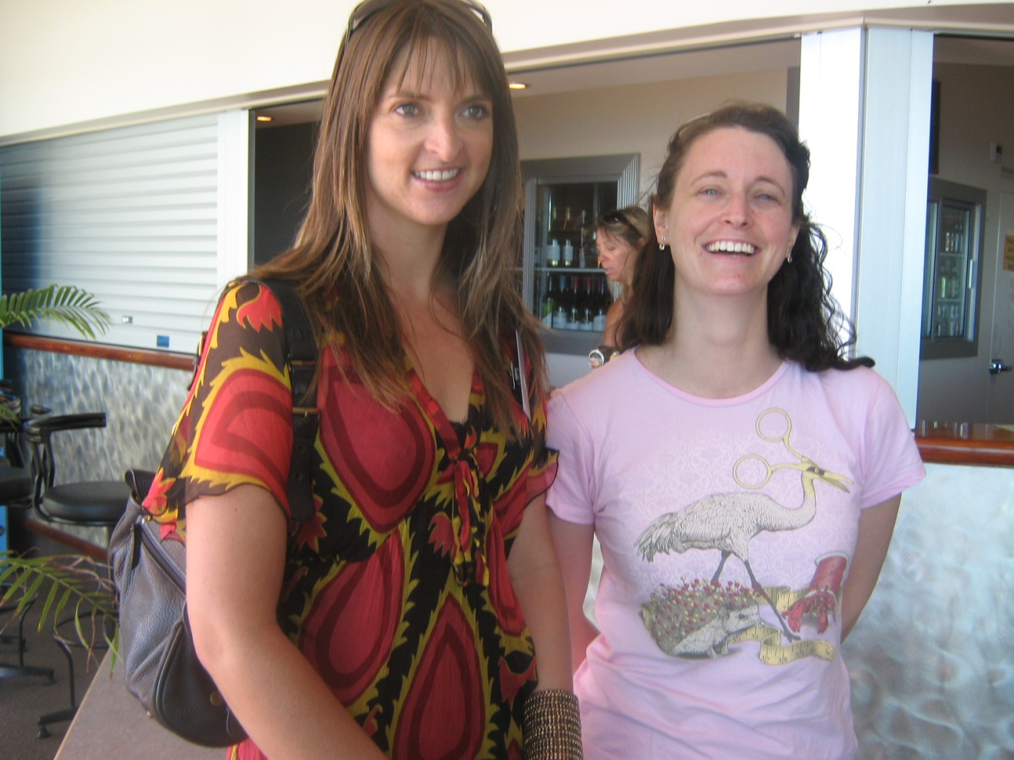
Angela Alldread (Whangarei) and Kirsty Macpherson (Brisbane) by Nicki Macpherson

Slide 5
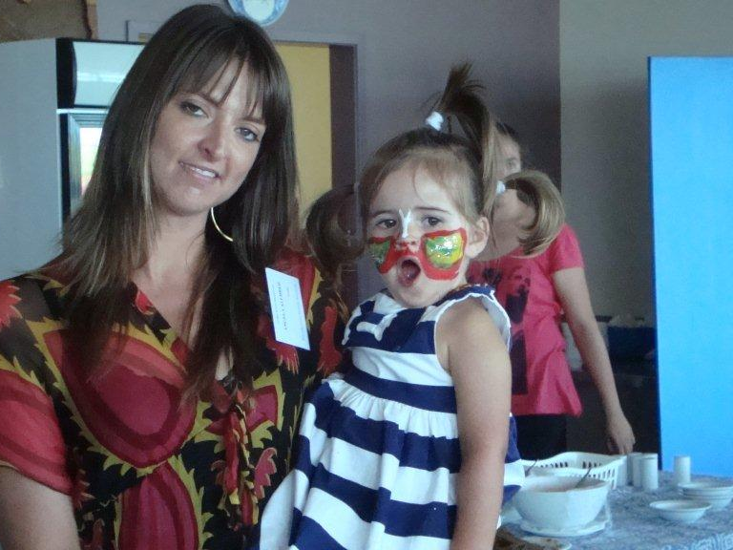
Angela and Eva Alldread by Robin Dunn

Slide 6
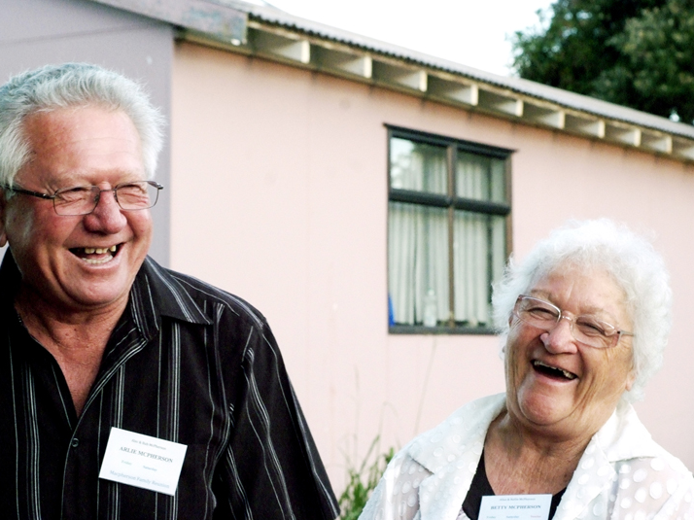
Arlie and Betty McPherson (Auckland) by Natalie McPherson

Slide 7
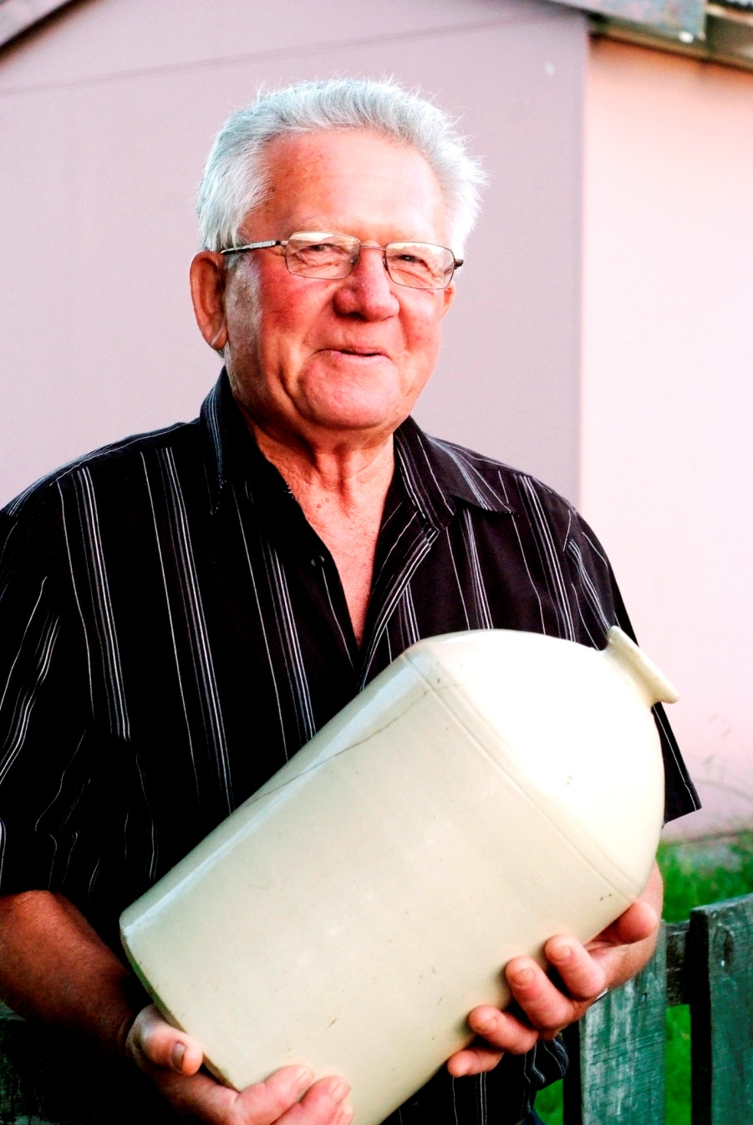
Arlie McPherson holds the last jar of his father Alec’s red wine, by Natalie McPherson

Slide 8
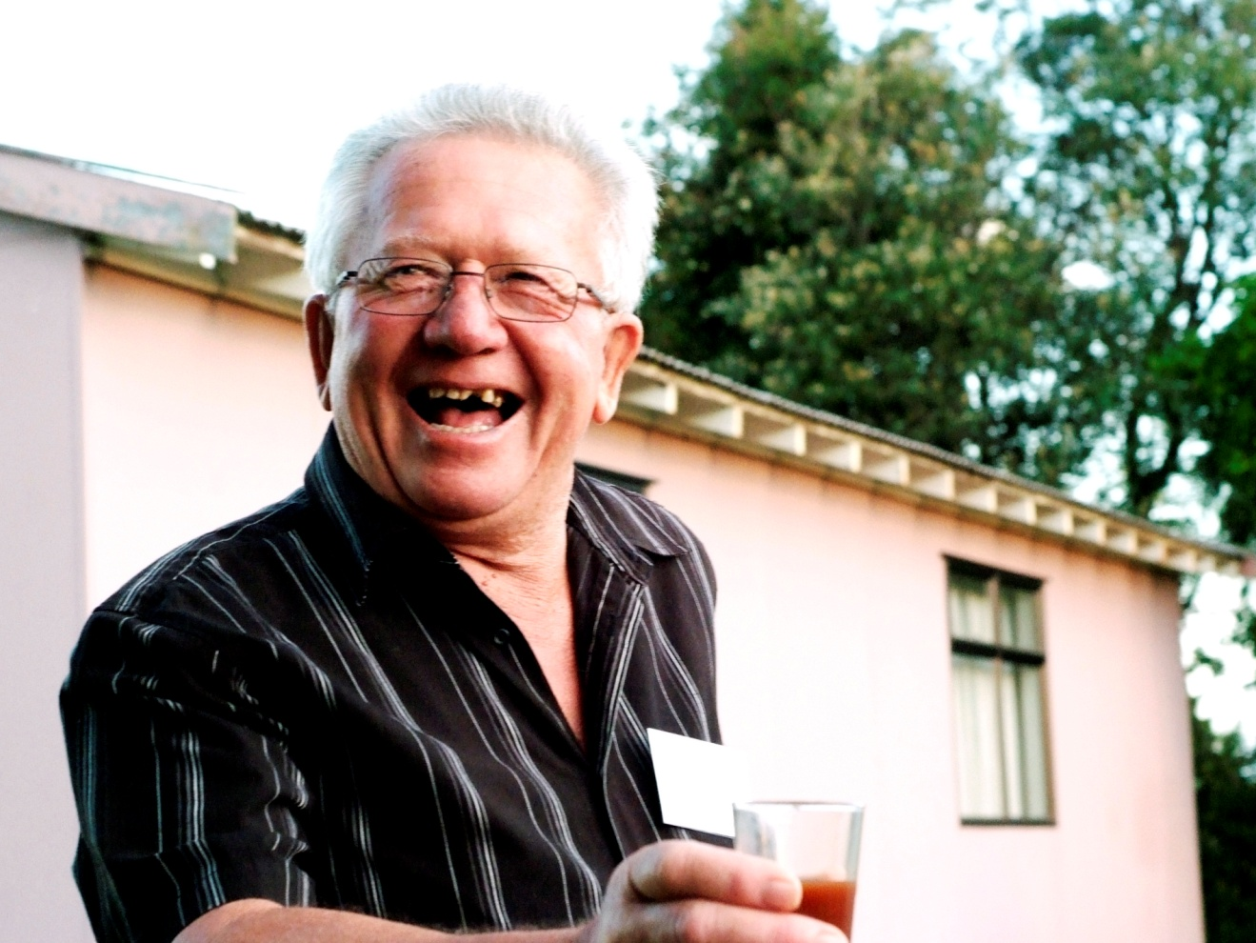
Arlie McPherson salutes family, by Natalie McPherson

Slide 9
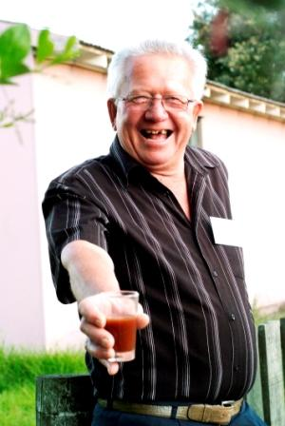
Arlie McPherson offers his father's wine, by Natalie McPherson

Slide 10
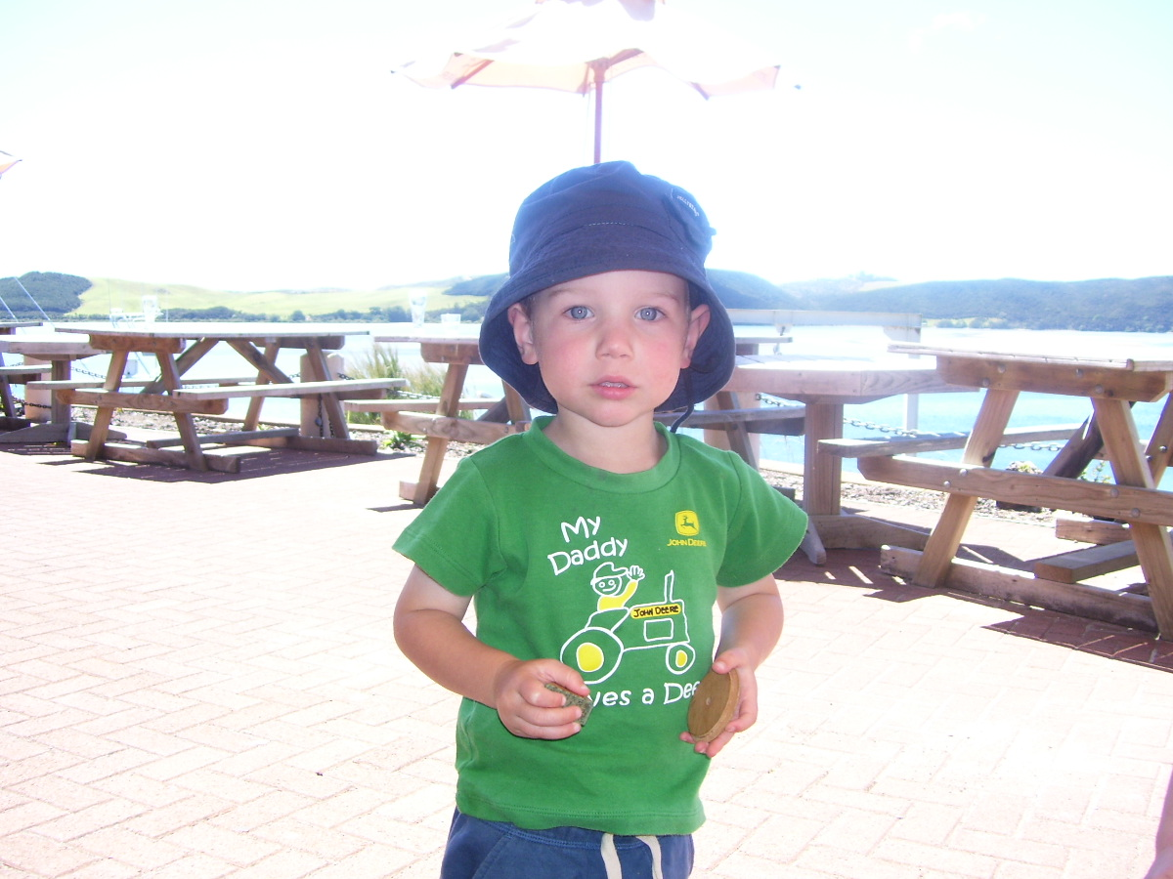
Austin Brooks (Tasmania) by Jan Hoskin

Slide 11
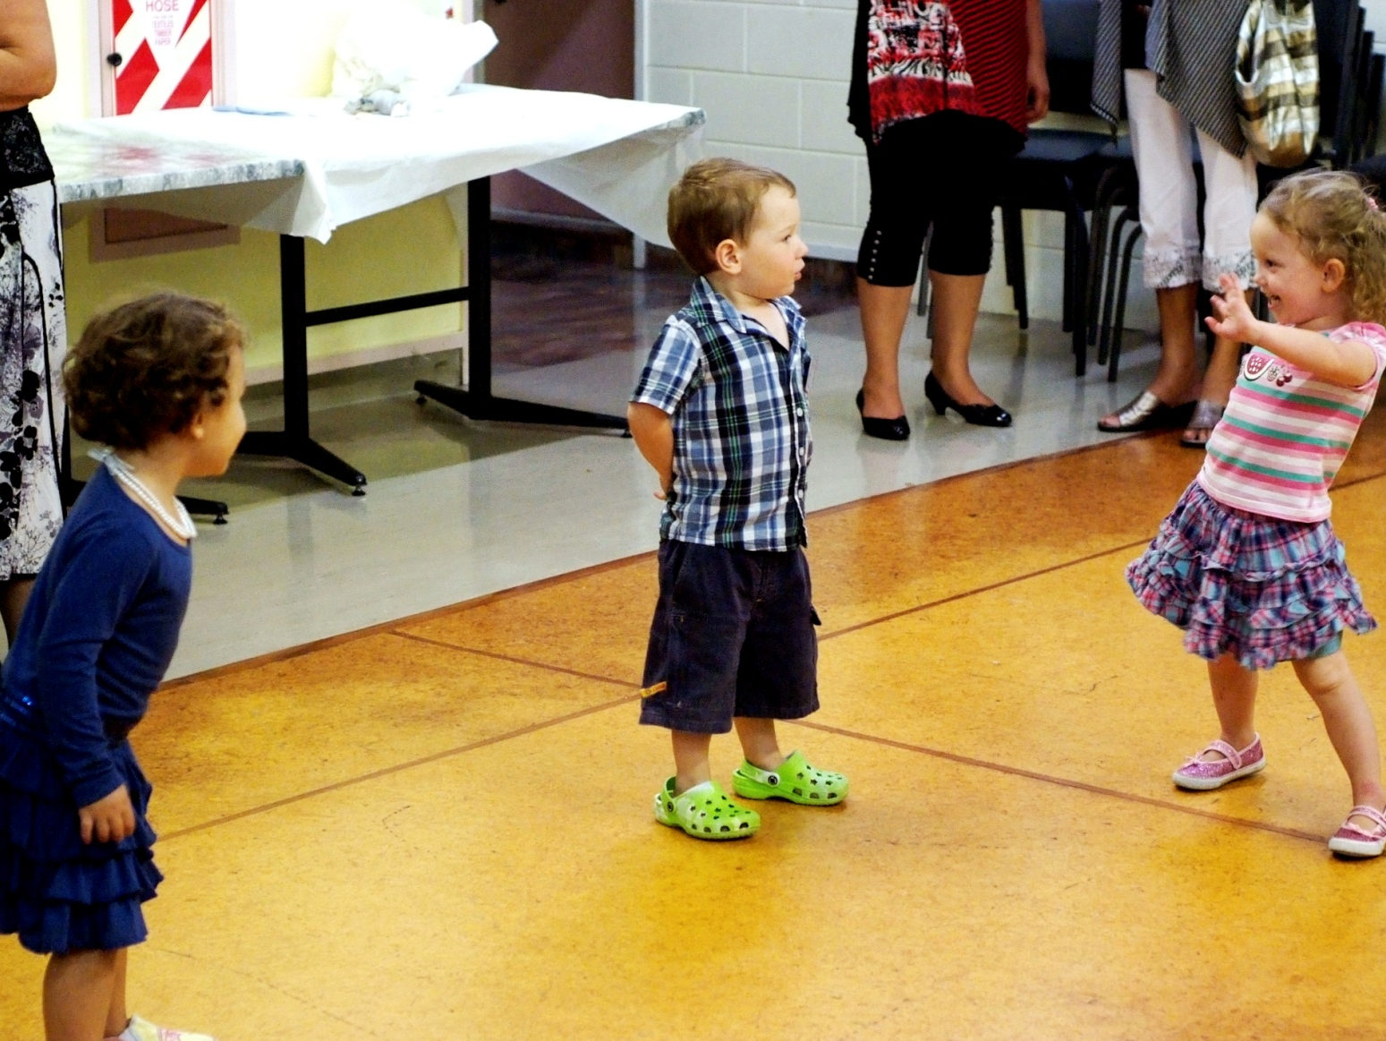
Jemma Sayles (Kaitaia) and Austin Brooks (Tasmania) watching Lily Hoskin (Christchurch), by Natalie McPherson

Slide 12
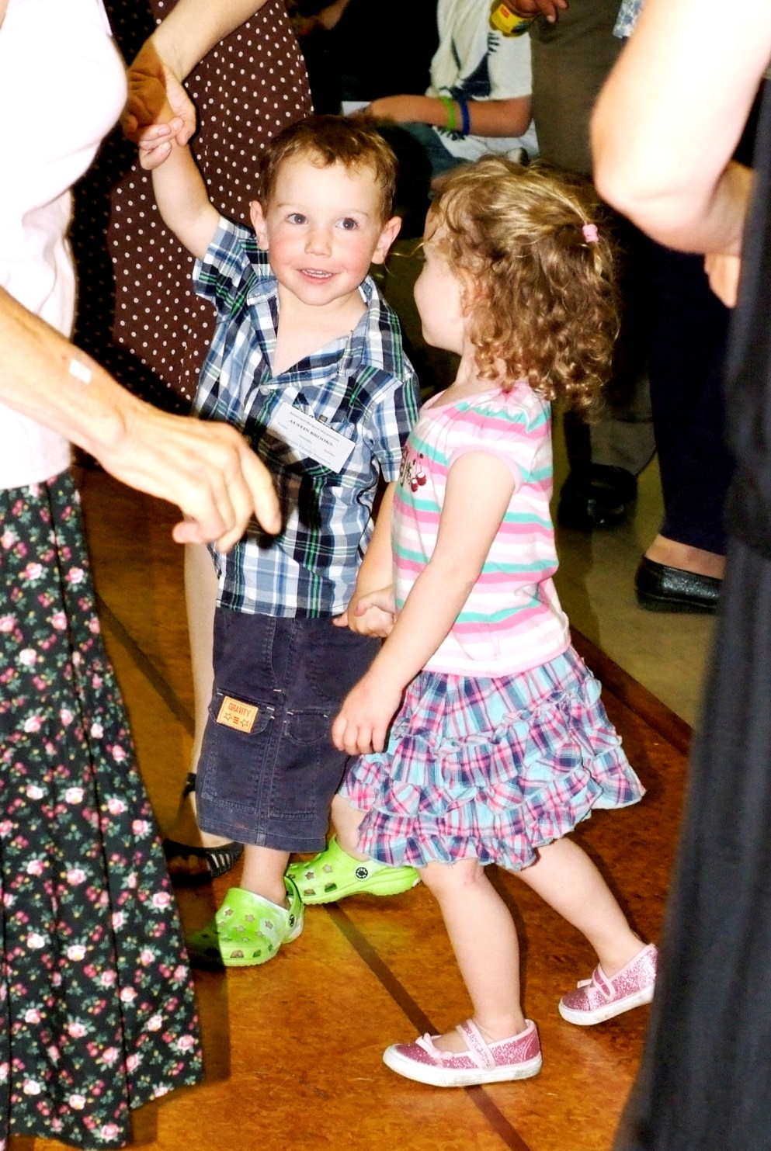
Austin Brooks (Tasmania) and Lily Hoskin (Christchurch) learning ceilidh dancing, by Natalie McPherson

Slide 13
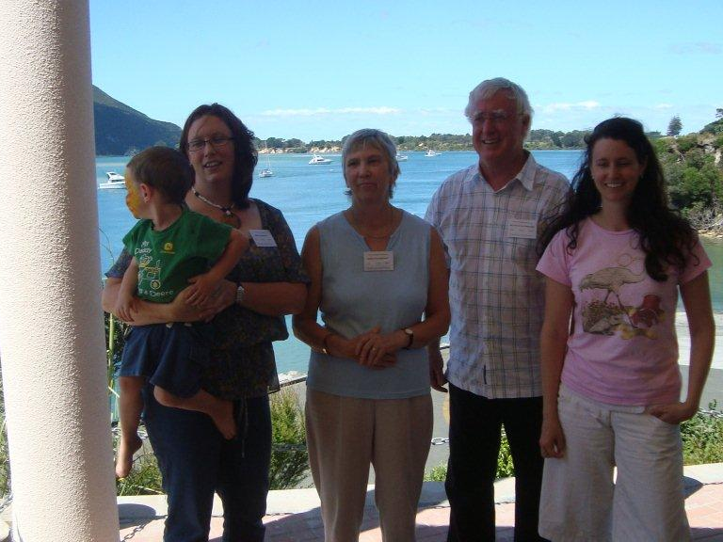
Austin and Shiona Brooks (Tasmania) Nicki and Reynold Macpherson (Rotorua) and Kirsty Macpherson (Brisbane) by Robin Dunn

Slide 14
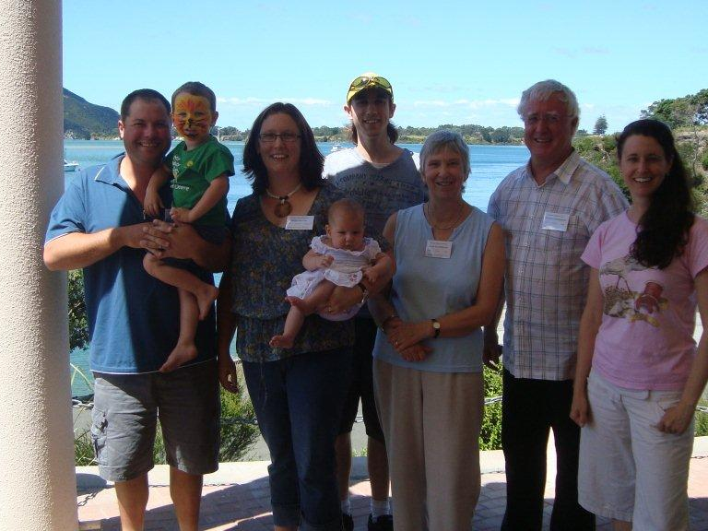
Damien, Austin, Shiona and Olive Brooks (Tasmania), Angus Macpherson (Brisbane) Nicki and Reynold Macpherson (Rotorua) and Kirsty Macpherson (Brisbane) by Robin Dunn

Slide 15
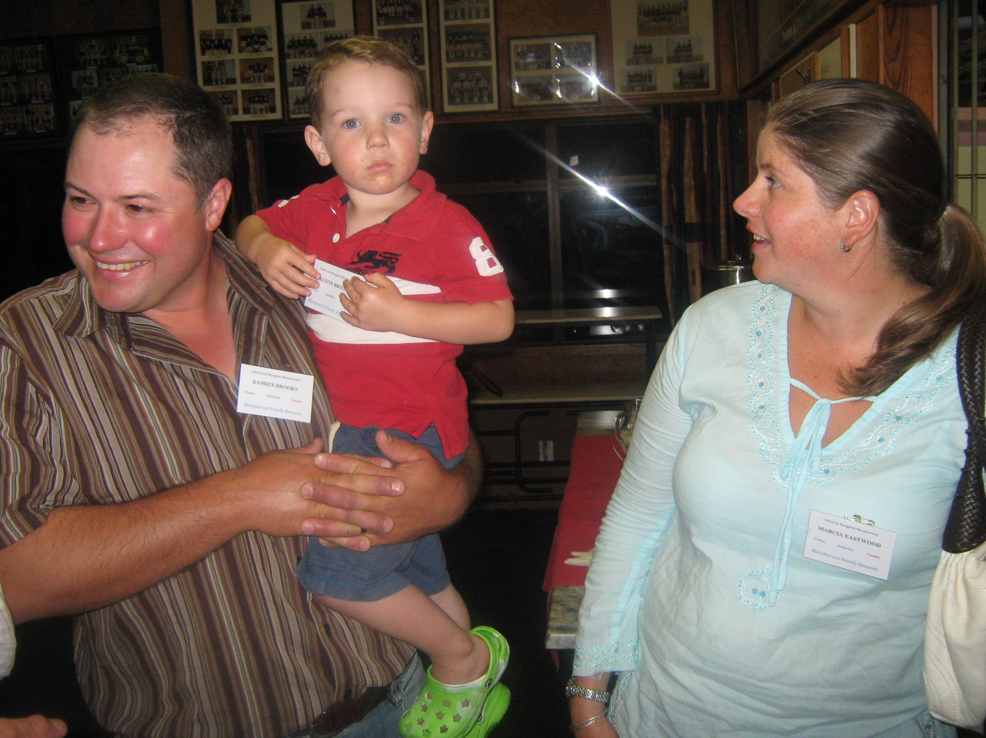
Damien and Austin Brooks (Tasmania) and Marcia Eastwood (Kaitaia), by Natalie McPherson

Slide 16
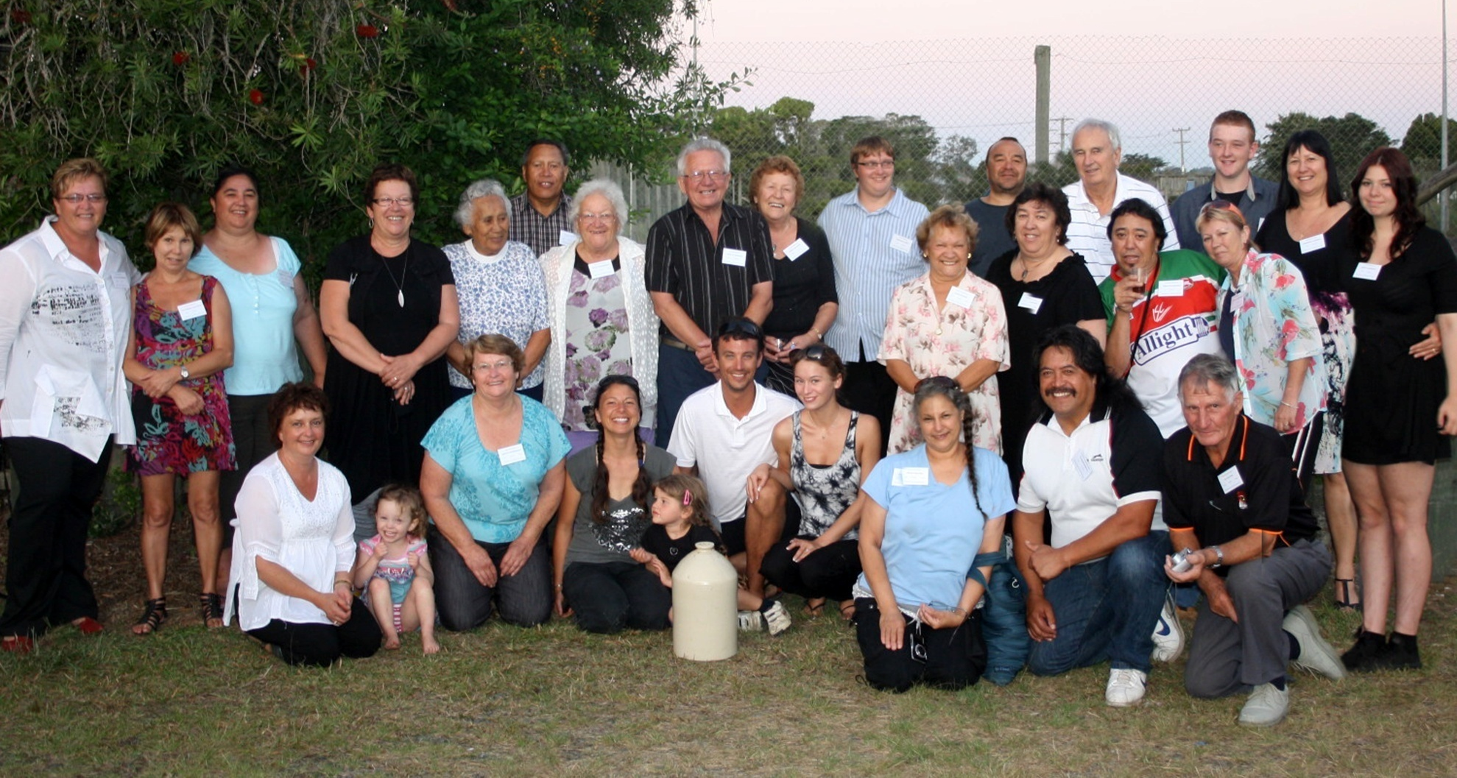
Descendents of Frank and Butu McPherson by Natalie McPherson and Greta Andrews. From the Left Back Row: Natalie McPherson, Jan-Maree Yelavich, Christine McPherson, Paulene McPherson, Mary Tepania, Terry Tepania, Betty McPherson, Arlie McPherson, Ethel Yelavich, Spencer Castle, Mark McPherson, Bob Yelavich, Mitchell Castle, Robynne Andrews and Greta Andrews. Middle Row from Left: Bela MacNee , Marilyn McPherson, Eddy McPherson and his wife. Front Row from Left (all sitting or kneeling): Jan Dixon, Lily Hoskin, Raewyn McPherson, Dana McPherson and her daughter, Joshua McPherson and his fianceé Renee Nichols, Moana McNee, Charlie Hohaia and Ian MacNee.

Slide 17
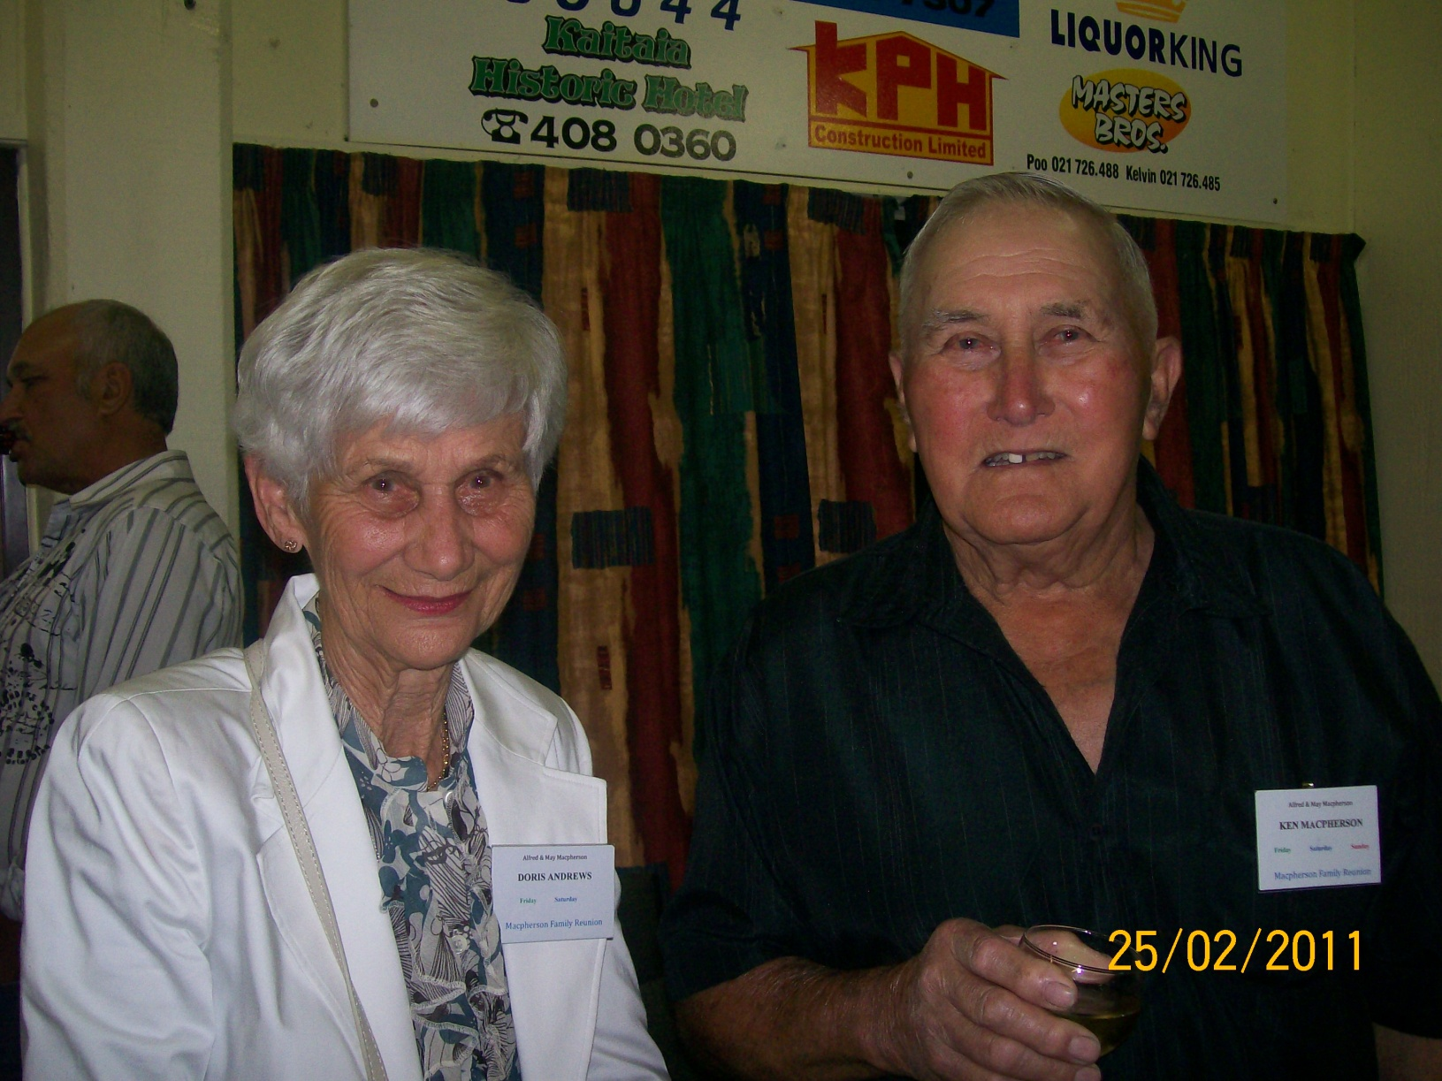
Doris Andrews and Ken Macpherson by Judi Rogers

Slide 18
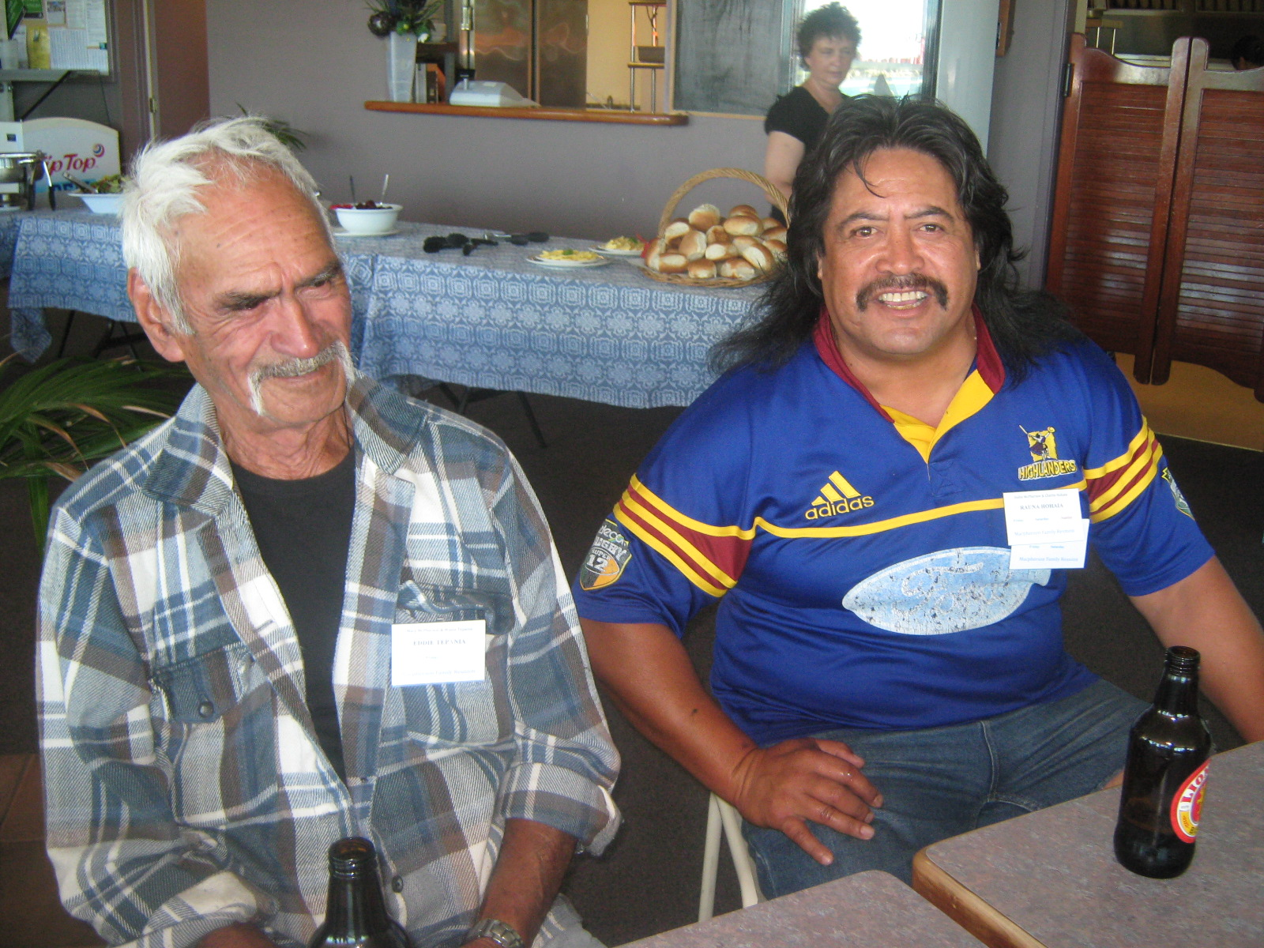
Eddie Tepania and Charlie Hohaia (Kaitaia) by Nicki Macpherson

Slide 19
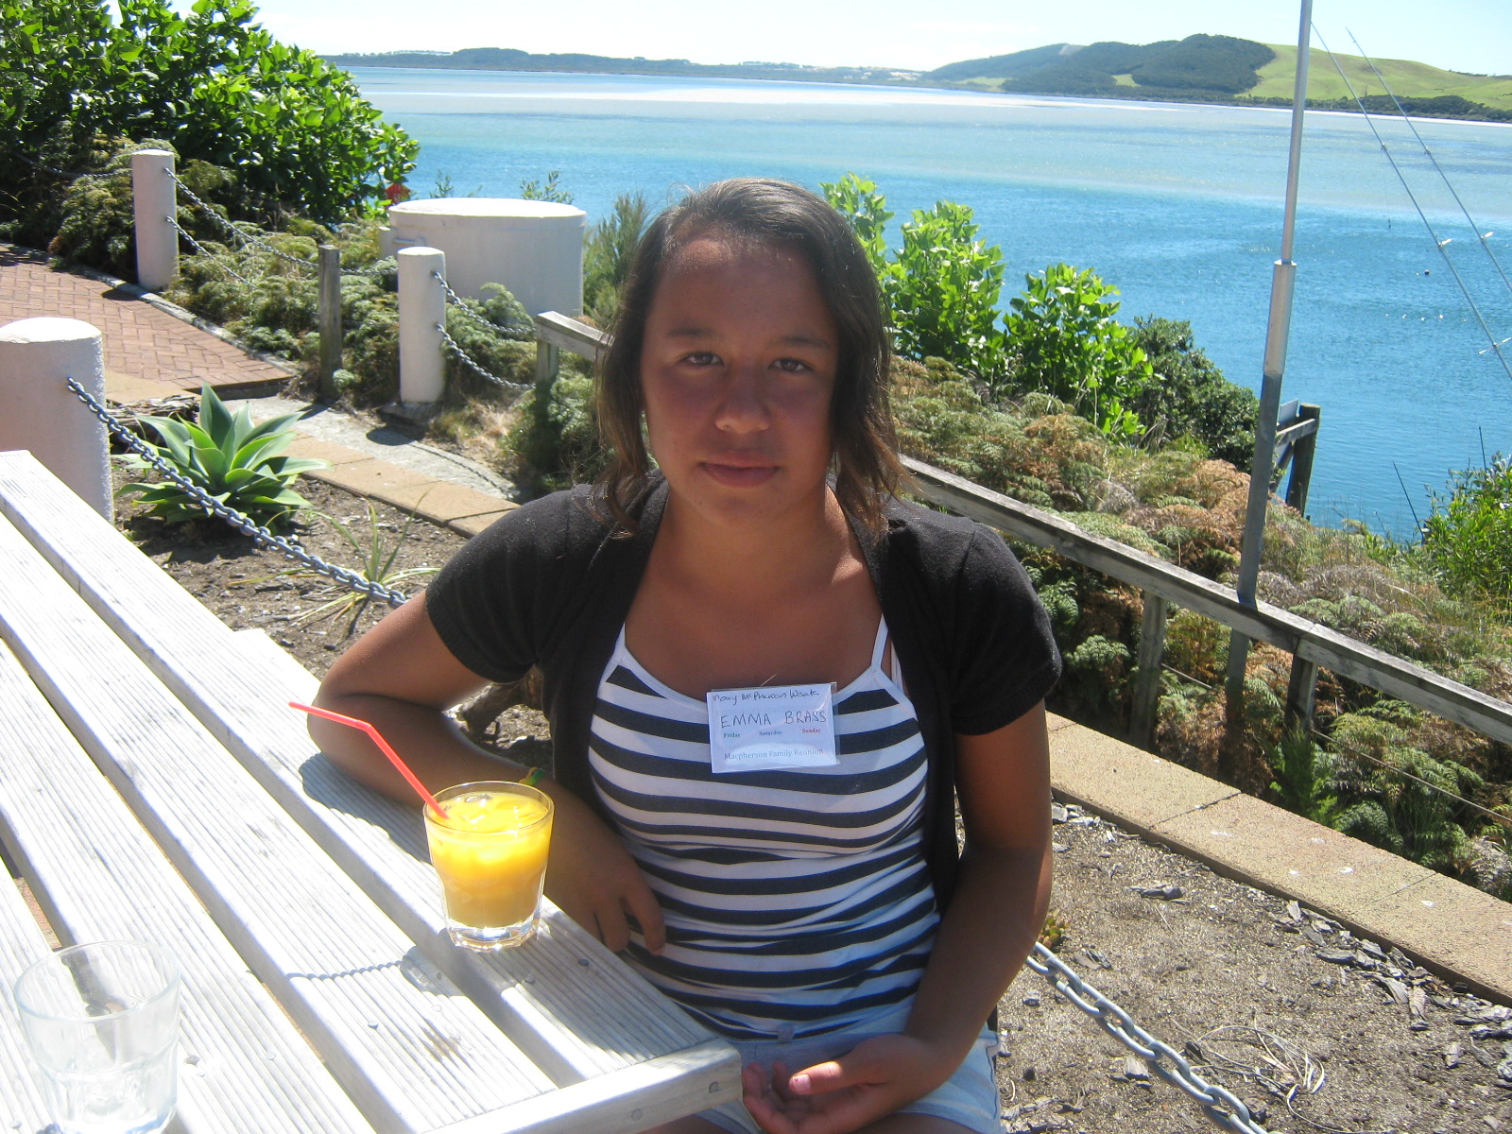
Emma Brass (Kaitaia) by Nicki Macpherson

Slide 20
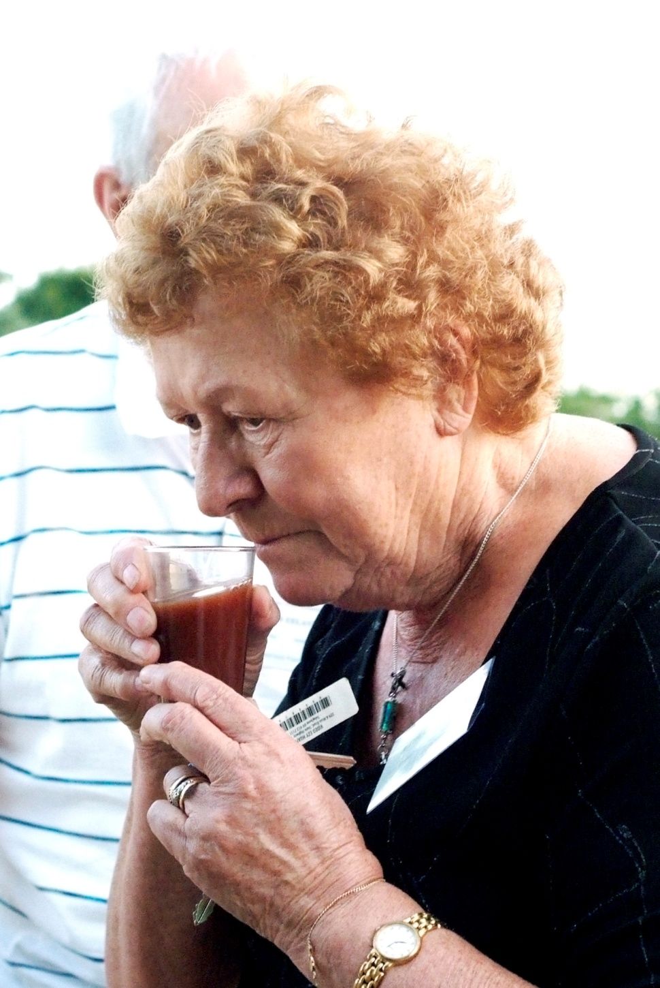
Ethel Yelavich (Auckland) remembers her father Alec’s winemaking, by Natalie McPherson

Slide 21
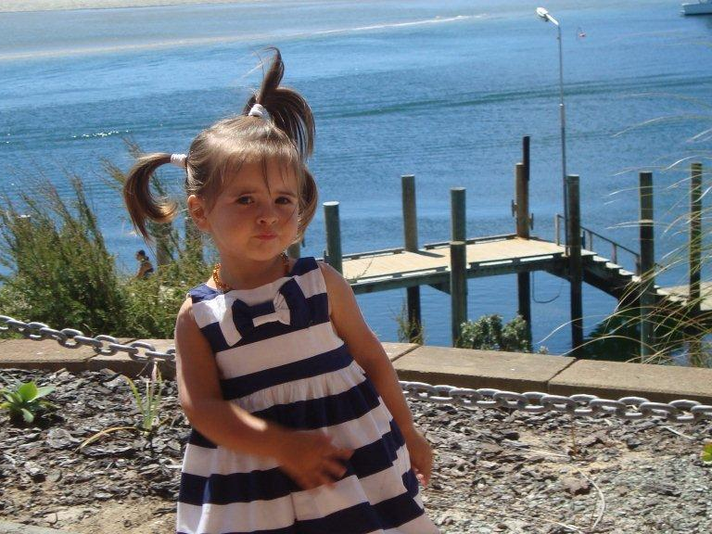
Eva Alldread by Robin Dunn

Slide 22
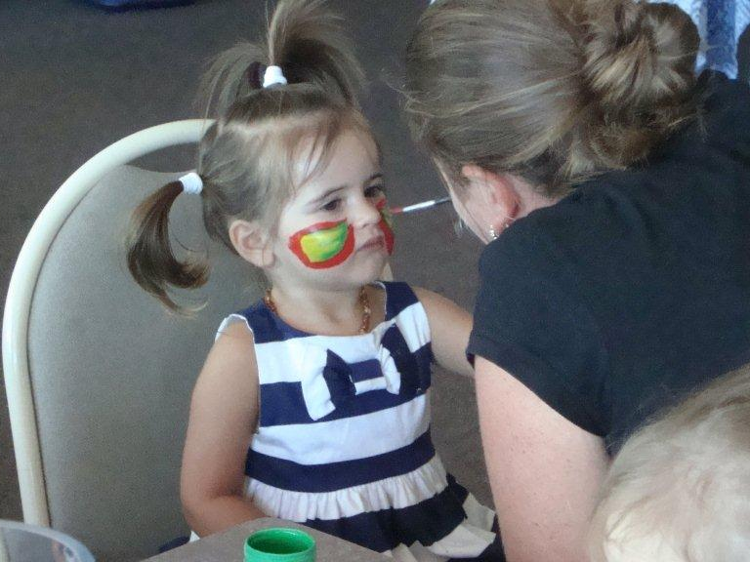
Eva Alldread having her face painted by Marcia Eastwood, by Robin Dunn

Slide 23
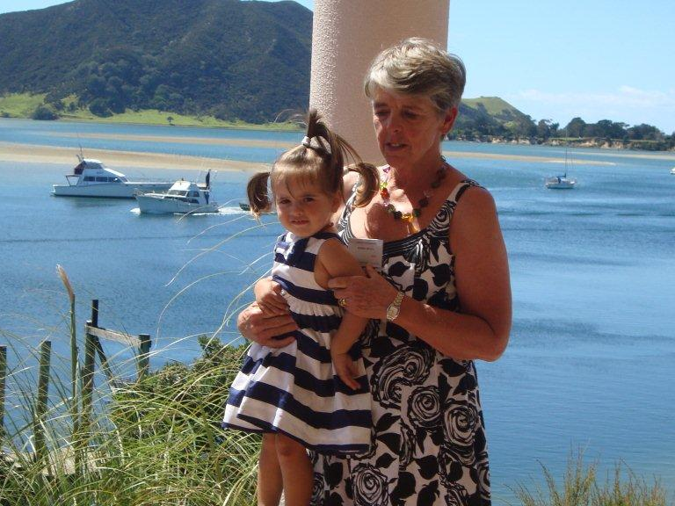
Eva Alldread and Robin Dunn, by Angela Alldread

Slide 24
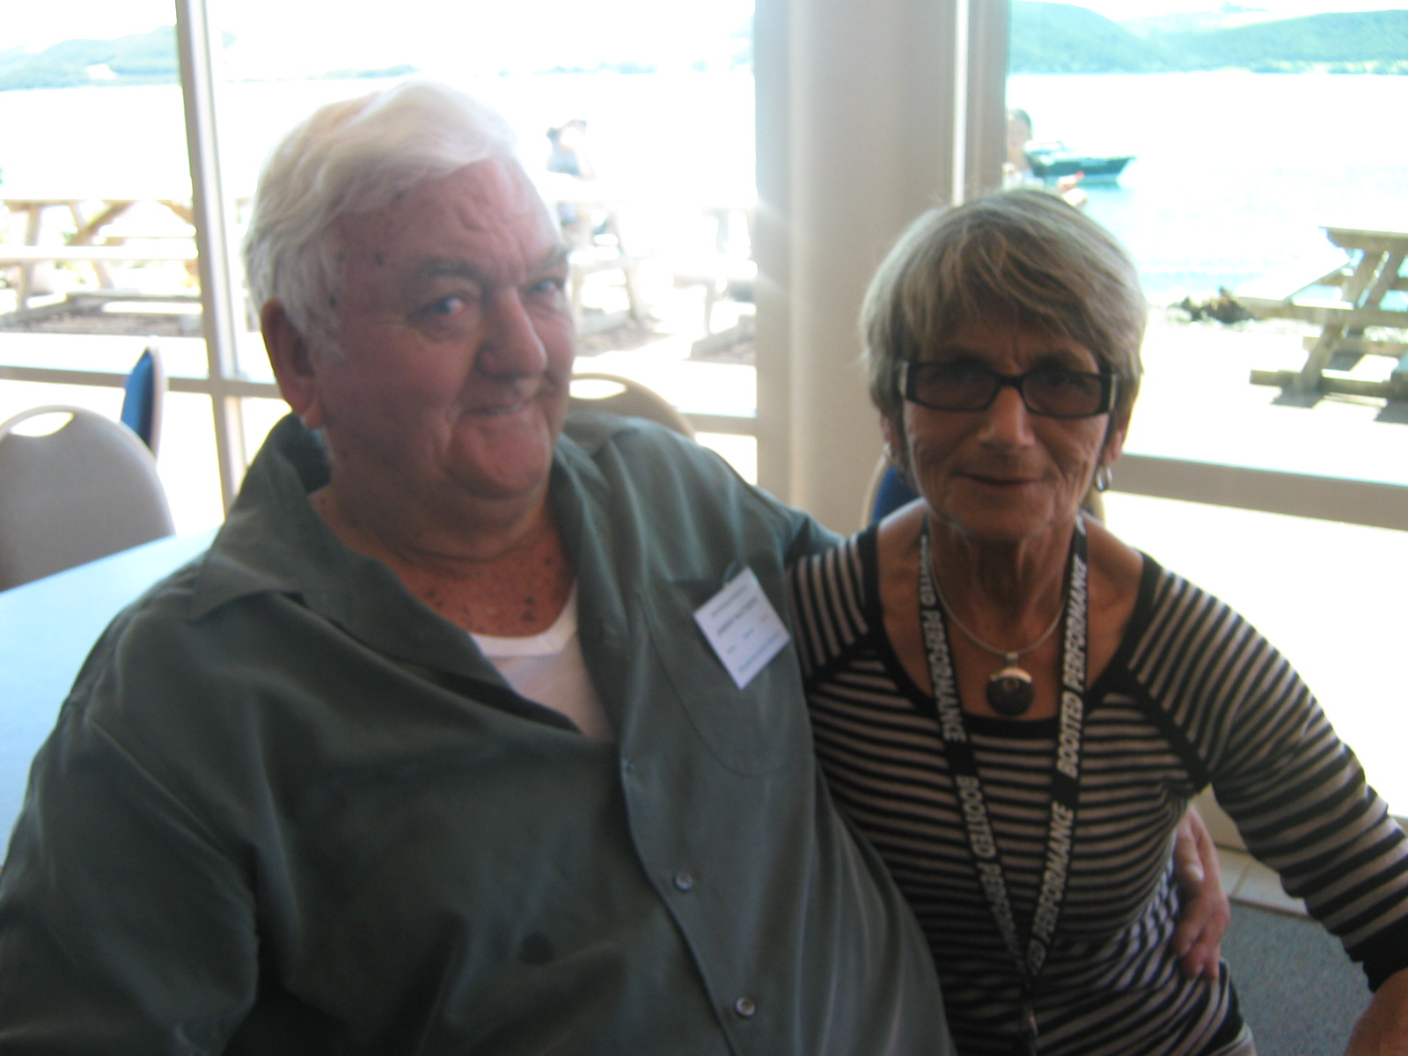
Johnny and Meg Matthews (Ahipara) by Nicki Macpherson

Slide 25
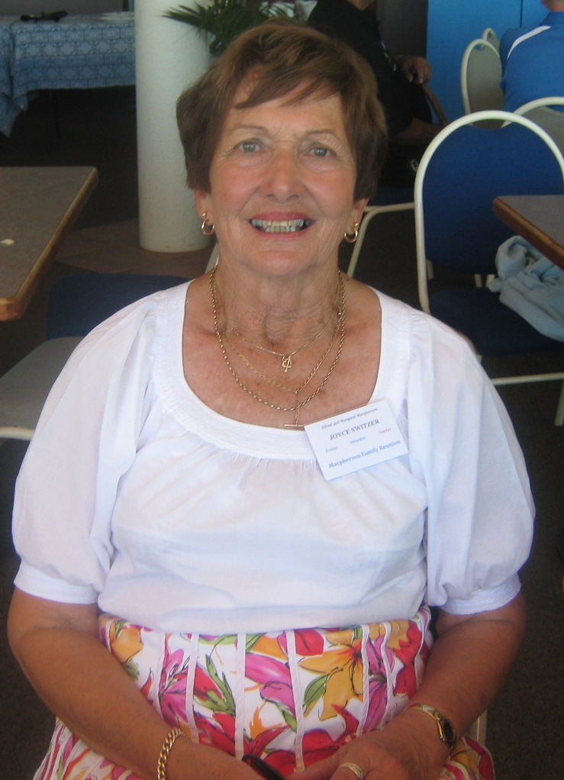
Joyce Switzer (Kaitaia) by Nicki Macpherson

Slide 26
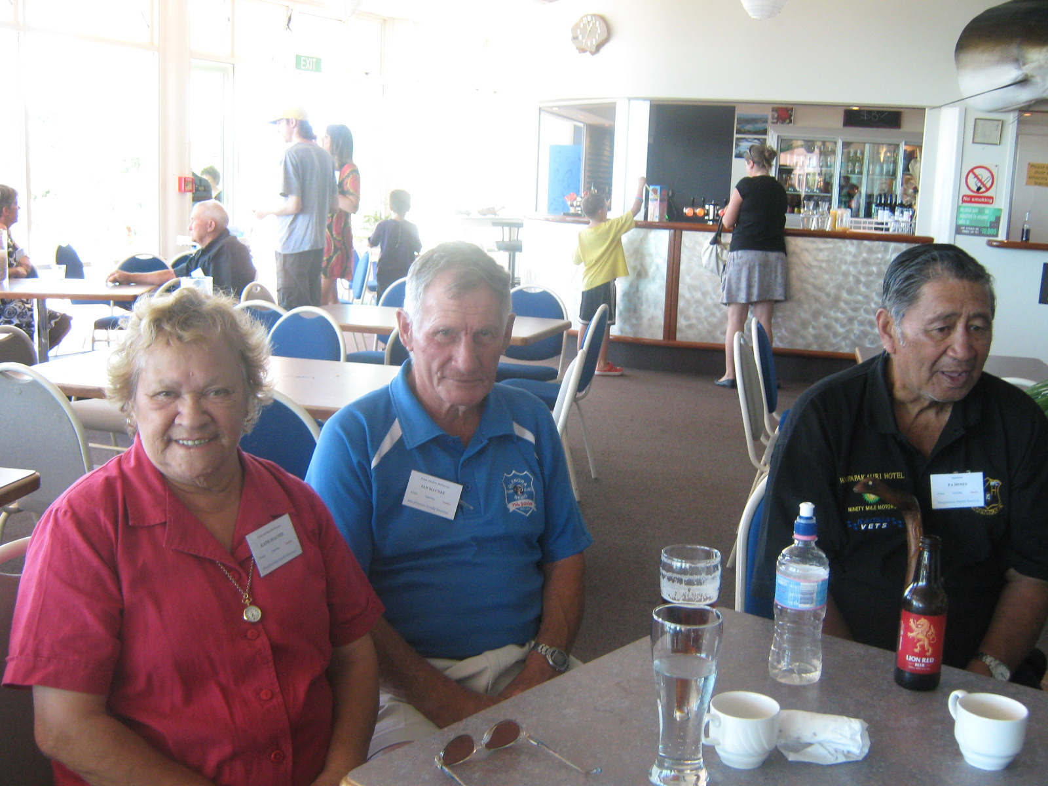
Kath and Ian McNee (Kaitaia) and Kaumatua Pa Moses (Waipapakauri) by Nicki Macpherson

Slide 27
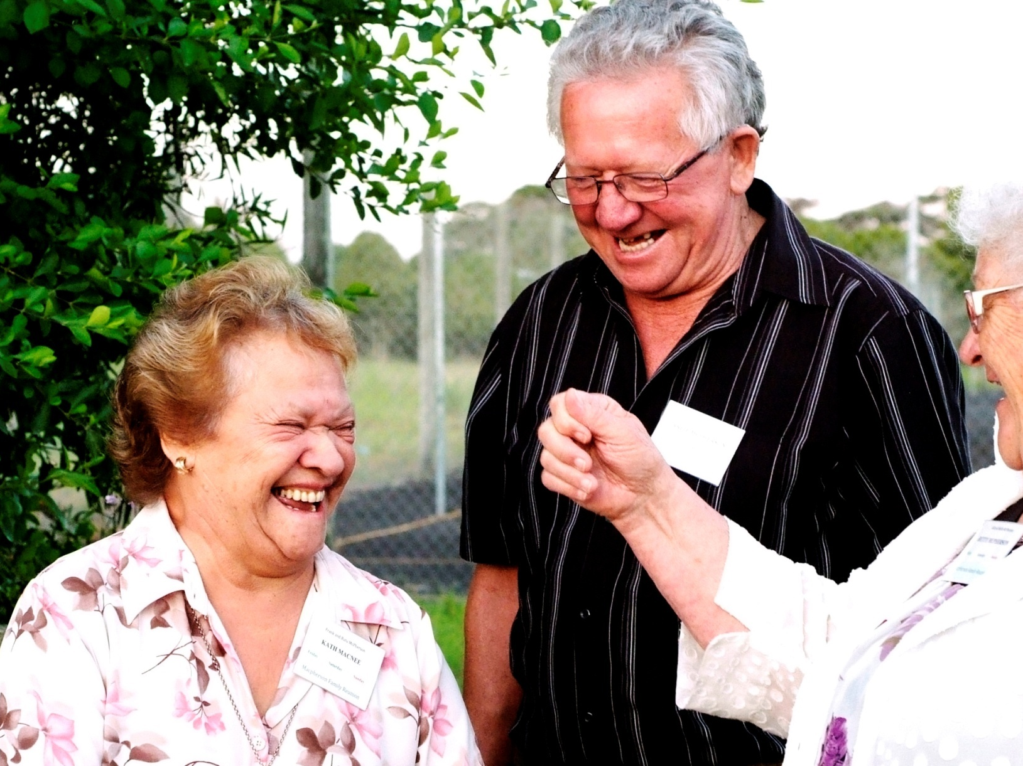
Kath MacNee (Kaitaia) Arlie and Betty McPherson (Auckland), by Natalie McPherson

Slide 28
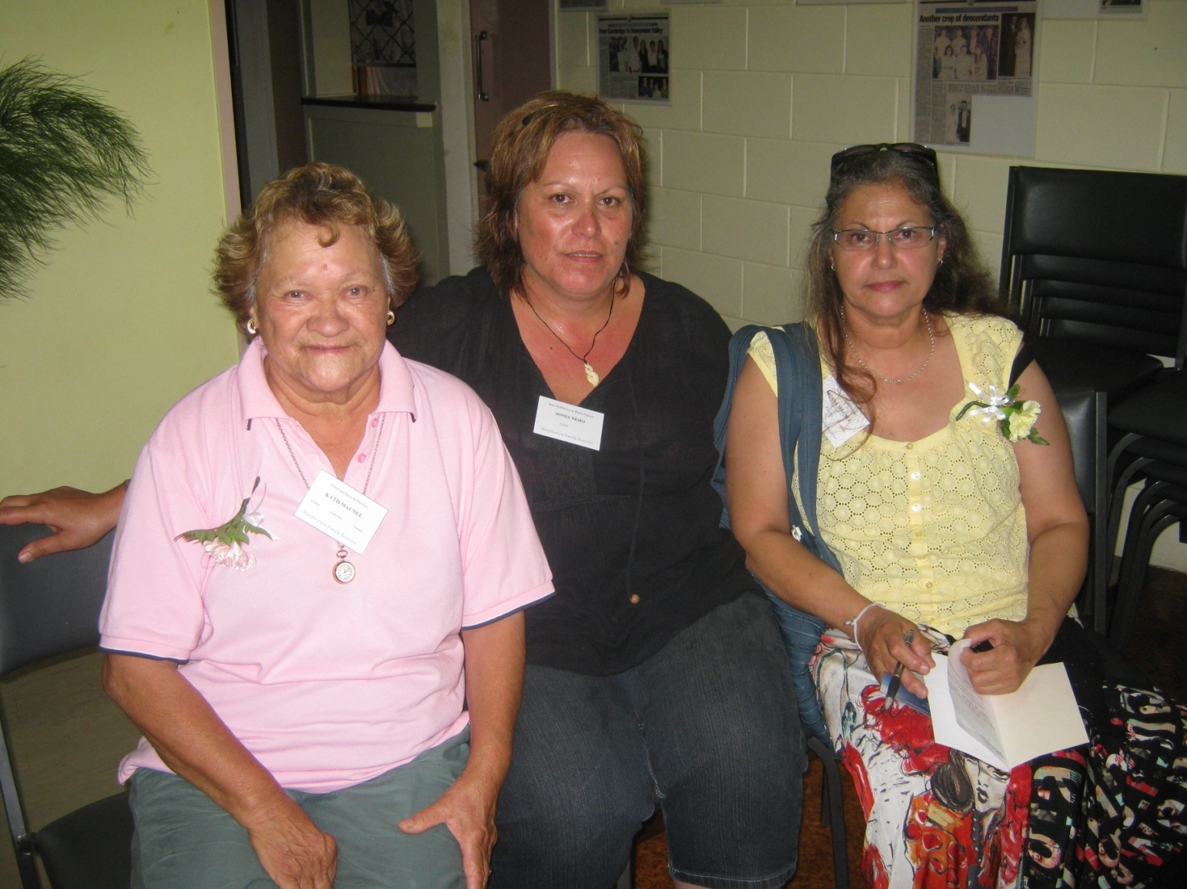
Kath McNee and Sonia Neho (Kaitaia) with Moana McNee (Auckland) by Eric Neho

Slide 29
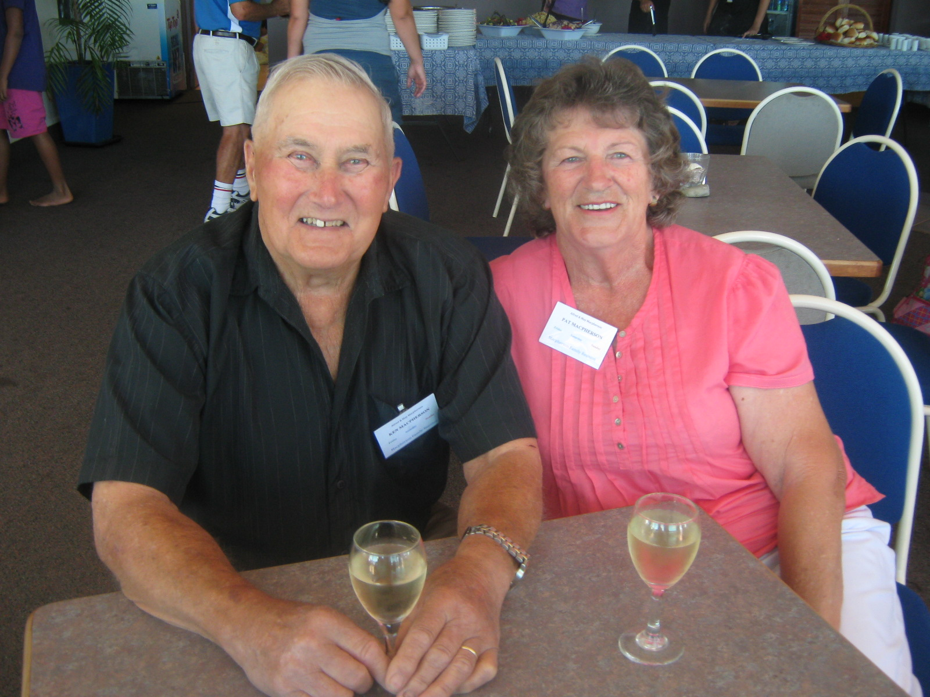
Ken and Pat Macpherson (Kaitaia), by Nicki Macpherson

Slide 30
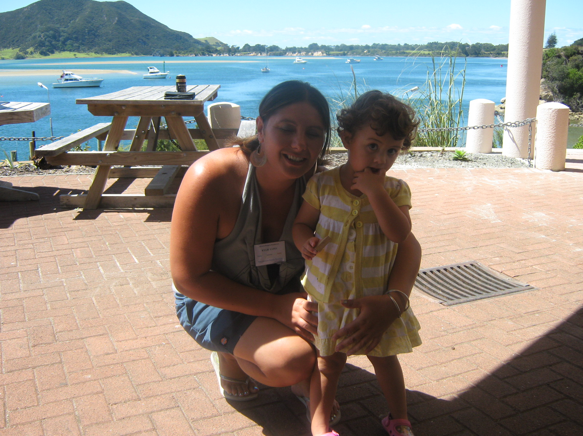
Kylie Yates and Gemma Sayles (Kaitaia) by Nicki Macpherson

Slide 31
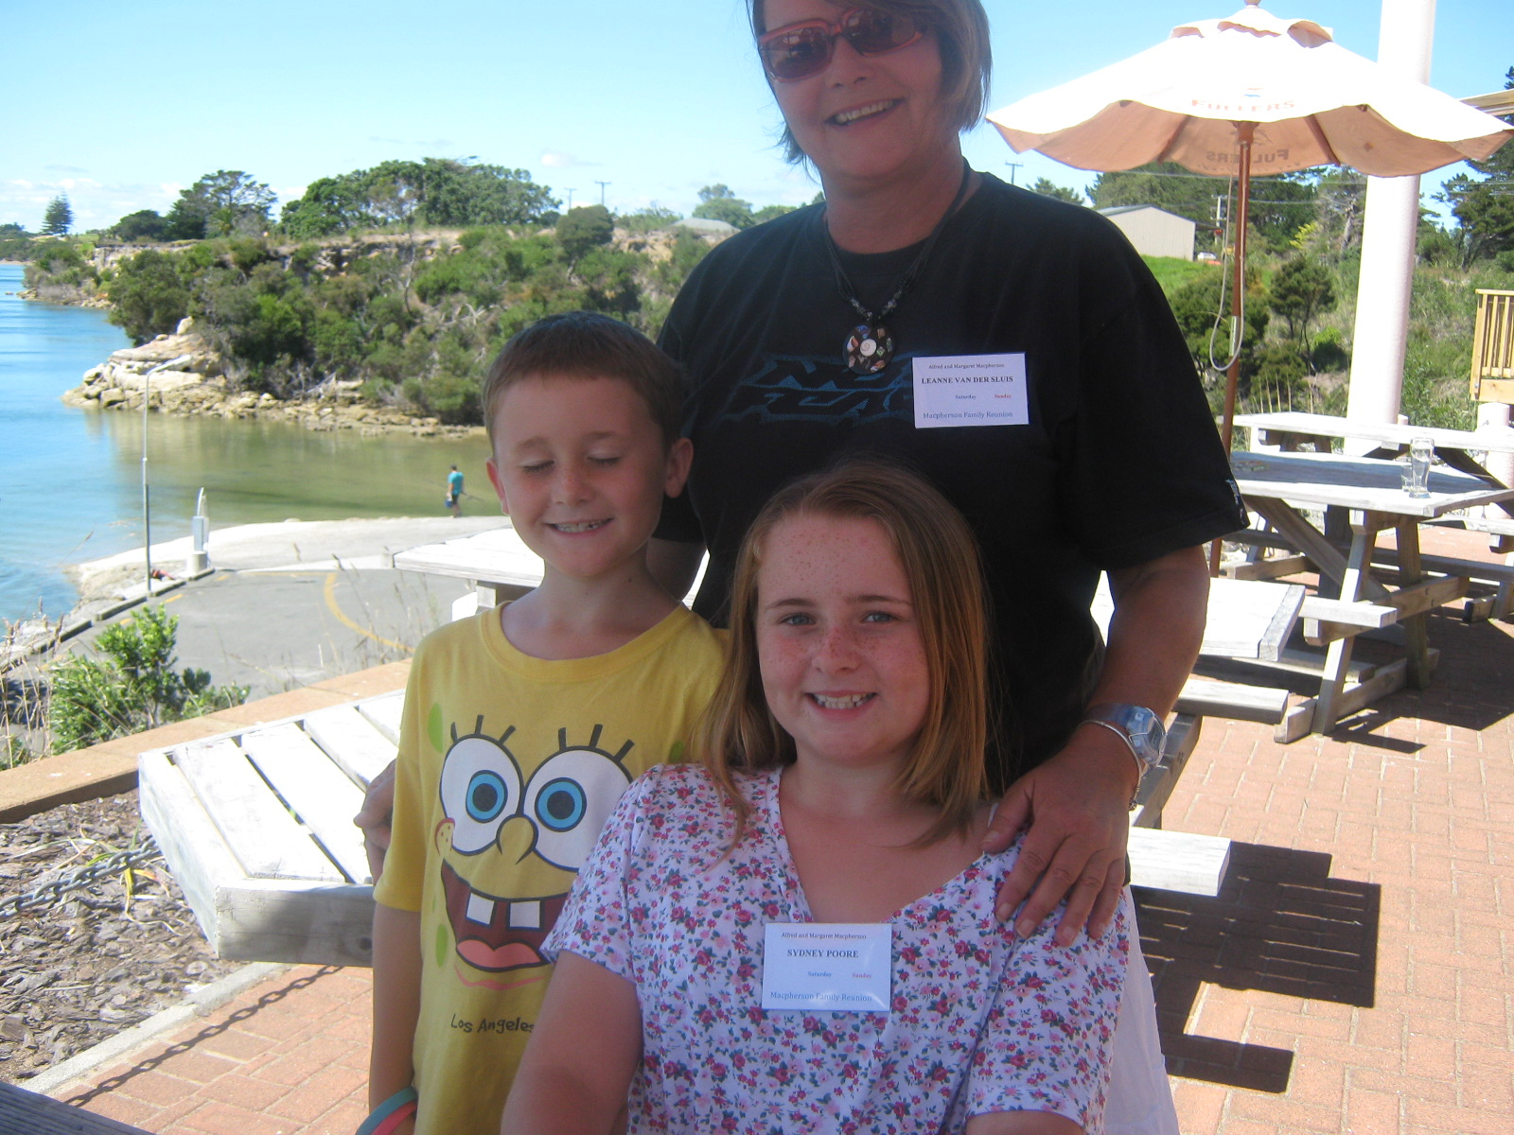
Leanne Van Der Sluis, Hunter and Sydney Poore (Auckland) by Nicki Macpherson

Slide 32
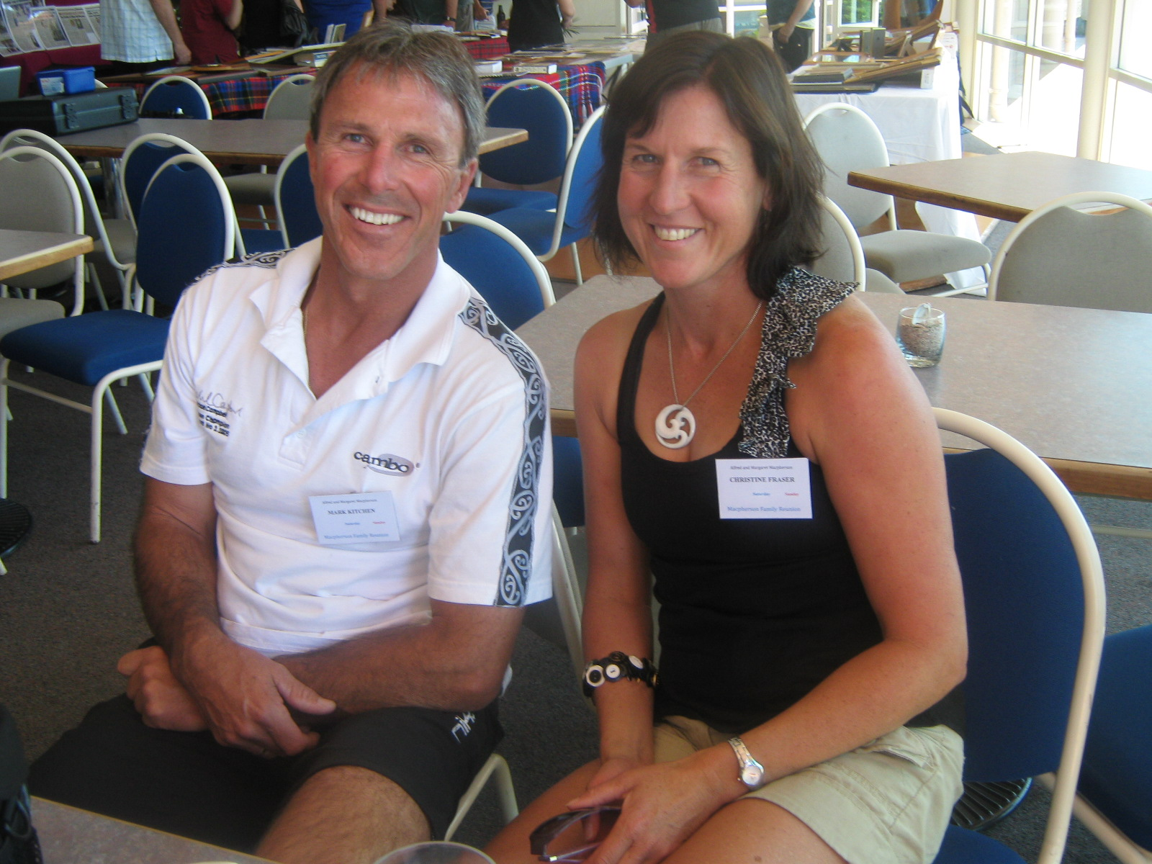
Mark Kitchen and Patricia Fraser (Whangarei) by Nicki Macpherson

Slide 33
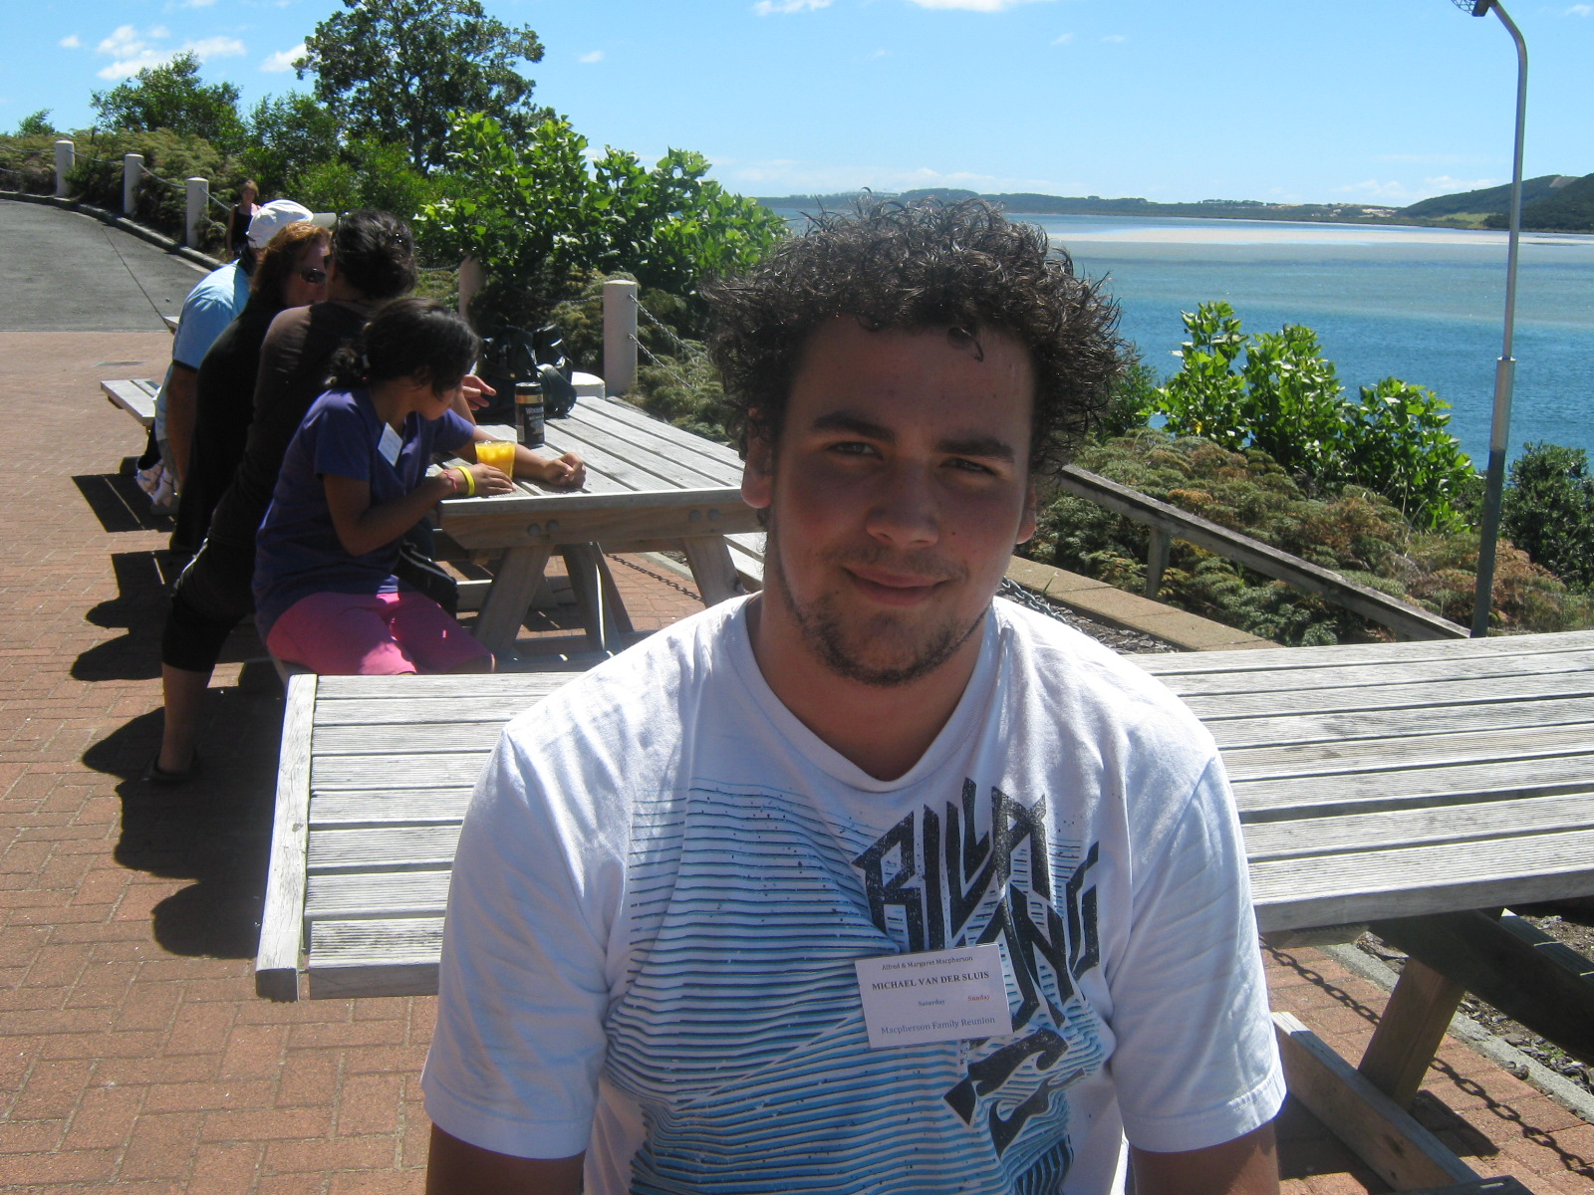
Michael Van Der Sluis (Auckland) by Nicki Macpherson

Slide 34
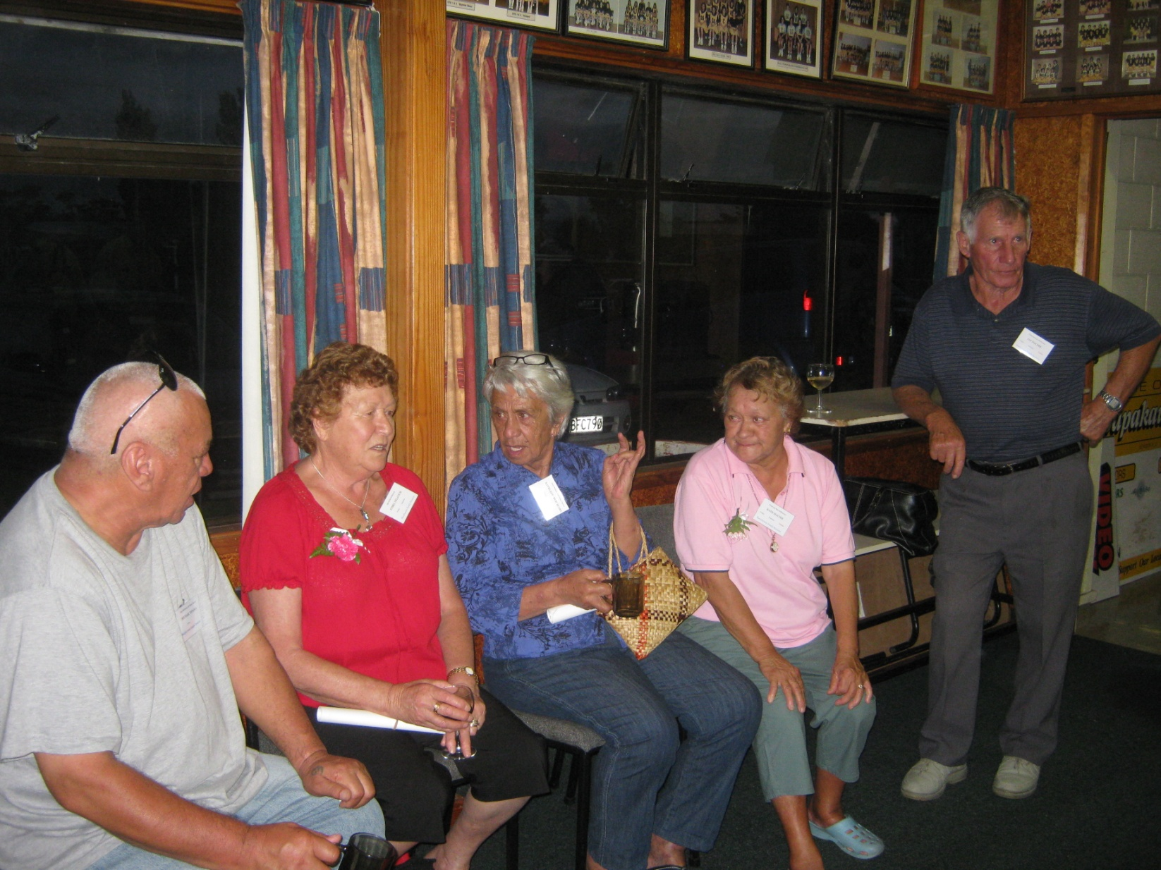
Micheal Tepania, Ethel Yelavich, Bub Busby, Kath and Ian MacNee by Sonia Neho

Slide 35
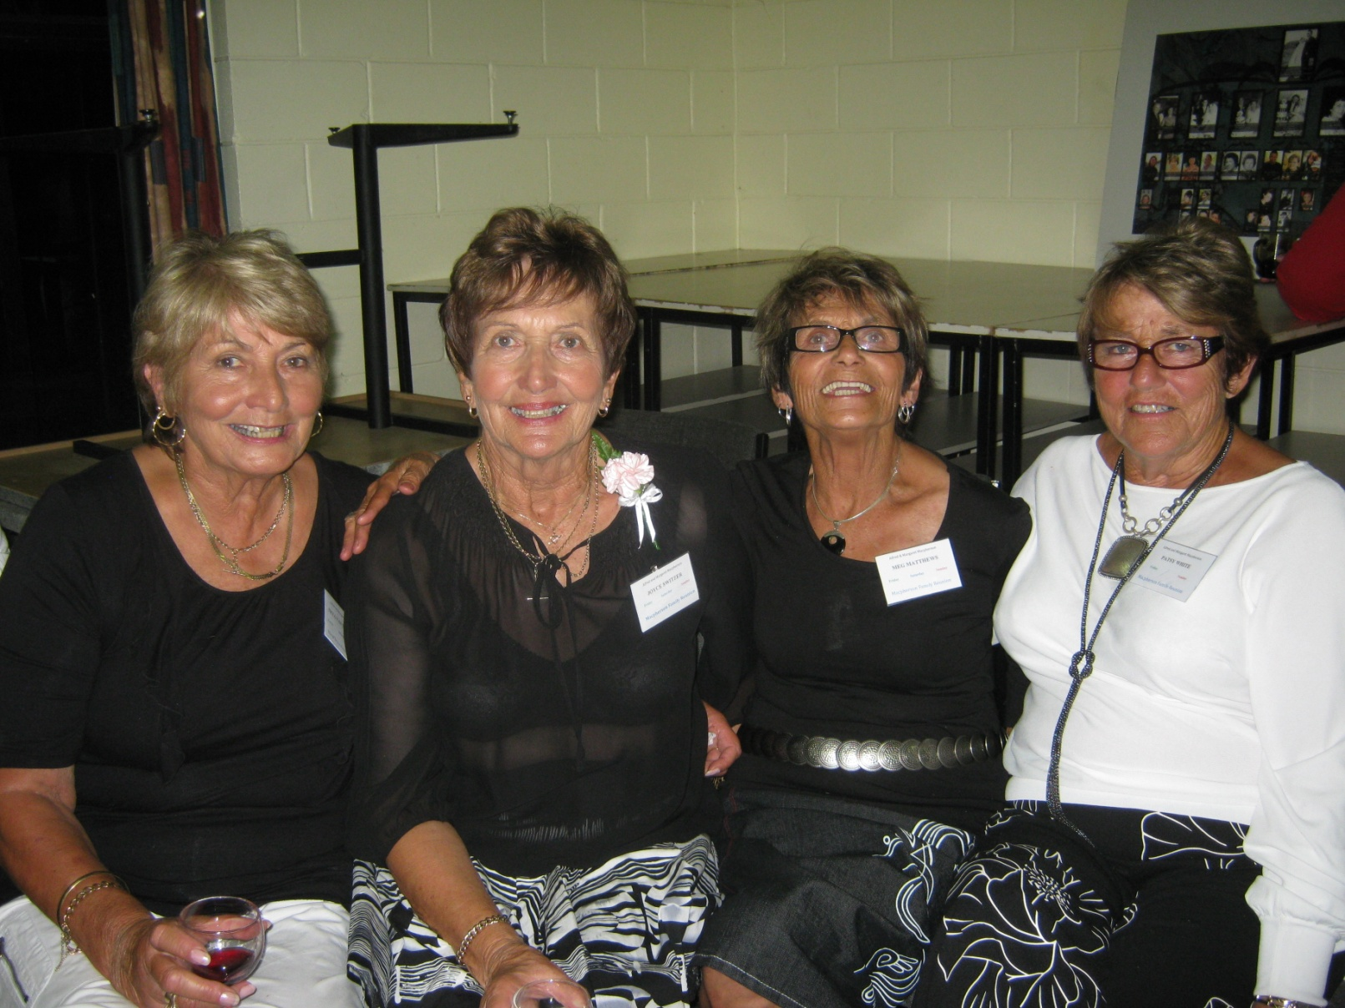
Neta, Joyce, Meg and Patsy neé Macphersons (Kaitaia) by Sonia Neho

Slide 36
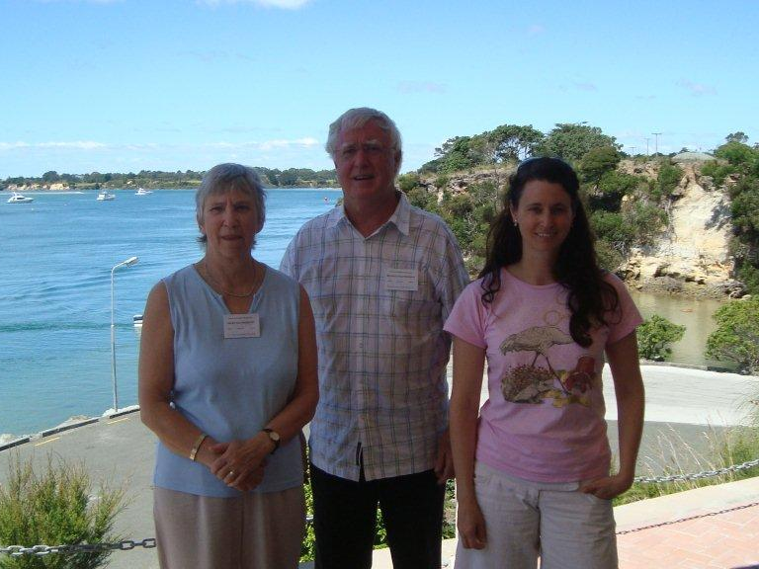
Nicki and Reynold Macpherson (Rotorua) and Kirsty Macpherson (Brisbane) by Robin Dunn

Slide 37
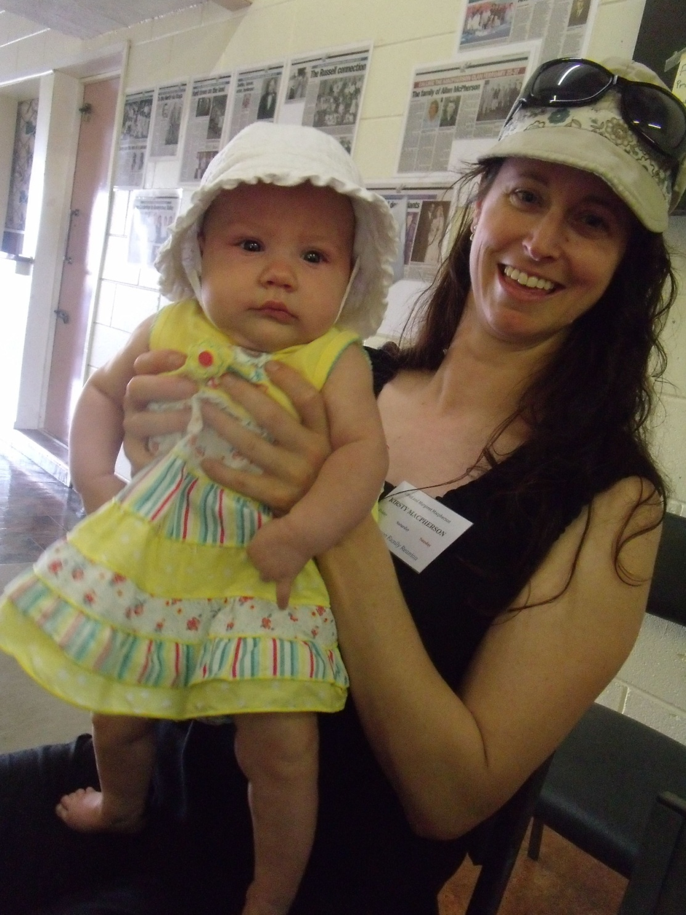
Olive Brooks (Tasmania) and Kirsty Macpherson (Brisbane), by Nicki Macpherson

Slide 38
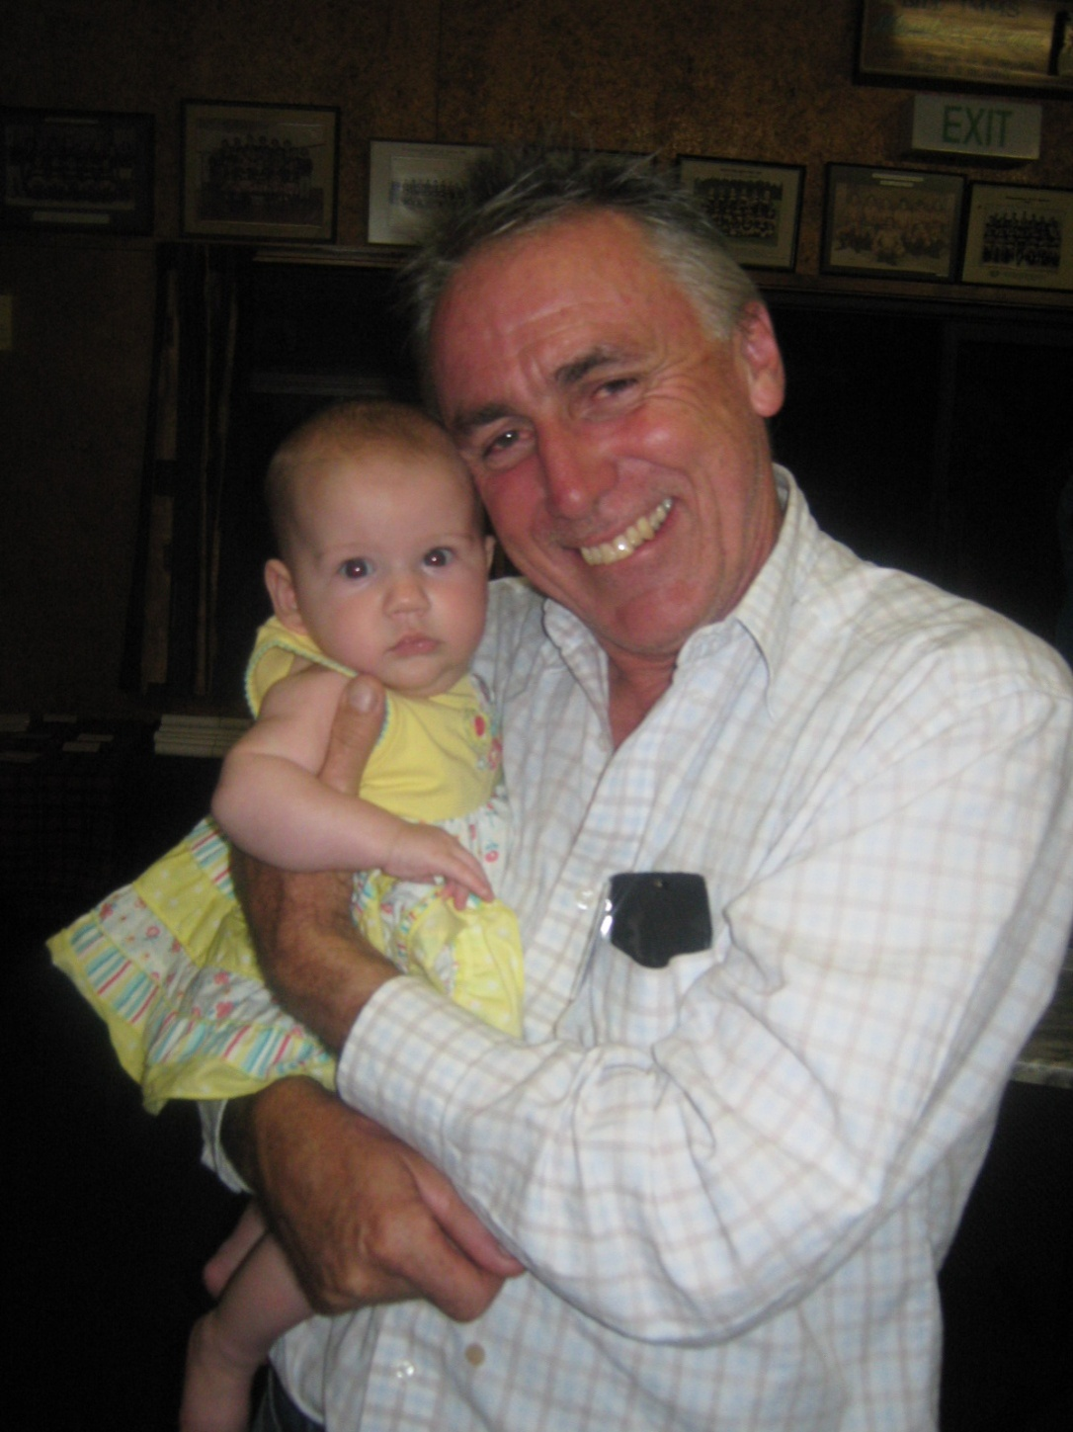
Olive Brooks (Tasmania) and Stuart Macpherson (Sydney), by Nicki Macpherson

Slide 39
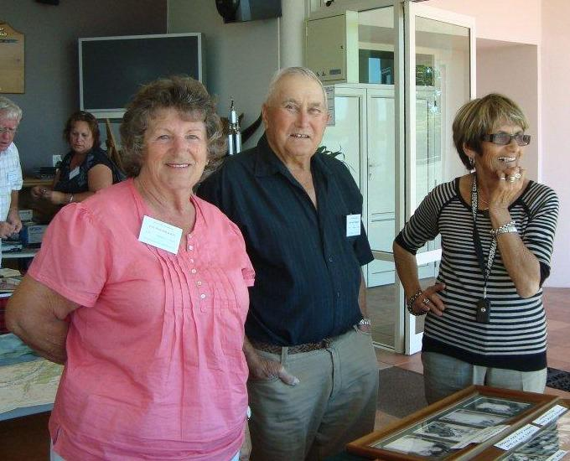
Pat and Ken Macpherson (Kaitaia) and Meg Matthews (Ahipara), by Robin Dunn

Slide 40
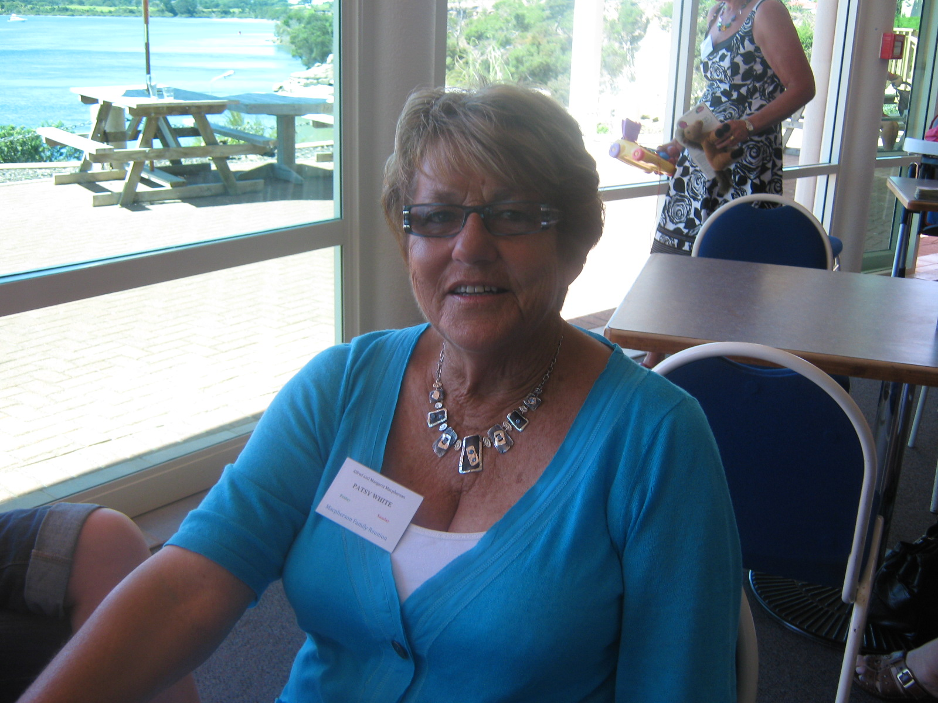
Patsy White (Cable Bay), by Nicki Macpherson

Slide 41
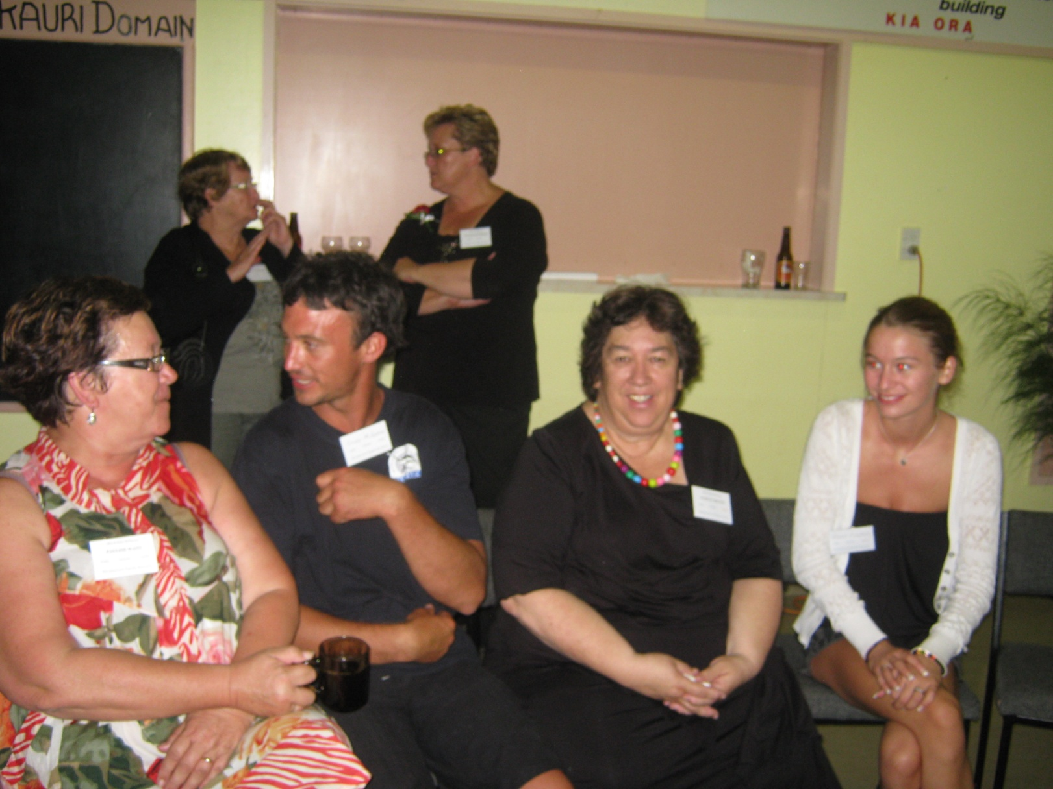
Pauline Waiti (Wellington), Joshua McPherson, Marilyn Brewin, Renee Nichols (Raewyn and Natalie McPherson in the background) (Auckland) by Sonia Neho

Slide 42
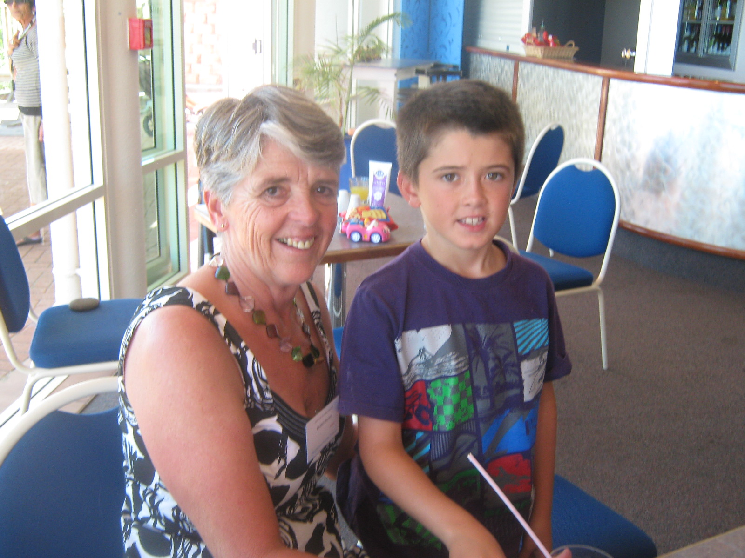
Robin Dunn and Max Alldread (Whangarei), by Nicki Macpherson

Slide 43
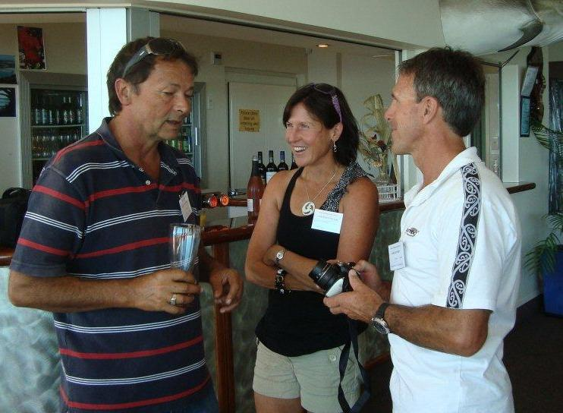
Shane Van Der Sluis (Auckland) with Patricia Fraser and Mark Kitchen (Whangarei) by Robin Dunn

Slide 44
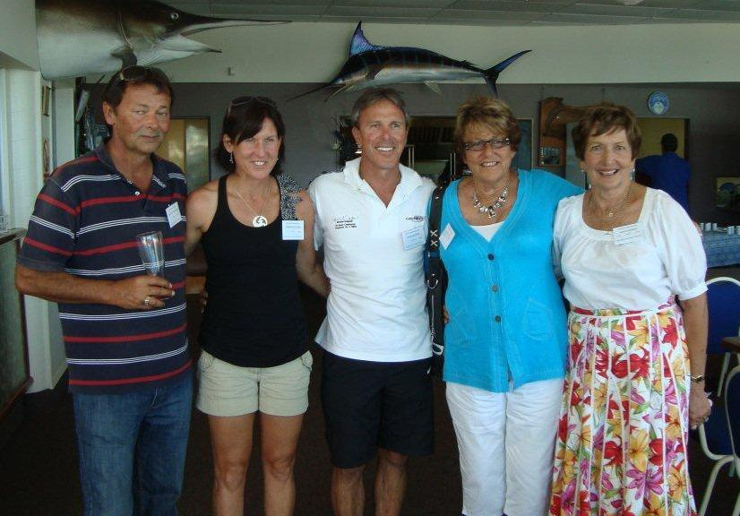
Shane Van Der Sluis (Auckland), Patricia Fraser and Mark Kitchen (Whangarei) with Patsy White and Joyce Switzer (Kaitaia), by Natalie McPherson

Slide 45
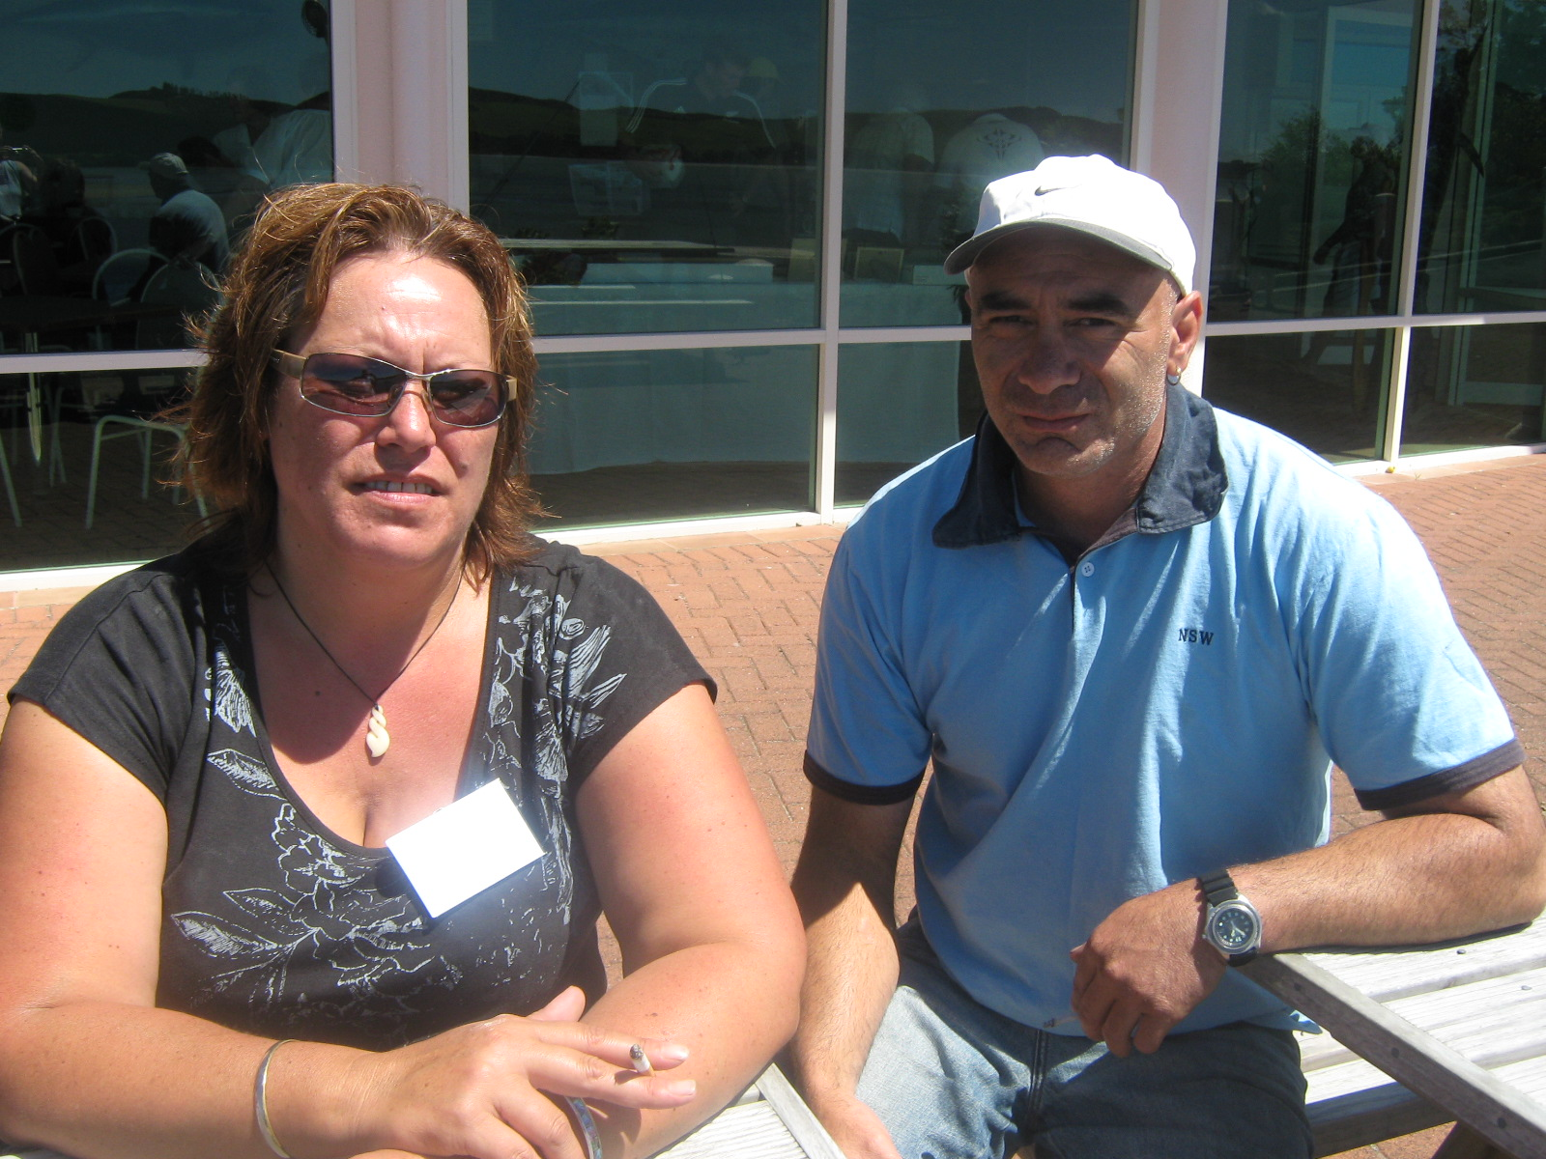
Sonia Neho and Thomas Busby (Kaitaia), by Nicki Macpherson

Slide 46
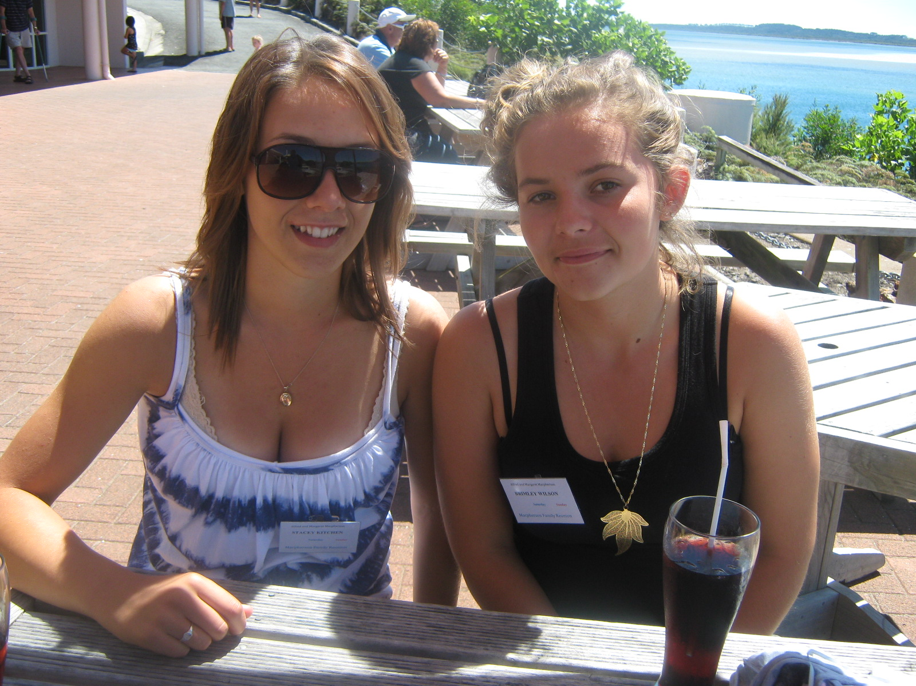
Stacey Kitchen (Whangarei) and Brimley Wilson (Auckland), by Nicki Macpherson

Slide 47
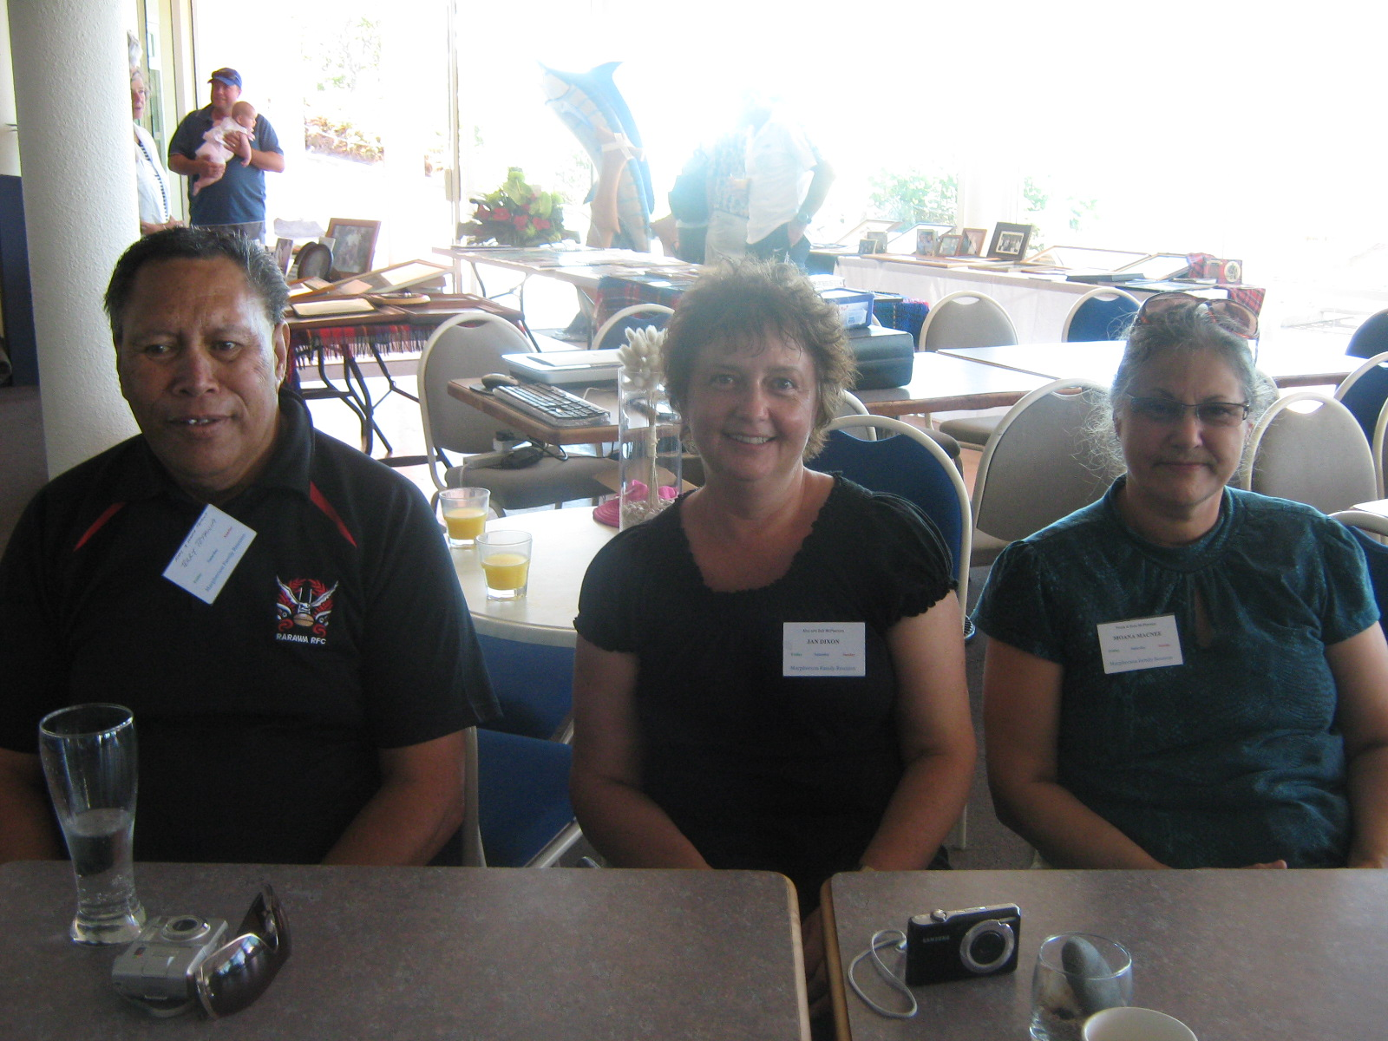
Terry Tepania (Kaitaia) Jan Dixon (Christchurch) and Moana McNee (Auckland), by Sonia Neho

Slide 48
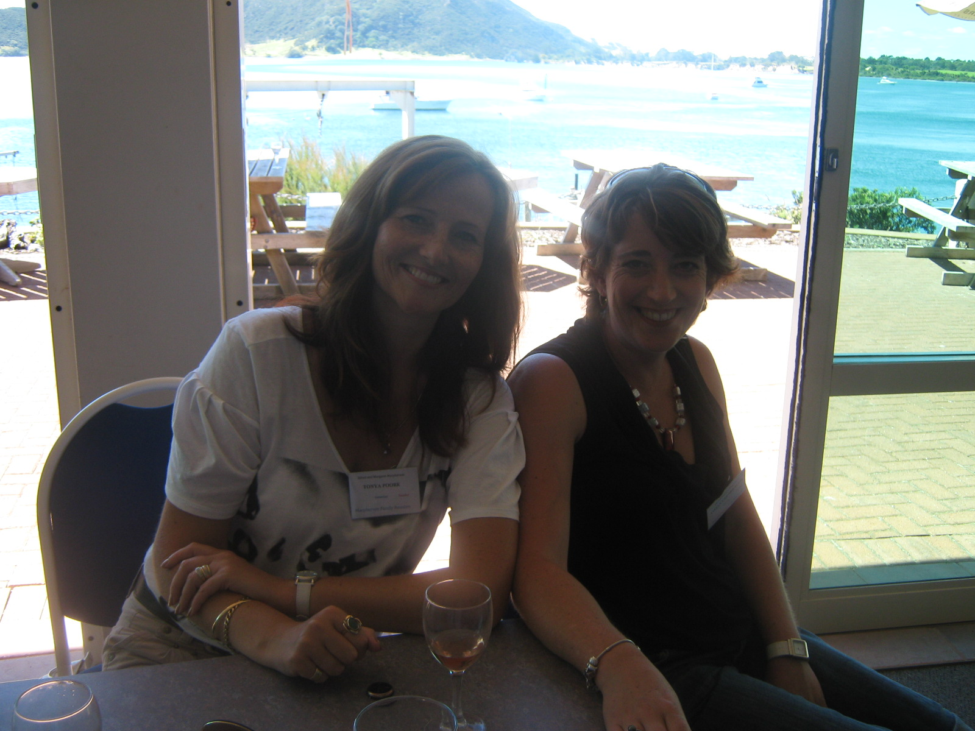
Tonya Poore and Jenny Gray (Auckland) by Nicki Macpherson

Slide 49
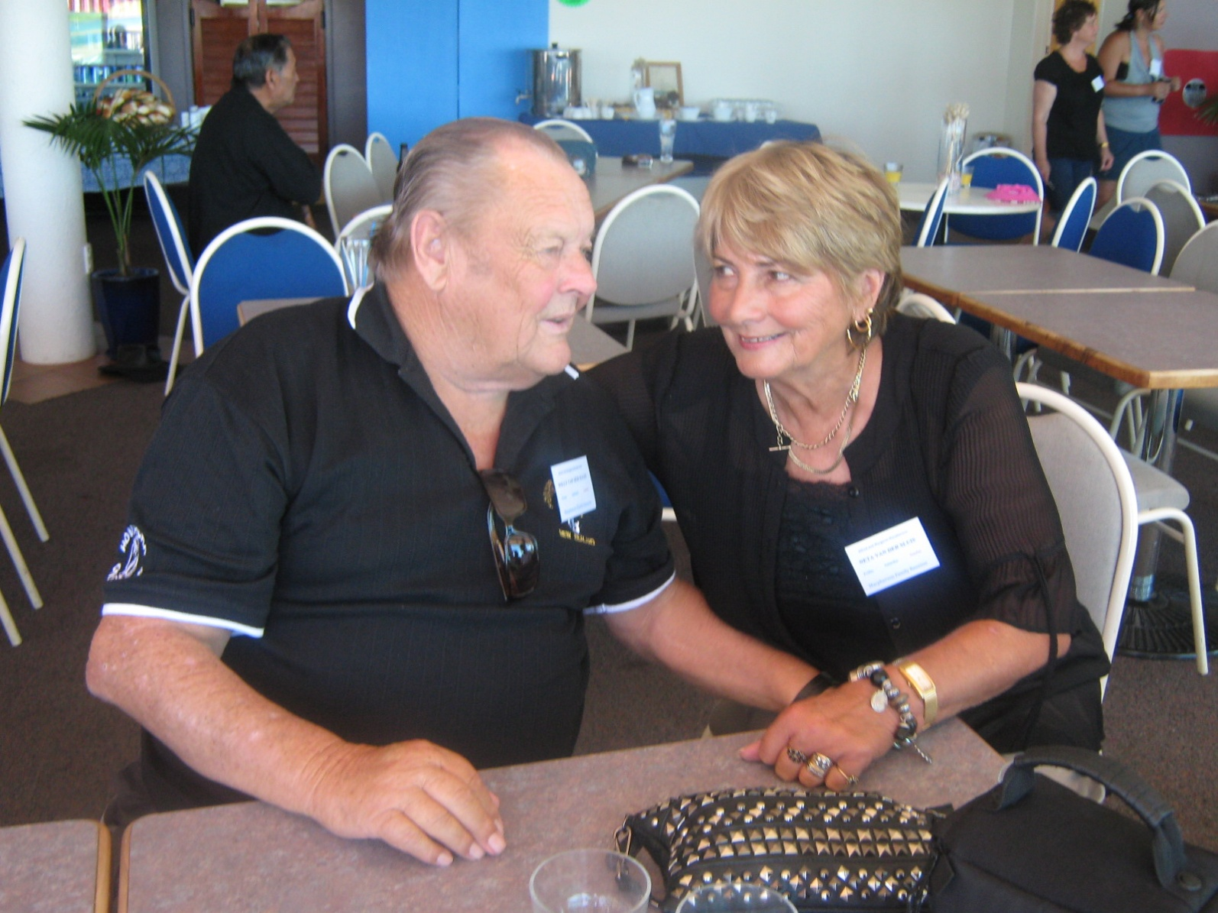
Willy and Neta Van Der Sluis (Houhora), by Nicki Macpherson

