Slide 1
The Mcpherson’s of the far north

Slide 2
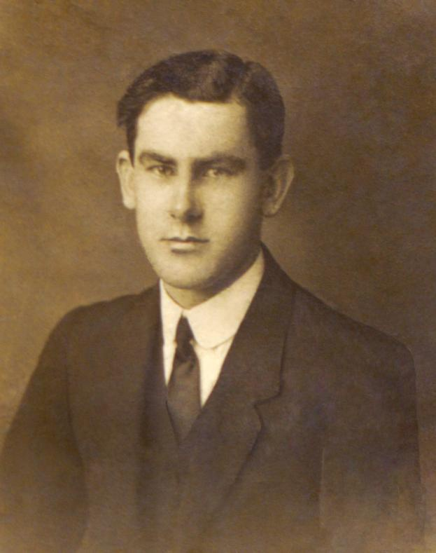
FRANCIS ‘FRANK’ mCpHERSON

Slide 3
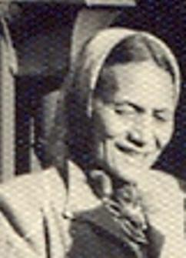
Morehu rebecca pene ‘butu’ arano

Slide 4
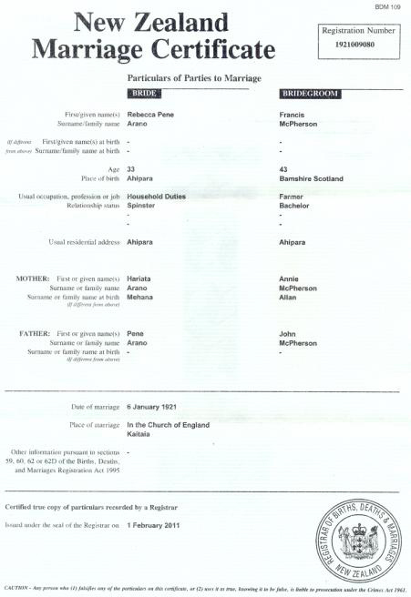
FRANCIS MCPHERSON MARRIES REBECCA ARANO
(6TH January 1921)

Slide 5
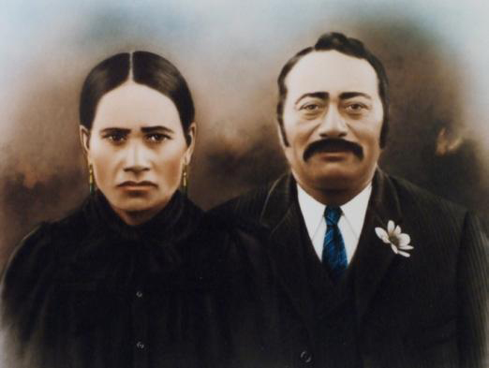
Hariata (nee mehana) & pene arano
– morehu’s parents

Slide 6
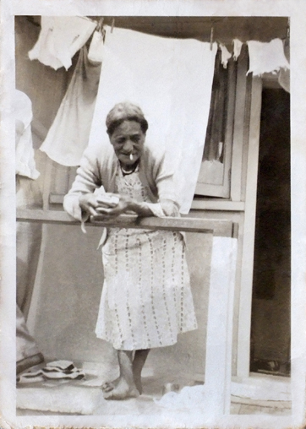
Morehu rebecca pene ‘butu’ arano

Slide 7
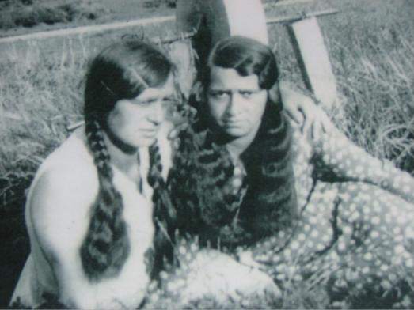
Mere (mary) and taare (dollie Mcpherson

Slide 8
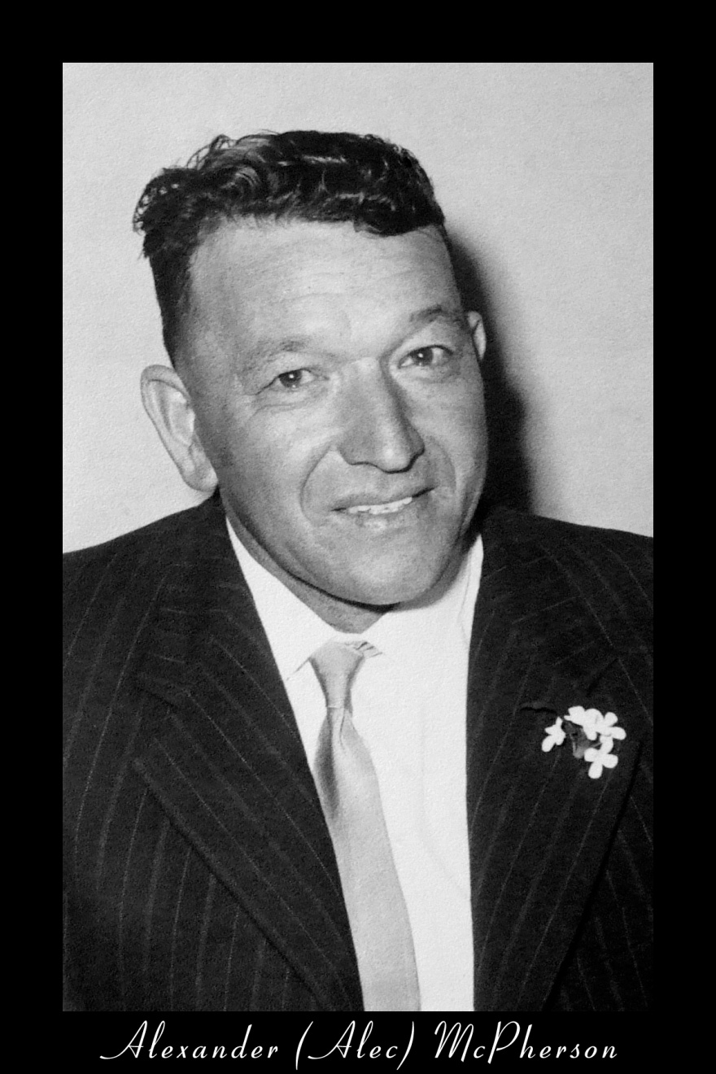
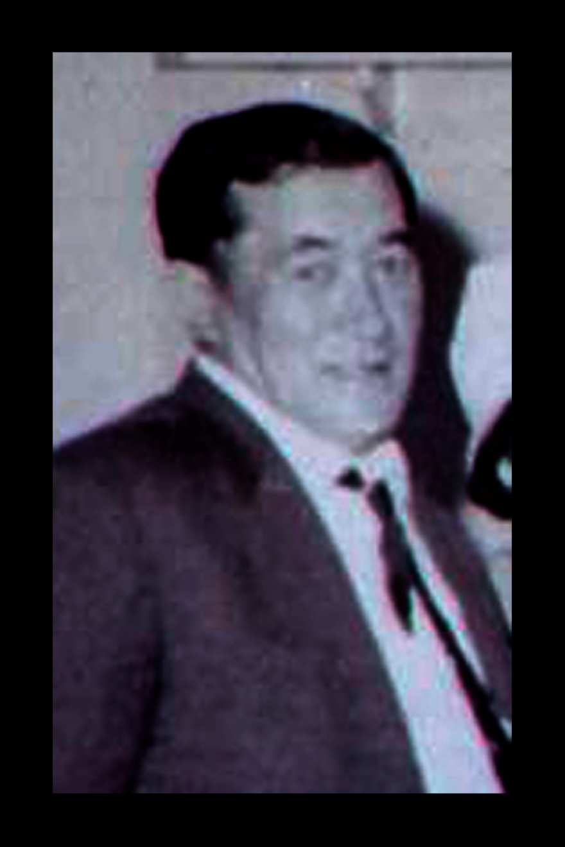
Allan McPherson

Slide 9
Alexander (alec) McPherson

Slide 10
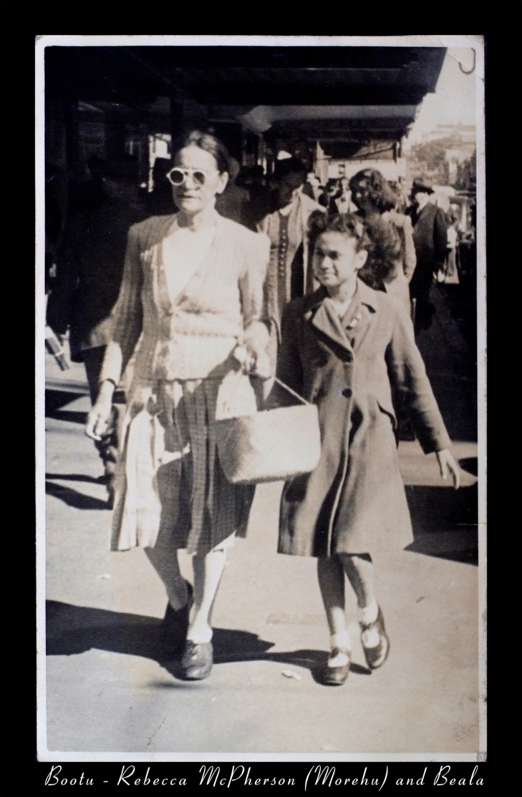
rebecca mcpherson with bela

Slide 11
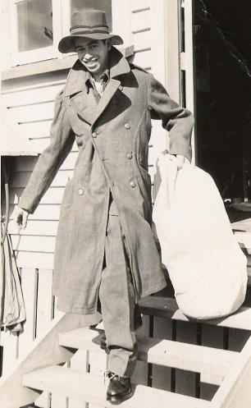
Noble hohaia

Slide 12
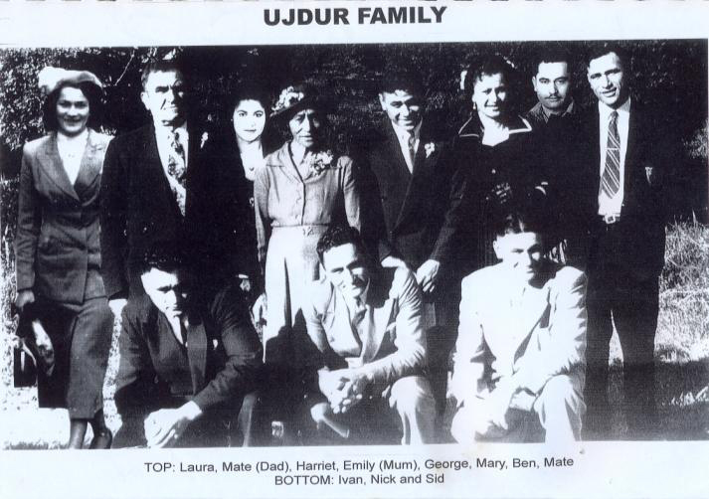

Slide 13
The family of Mary and Waata Tepania

Slide 14
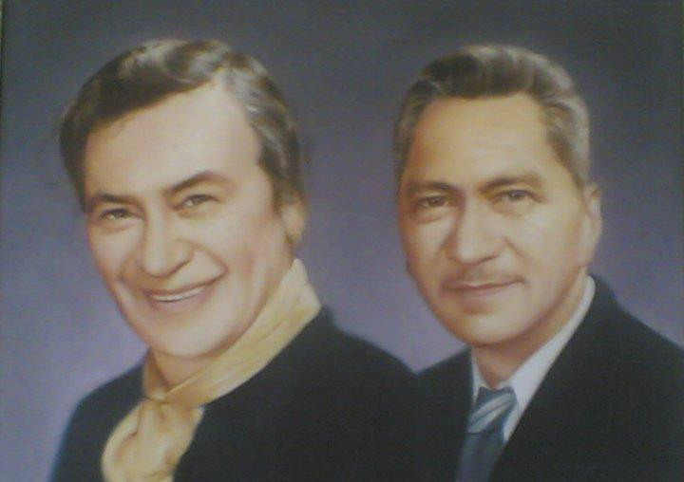

Slide 15
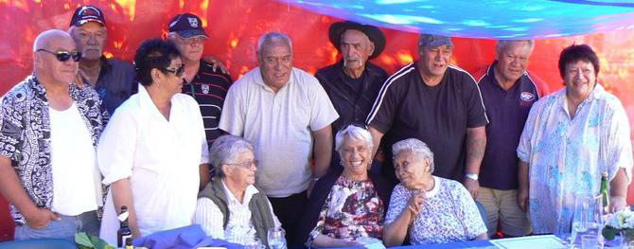

Slide 16
the family of
allan and nellie mcpherson

Slide 17
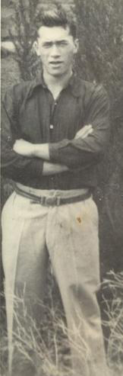

Slide 18
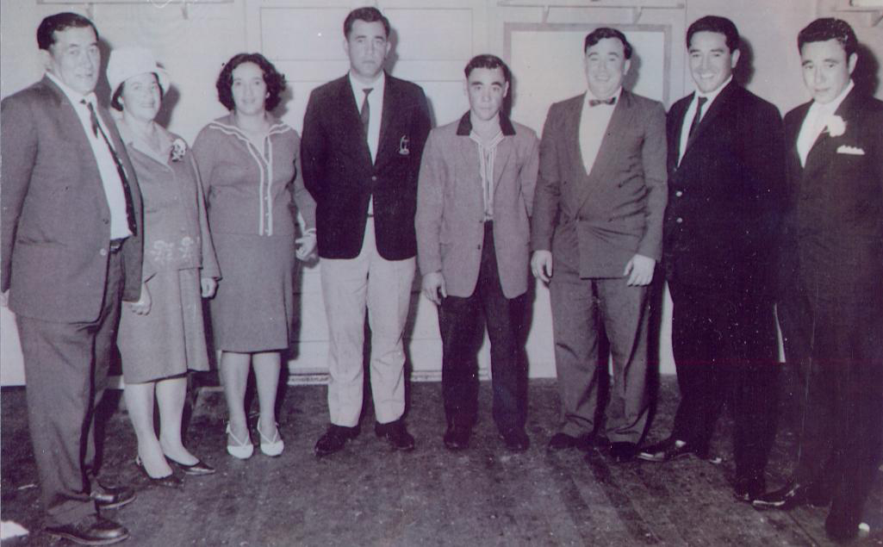

Slide 19
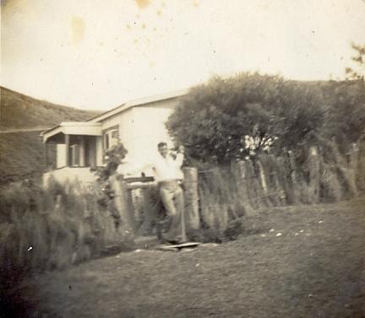

Slide 20
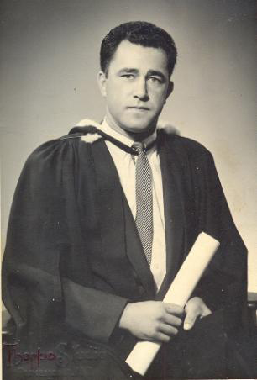
Frank ‘scotty’ mcpherson

Slide 21
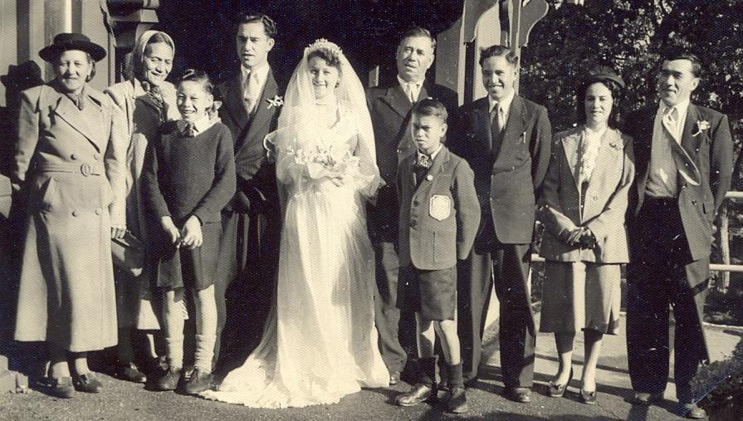

Slide 22
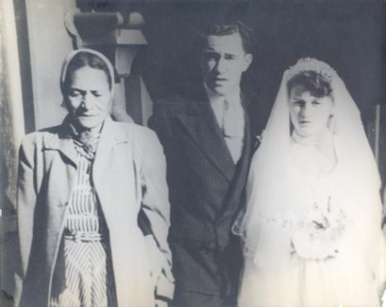

Slide 23
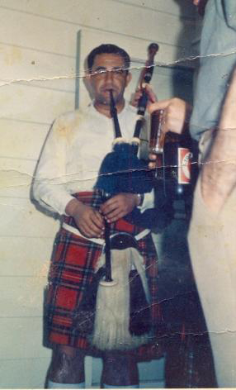

Slide 24
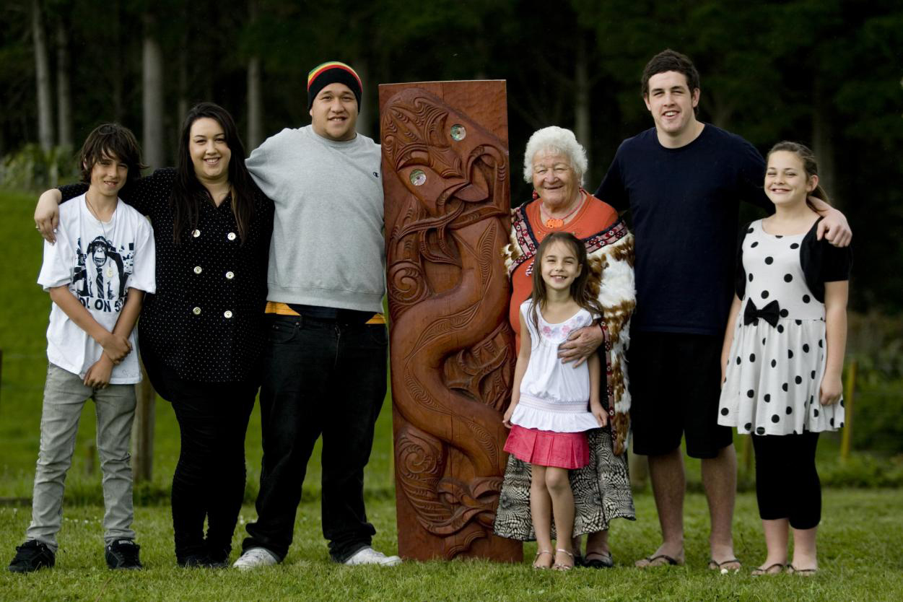

Slide 25
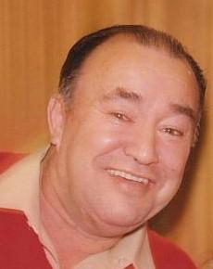

Slide 26
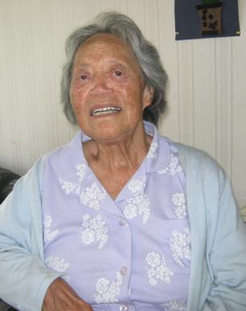

Slide 27
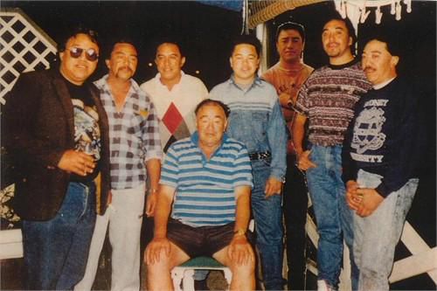

Slide 28
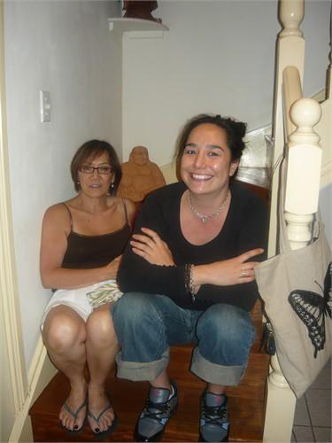

Slide 29
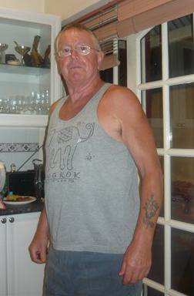

Slide 30
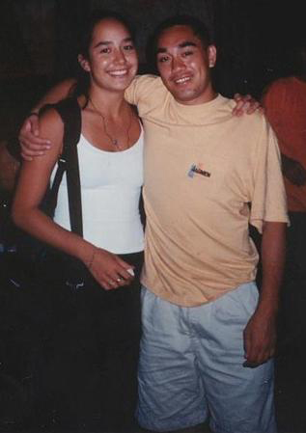

Slide 31
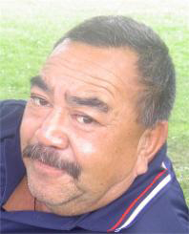

Slide 32
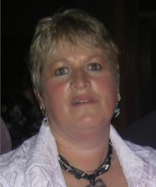

Slide 33
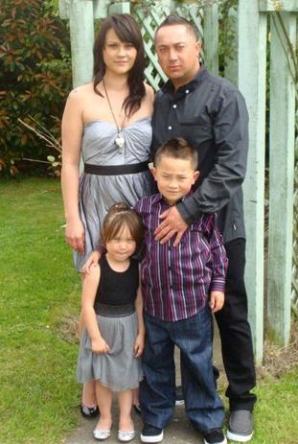

Slide 34
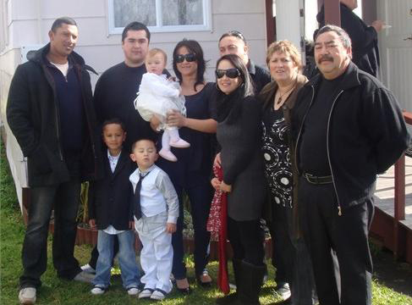

Slide 35
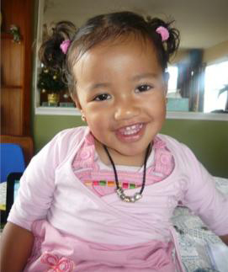

Slide 36
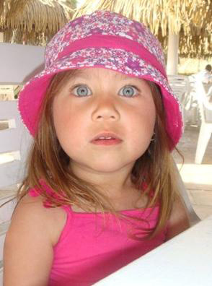

Slide 37
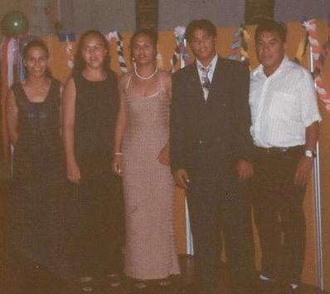

Slide 38
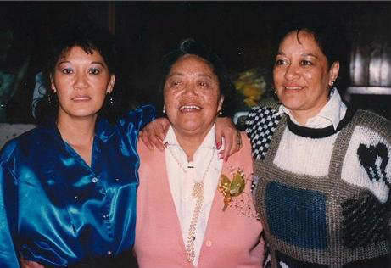

Slide 39
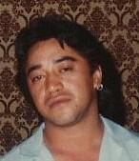

Slide 40
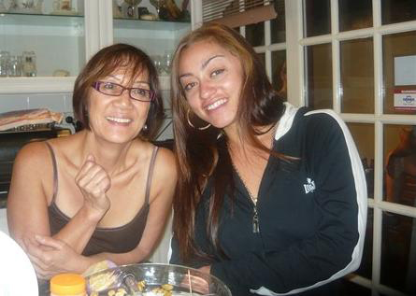

Slide 41
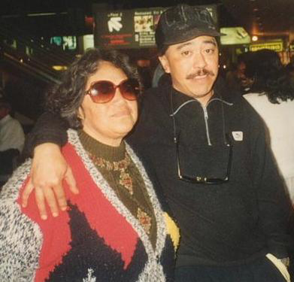

Slide 42
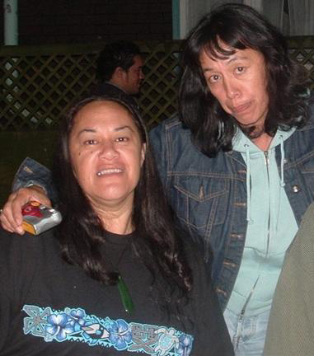

Slide 43
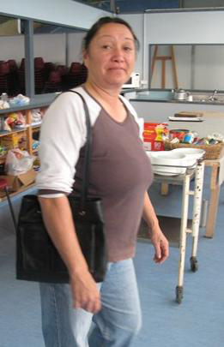

Slide 44
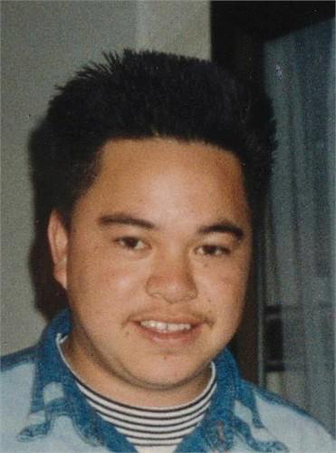

Slide 45


Slide 46


Slide 47
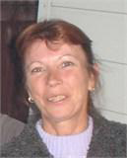

Slide 48
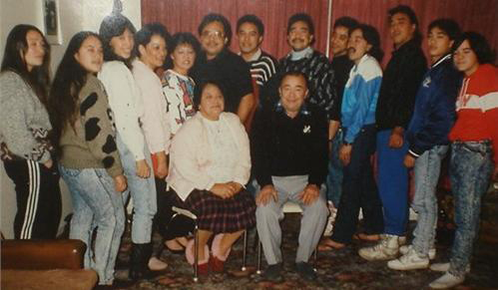

Slide 49
the family of
Taare ‘dollie’ and charlie hohaia

Slide 50
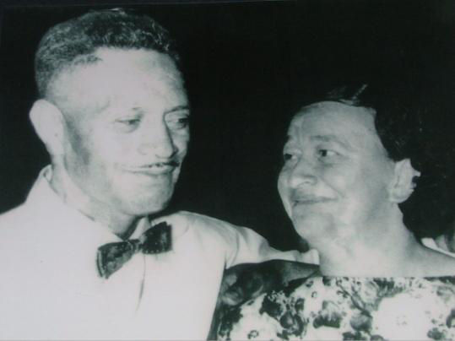

Slide 51
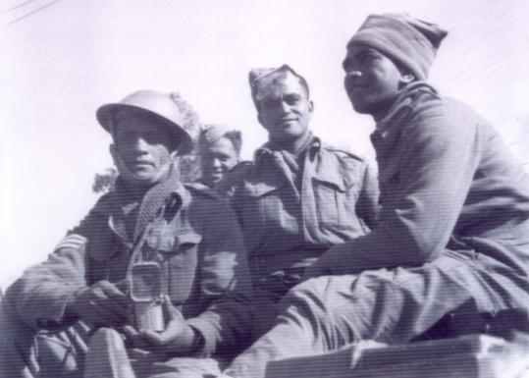

Slide 52
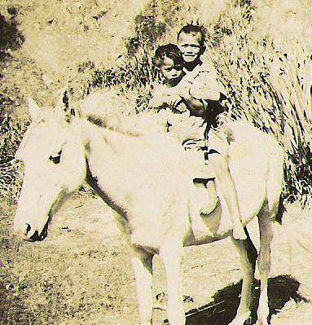

Slide 53
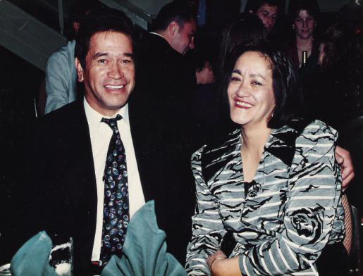

Slide 54
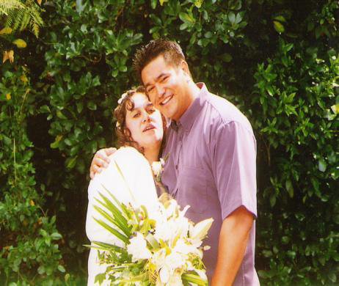

Slide 55
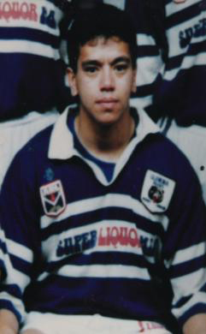

Slide 56
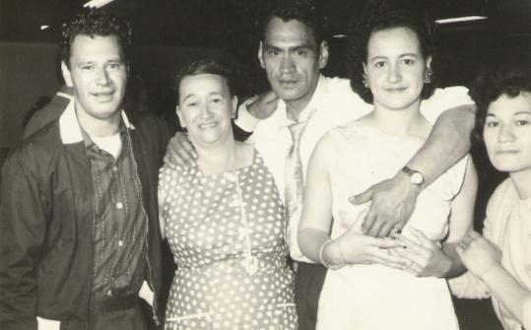

Slide 57
the family of
Alexander and sarah mcpherson

Slide 58


Slide 59


Slide 60


Slide 61


Slide 62


Slide 63



Slide 64



Slide 65



Slide 66


Slide 67


Slide 68


Slide 69


Slide 70


Slide 71



Slide 72


Slide 73



Carlin Andrews
(The late grandson of Ethel and Bob and twin of Jarni)

Slide 74





Slide 75


Slide 76



Slide 77


Slide 78


Slide 79


Slide 80



Slide 81



Slide 82





Slide 83




Slide 84



Slide 85


Slide 86


Slide 87


Slide 88


Slide 89


Slide 90


Slide 91





Slide 92





Slide 93


Slide 94


Slide 95


Slide 96


Slide 97


Slide 98
the family of
Taupiri ‘bela’ (kath) and ian mcnee

Slide 100


